Slide 1
Pathway to Joint Replacement
Examination, Diagnosis and Referral for Modern Hip & Knee Arthroplasty
Mr Matthew Lee, Consultant Orthopaedic Surgeon
Mr Robert Kenyon, Consultant Orthopaedic Surgeon

Slide 2
Learning objectives
A practical pathway for General Practitioners in Ireland
1
2
3
4
5
Recognise
Examine
Manage
Refer
Explain
Typical OA and red flags
Hip, knee and adjacent sources
Evidence-based first-line care
The right patient at the right time
Modern surgery and recovery
Goal: efficient access to tailored, high-quality hip and knee care
Notes:
[Sources]
- https://www.nice.org.uk/guidance/ng226/chapter/Recommendations
- https://healthservice.hse.ie/documents/7505/National_Osteoarthritis_OA_Hip_and_Knee_Pathway.pdf
[/Sources]

Slide 3
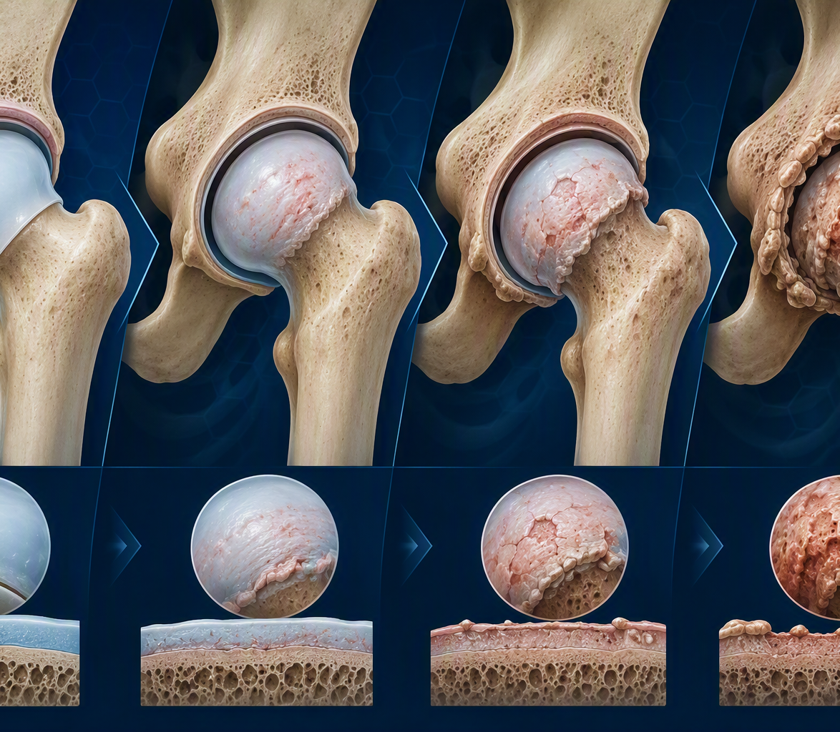
Osteoarthritis is usually a clinical diagnosis
Age ≥45, activity-related pain, and no morning stiffness or stiffness ≤30 minutes
Symptoms
Signs
Loading pain, short-lived stiffness, loss of function
Restricted motion, crepitus, bony enlargement, gait change
1
Impact
Context
Walking, stairs, sleep, work, caring and recreation
Comorbidities, goals, expectations and readiness
Goal: efficient access to tailored, high-quality hip and knee care
High Index of Suspicion
High Index of Suspicion
Notes:
[Sources]
- https://www.nice.org.uk/guidance/ng226/chapter/Recommendations
- Visual on this slide was generated with Microsoft Copilot.
[/Sources]

Slide 4
Hip OA: history and diagnostic clues
Hip pain may present in the groin, buttock, thigh or knee
Ask
Red flags / alternatives
Pain location and radiation
Shoes, socks, car transfers and
low chairs
Walking tolerance, night pain
and analgesia
Prior trauma, childhood disease or steroid exposure
Back, neurological and systemic symptoms
Acute inability to weight-bear; hot joint or fever; fracture concern; rapidly progressive symptoms; malignancy features; significant neurology.
Useful pattern
Activity-related groin pain + reduced internal rotation + functional limitation. Assess spine and knee when symptoms do not localise.
4
Notes:
[Sources]
- https://www.nice.org.uk/guidance/ng226/chapter/Recommendations
[/Sources]

Slide 5
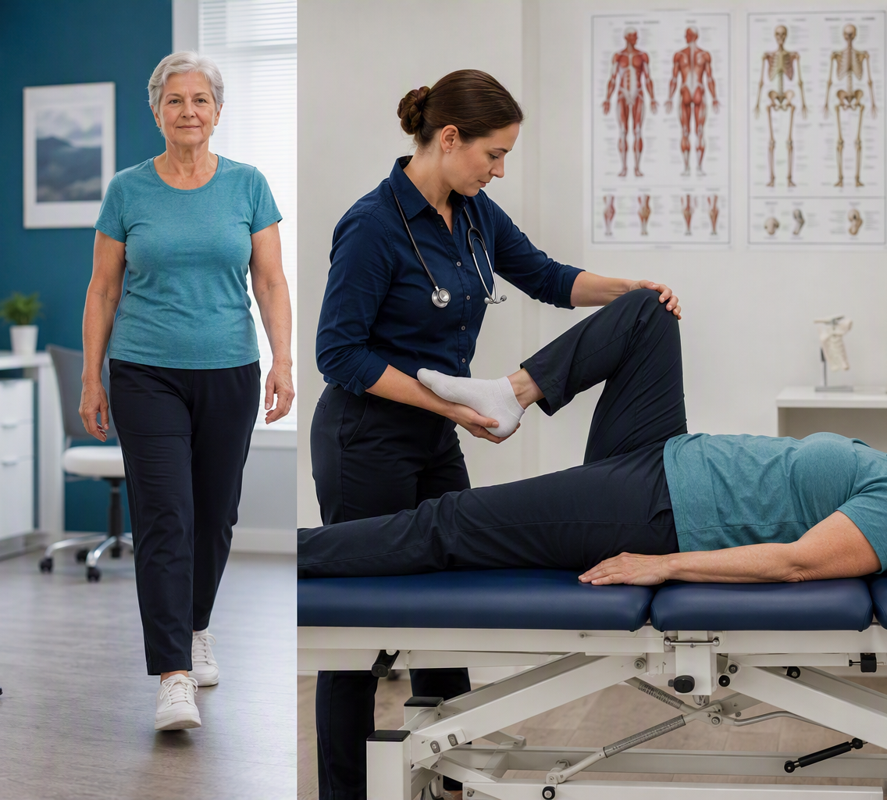
Hip examination: six high-yield observations
Compare sides and reproduce the patient’s familiar pain
Gait
Leg length
Antalgic / Trendelenburg
True and apparent
Range
Strength
Internal rotation often first lost
Abductors and flexors
Provocation
Screen
FADIR / FABER in context
Lumbar spine, SI joint, knee
5
Notes:
[Sources]
- https://www.nice.org.uk/guidance/ng226/chapter/Recommendations
- Visual on this slide was generated with Microsoft Copilot.
[/Sources]

Slide 6
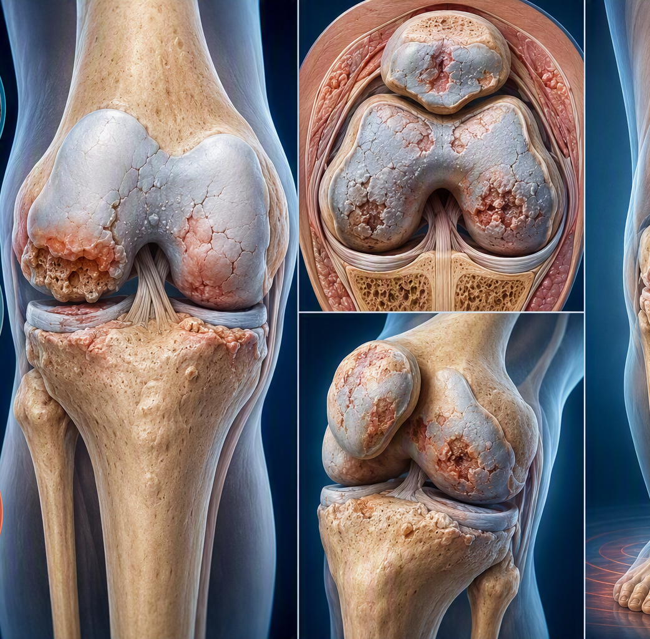
Knee OA: localise the disease
Symptoms and examination should identify compartment pattern and stability
History
Pattern
Mechanical pain, swelling, stiffness, walking, stairs, kneeling, locking versus giving way
Medial or lateral joint line, patellofemoral symptoms, single or multicompartment disease
Function
Modifiers
Distance, aids, chair rise, work, sport and sleep
Prior surgery or trauma, inflammatory features, hip or spine referral
Red flags: hot swollen joint, systemic illness, acute locked knee, fracture risk or neurovascular compromise.
6
Notes:
[Sources]
- https://www.nice.org.uk/guidance/ng226/chapter/Recommendations
- Visual on this slide was generated with Microsoft Copilot.
[/Sources]

Slide 7
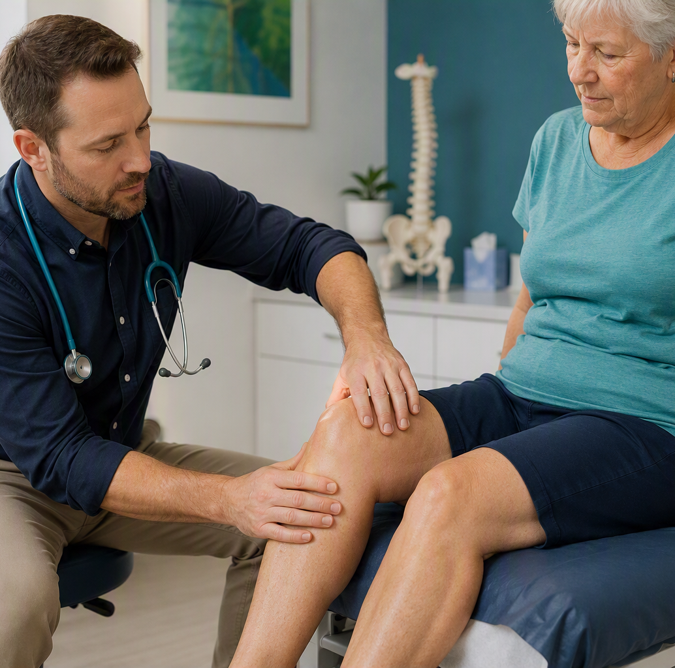
Knee examination: alignment, compartments and stability
Examine standing, walking and supine
Look
Varus/valgus, scars, quadriceps bulk, effusion
Move
ROM, fixed flexion and extensor lag
Feel
Joint lines, patellofemoral crepitus, temperature
Stress
Collateral stability and AP stability
Function
Gait, sit-to-stand and stairs if safe
Screen
Hip rotation, lumbar neurology and vascular status
7
Notes:
[Sources]
- https://www.nice.org.uk/guidance/ng226/chapter/Recommendations
- Visual on this slide was generated with Microsoft Copilot.
[/Sources]

Slide 8
Imaging: answer the clinical question
Weight-bearing radiographs are the workhorse when surgery is being considered
Hip
Knee
MRI
AP pelvis + lateral hip
Assess joint-space loss, osteophytes, cysts, morphology and the opposite hip.
Standing AP + lateral + skyline
Add alignment or flexion views when the surgical question requires them.
Meniscal pathology
Ligamentous injury
Chondral loss
Bone oedema “subchondral fractures”
Treat the patient, not the X-ray: correlate symptoms, disability, goals and examination
8
Notes:
[[Sources]
- https://hipkneeinfo.org/
- Visual on this slide was generated with Microsoft Copilot.
[/Sources]

Slide 9
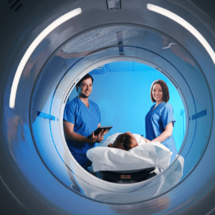
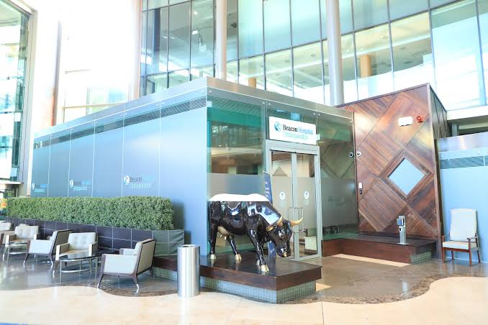
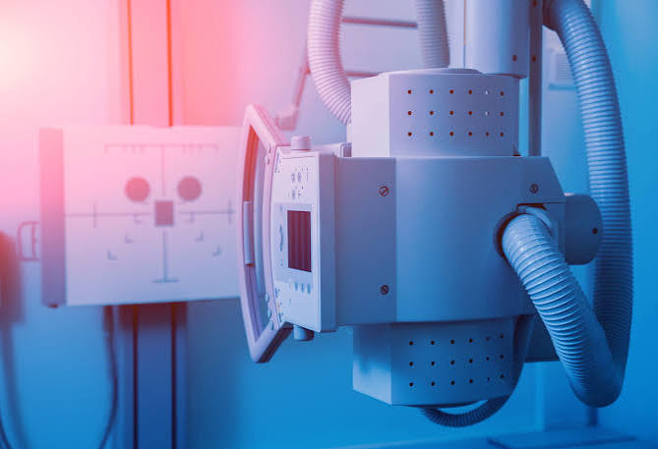
Imaging at Beacon Hospital
9
Notes:
[Sources]
- https://www.nice.org.uk/guidance/ng226/chapter/Recommendations
- https://www.beaconhospital.ie/department-service/orthopaedics/rapid-access-oa-hip-knee/
[/Sources]

Slide 10
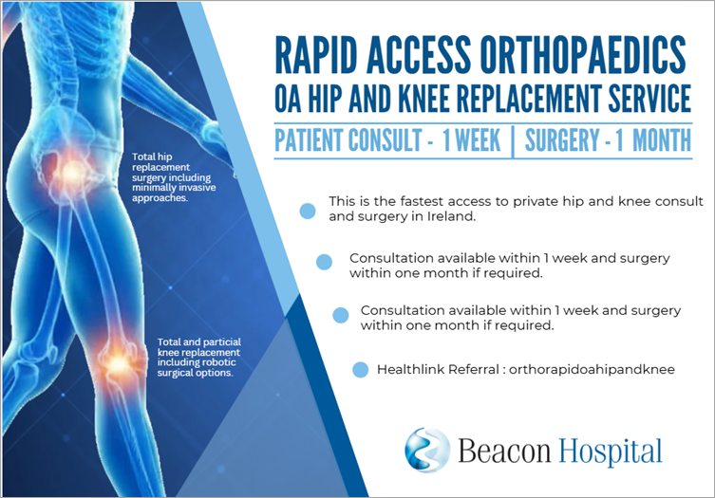
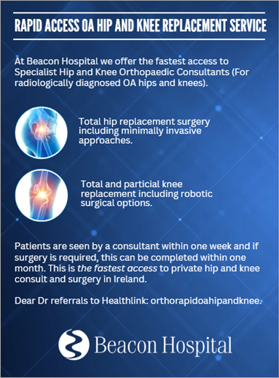
Rapid Access Hip and Knee Osteoarthritis
10
Notes:
[Sources]
- https://hipkneeinfo.org/
- Visual on this slide was generated with Microsoft Copilot.
[/Sources]

Slide 11
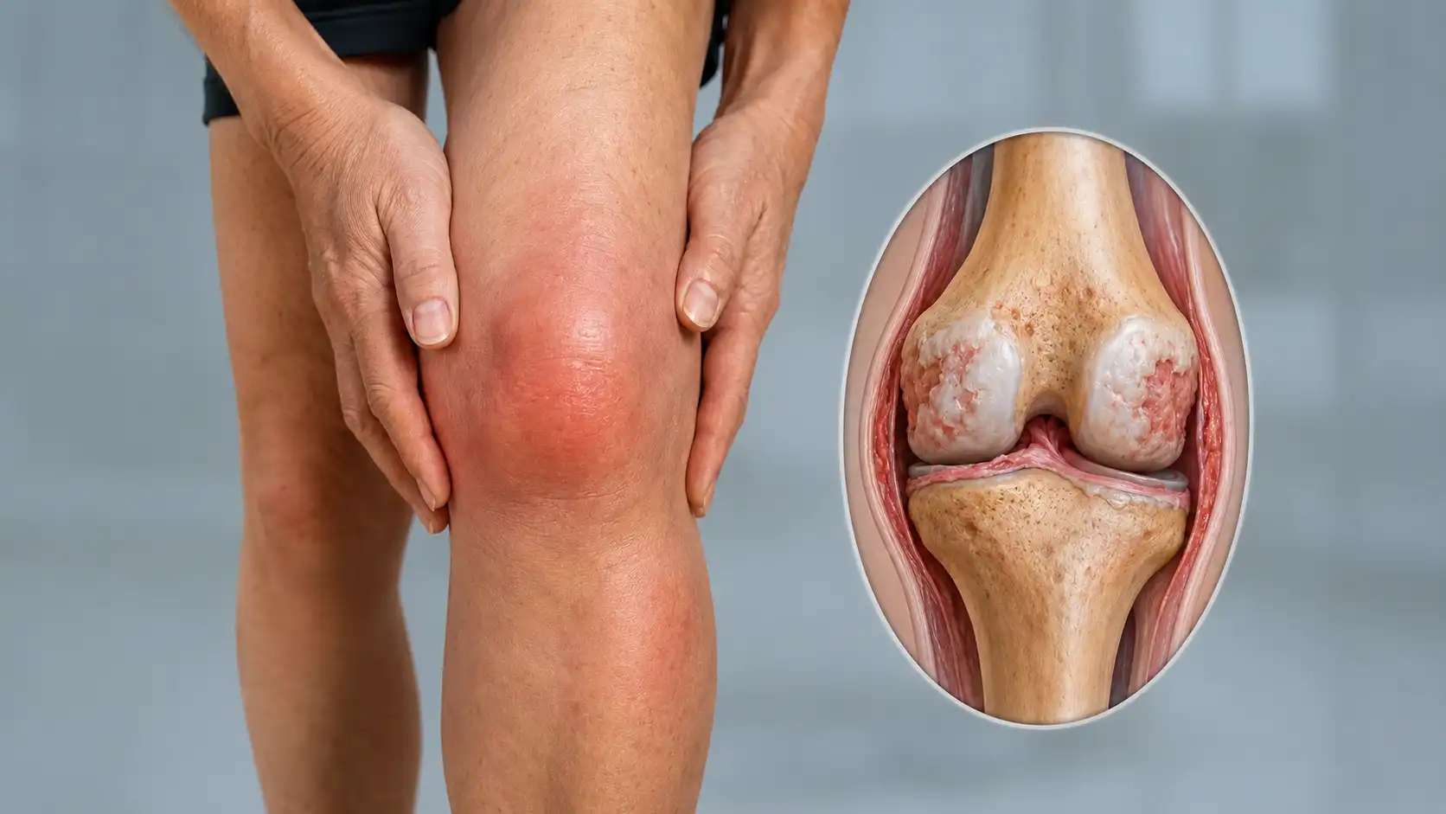
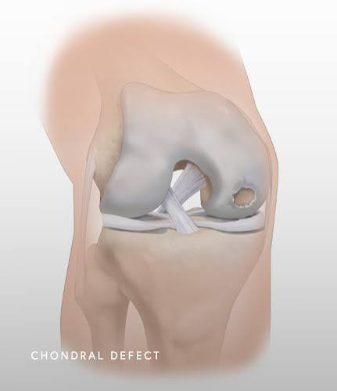
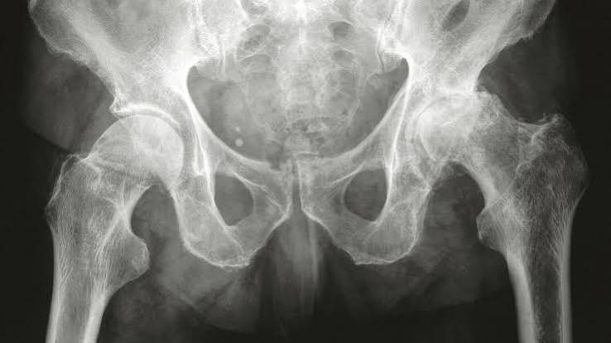
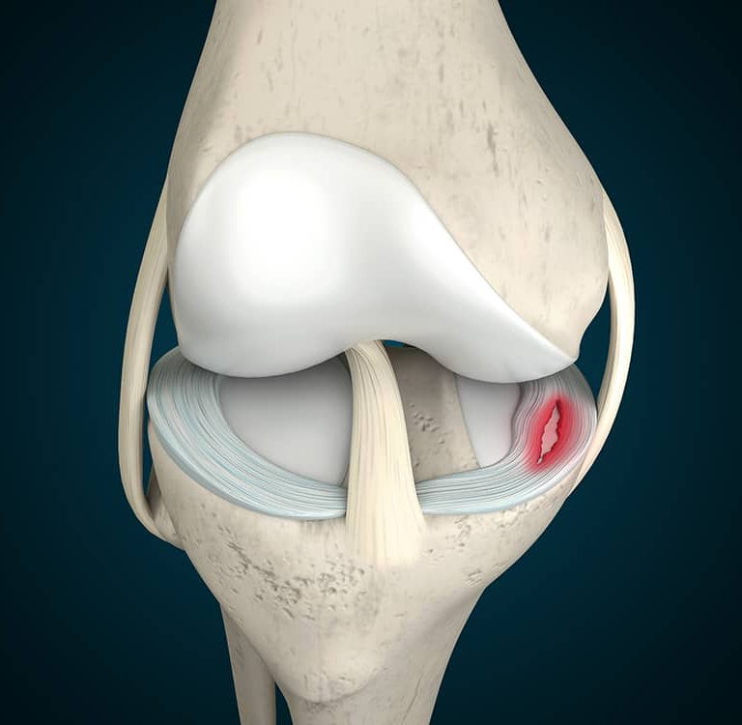
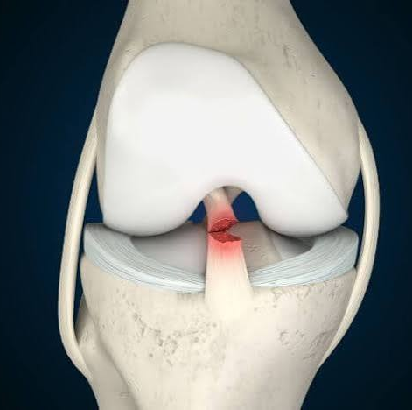
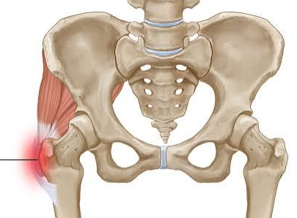
Rapid Access Hip and Knee Osteoarthritis
Range of Pathologies
11
Notes:
[Sources]
- https://hipkneeinfo.org/
- Visual on this slide was generated with Microsoft Copilot.
[/Sources]

Slide 12
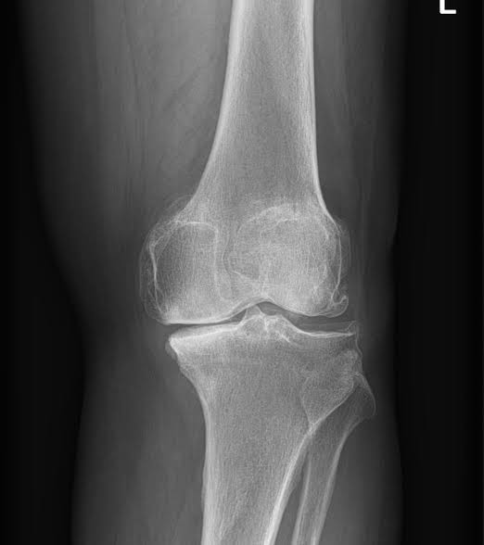
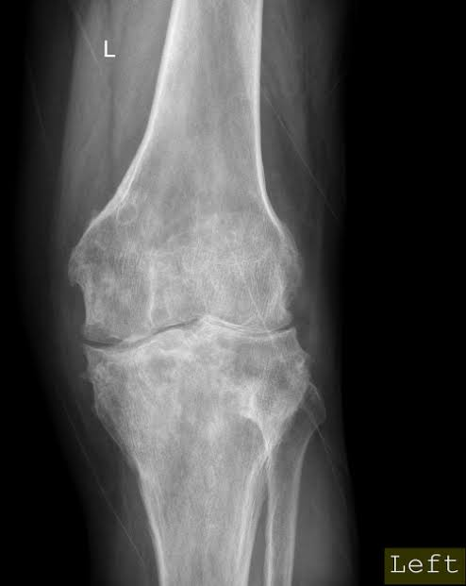
Rapid Access Hip and Knee Osteoarthritis
Service philosophy
Facilitate patients that need acute assessment
Early surgical management if required
Offer guidance and initiate programs of disease prevention / stabilisation
Joint preserving surgical options
Definitively manage end stage disease
Notes:
[Sources]
- https://hipkneeinfo.org/
- Visual on this slide was generated with Microsoft Copilot.
[/Sources]

Slide 13
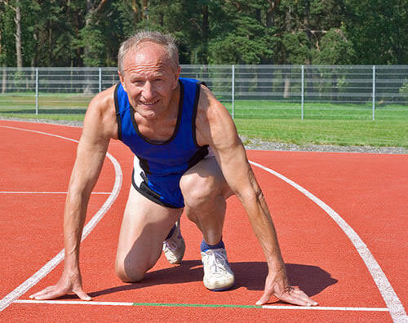
Rapid Access Hip and Knee Osteoarthritis
Service philosophy
Movement away from traditional model of simply awaiting end stage arthritis
Focus on early appropriate management at all stages of disease
Notes:
[Sources]
- https://hipkneeinfo.org/
- Visual on this slide was generated with Microsoft Copilot.
[/Sources]

Slide 14
When is orthopaedic referral appropriate?
Use a clinical threshold, not a radiographic threshold alone
Refer when
Do not use as automatic barriers
• Pain, stiffness or reduced function substantially affects quality of life
• Appropriate non-surgical care is ineffective, unsuitable or not tolerated
• Clinical findings and imaging support the surgical question
• The patient understands options and would consider surgery
• Severe deformity, rapid progression or diagnostic complexity merits earlier input
Age, sex, smoking, comorbidity or BMI should not automatically exclude referral.
Optimise in parallel
Address modifiable risk factors, but avoid indefinite delay. Shared optimisation supports informed decisions.
Notes:
[Sources]
- https://www.nice.org.uk/guidance/ng226/chapter/Recommendations
- https://healthservice.hse.ie/documents/7505/National_Osteoarthritis_OA_Hip_and_Knee_Pathway.pdf
[/Sources]

Slide 15
First-line management
Build capacity before considering surgery
EDUCATE
MOVE
WEIGHT
RELIEVE
REVIEW
Explain OA and set goals
Strength and aerobic exercise
Supportive weight management
Medication and aids when appropriate
Function, goals and response
Use selectively
Avoid low-value care
Document response
Walking aids, medication and injections can support activity and exercise.
Do not routinely offer arthroscopic lavage or debridement for OA.
Intervention, duration, adherence, benefit, adverse effects and goals.
15
Notes:
[Sources]
- https://www.nice.org.uk/guidance/ng226/chapter/Recommendations
- https://healthservice.hse.ie/documents/7505/National_Osteoarthritis_OA_Hip_and_Knee_Pathway.pdf
[/Sources]

Slide 16

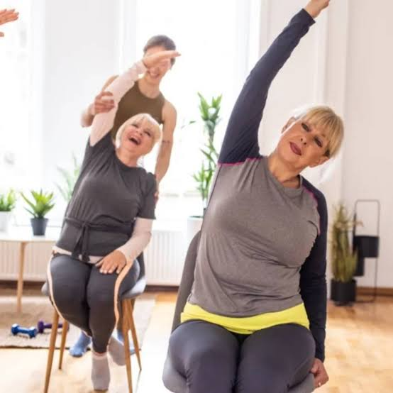
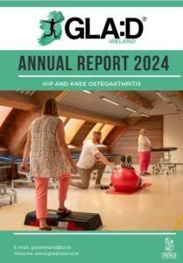

Lifestyle Modifications
Conservative measures
Good Life with osteoarthritis: Denmark
Notes:
[Sources]
- https://hipkneeinfo.org/
- Visual on this slide was generated with Microsoft Copilot.
[/Sources]

Slide 17
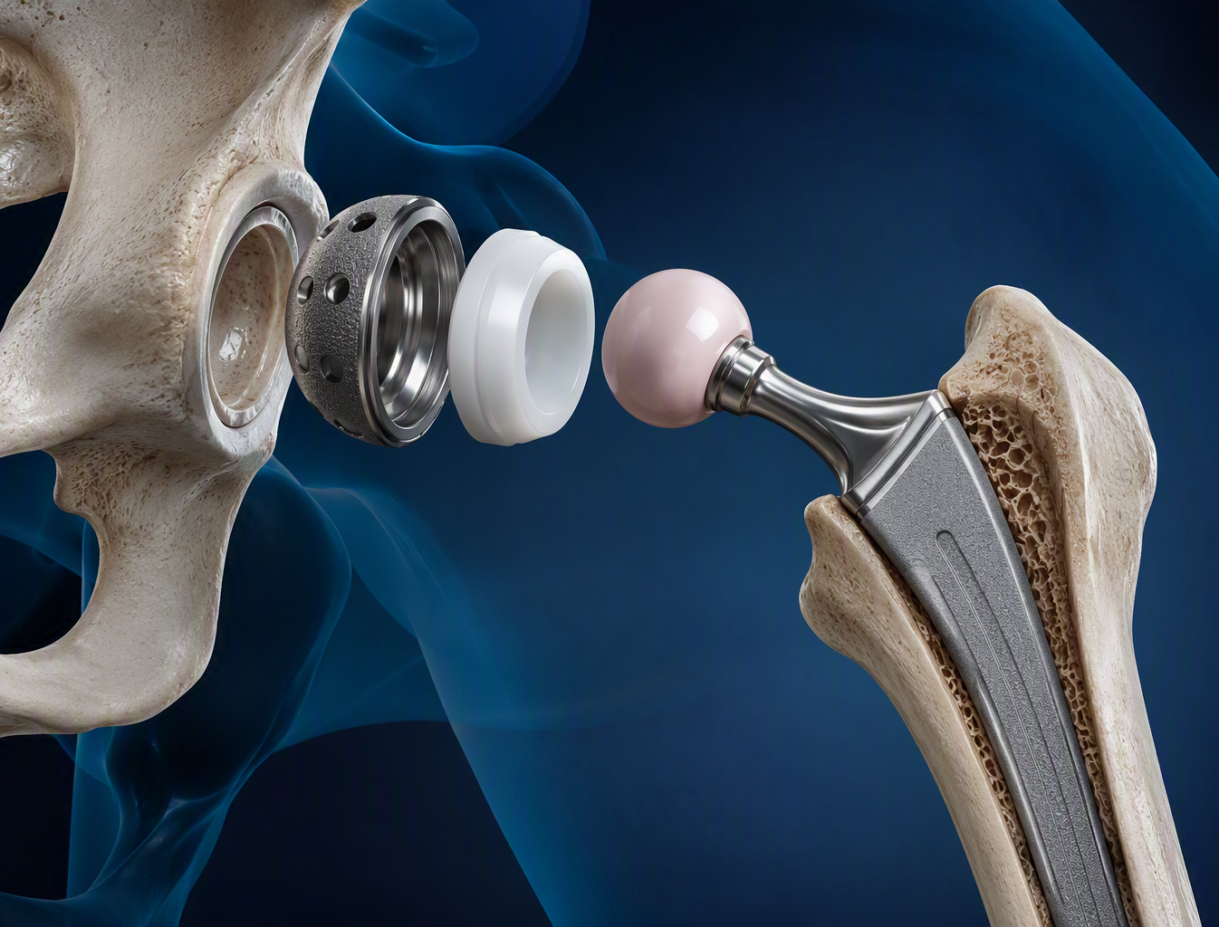
Modern total hip arthroplasty
Damaged ball and socket surfaces are replaced with durable components
Acetabular shell
Fixation to pelvic bone
Liner
Usually highly cross-linked polyethylene
Head
Often ceramic or metal
Femoral stem
Cemented or uncemented to suit bone and patient
17
Notes:
[Sources]
- https://hipkneeinfo.org/
- Visual on this slide was generated with Microsoft Copilot.
[/Sources]

Slide 18
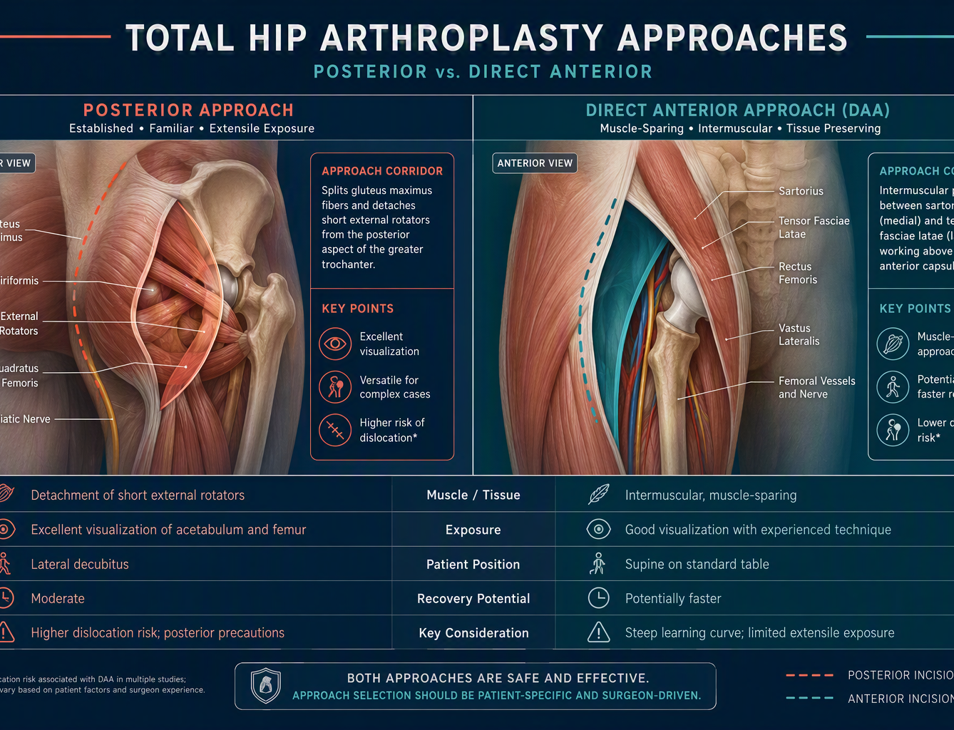
Anterior or posterior hip approach?
Both can deliver excellent outcomes when carefully selected and performed
Direct anterior
Intermuscular approach with supine positioning. May aid early recovery in selected patients; requires approach-specific expertise.
Posterior
Versatile exposure and extensile options. Soft-tissue repair and precautions are technique-specific.
Our principle
Expertise in both approaches. Select according to anatomy, complexity, previous surgery, body habitus and patient priorities.
18
Notes:
[Sources]
- https://hipkneeinfo.org/
- Visual on this slide was generated with Microsoft Copilot.
[/Sources]

Slide 19
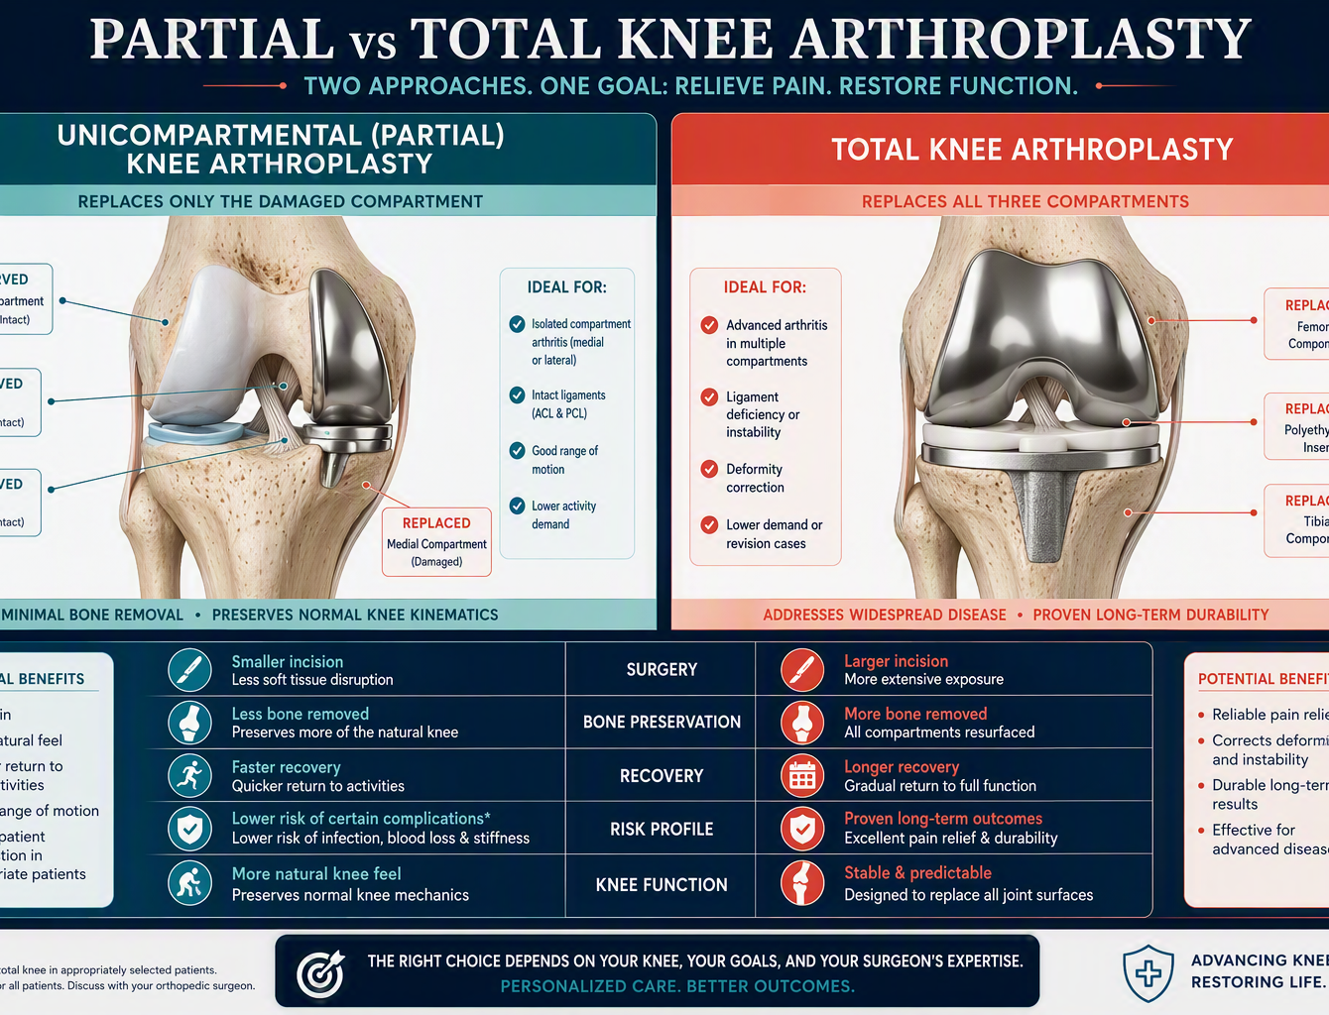
Partial or total knee arthroplasty?
Disease distribution, ligament competence, deformity and goals drive selection
Partial knee
For appropriately selected isolated compartment disease with preserved ligaments and correctable alignment. Preserves more native knee.
Total knee
For multicompartment disease, major deformity or instability. Resurfaces femur and tibia with tailored patellar management.
Tailored expertise
Preserve when appropriate; reconstruct comprehensively when required.
19
Notes:
[Sources]
- https://www.stryker.com/us/en/joint-replacement/systems/mako-total-knee.html
- Visual on this slide was generated with Microsoft Copilot.
[/Sources]

Slide 20
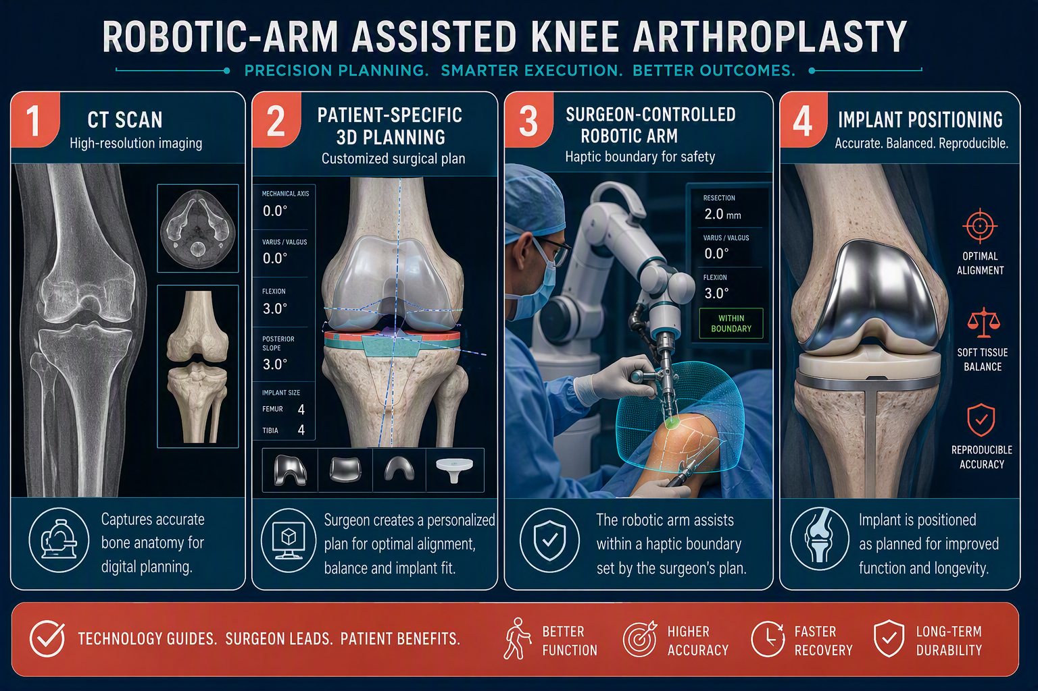
MAKO robotic-arm assisted knee arthroplasty
Technology assists; the surgeon plans, balances and performs the operation
SCAN
CT-based 3D model
PLAN
Patient-specific component position
BALANCE
Assess alignment and soft tissues
EXECUTE
Haptic boundary guides preparation
Available for appropriately selected partial and total knee replacement.
20
Notes:
[Sources]
- https://www.stryker.com/us/en/joint-replacement/systems/mako-total-knee.html
- Visual on this slide was generated with Microsoft Copilot.
[/Sources]

Slide 21
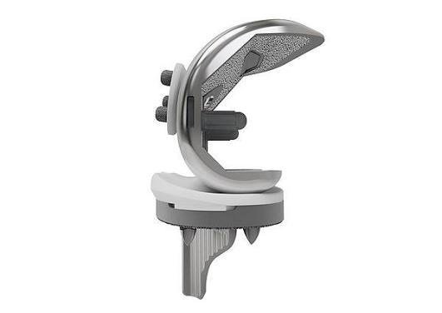
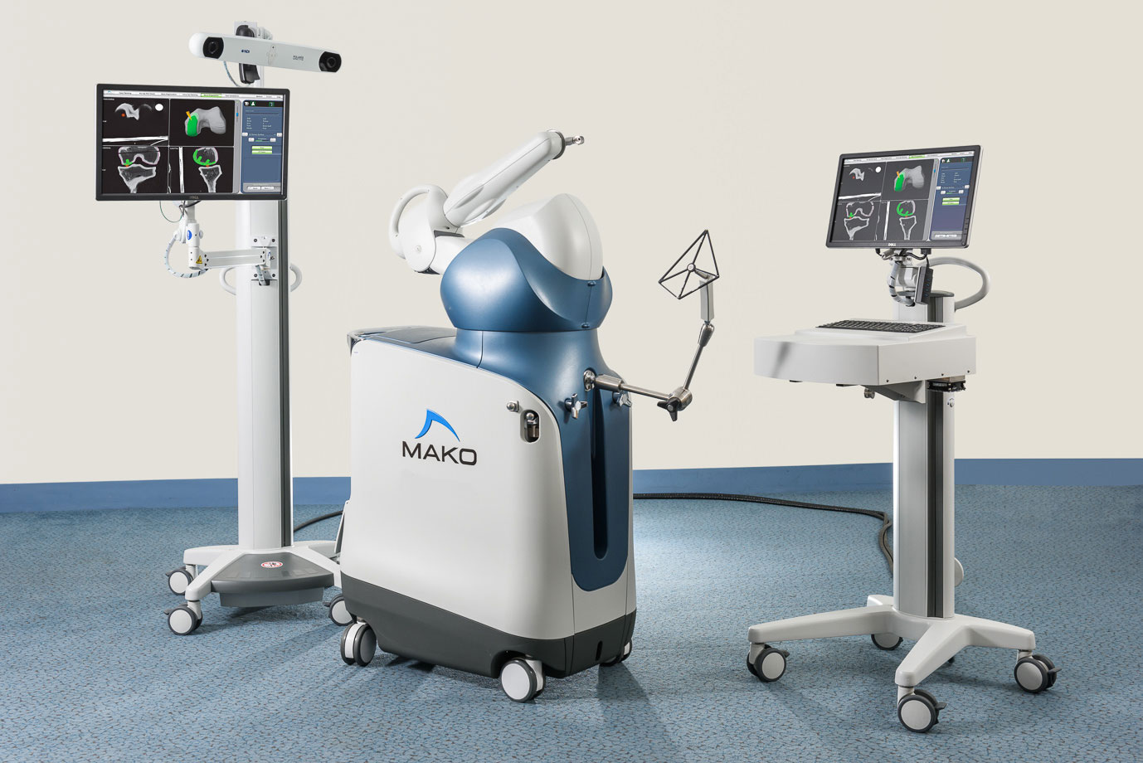
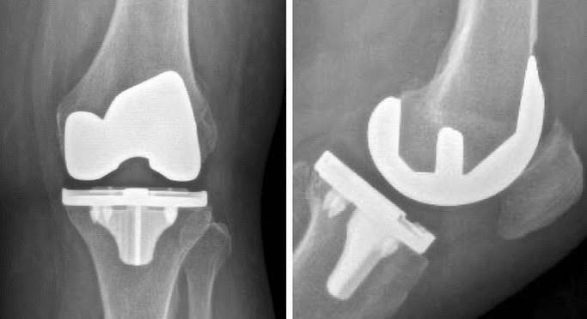
Robotic Assisted Arthroplasty
Mako Robotic System
21
Notes:
[Sources]
- https://hipkneeinfo.org/
- Visual on this slide was generated with Microsoft Copilot.
[/Sources]

Slide 22
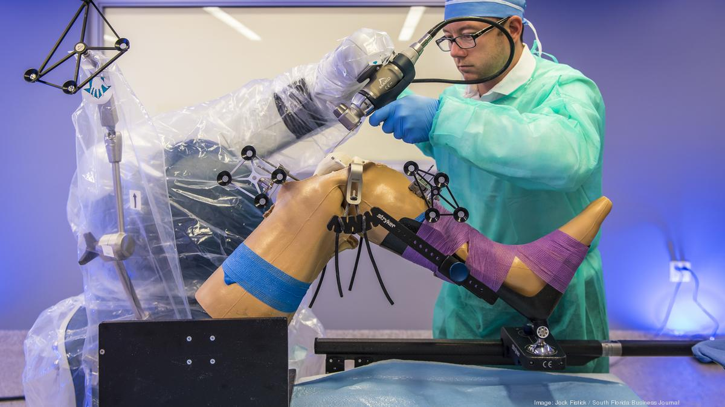
Robotic Assisted Arthroplasty
Mako Robotic System
22
Notes:
[Sources]
- https://hipkneeinfo.org/
- Visual on this slide was generated with Microsoft Copilot.
[/Sources]

Slide 23
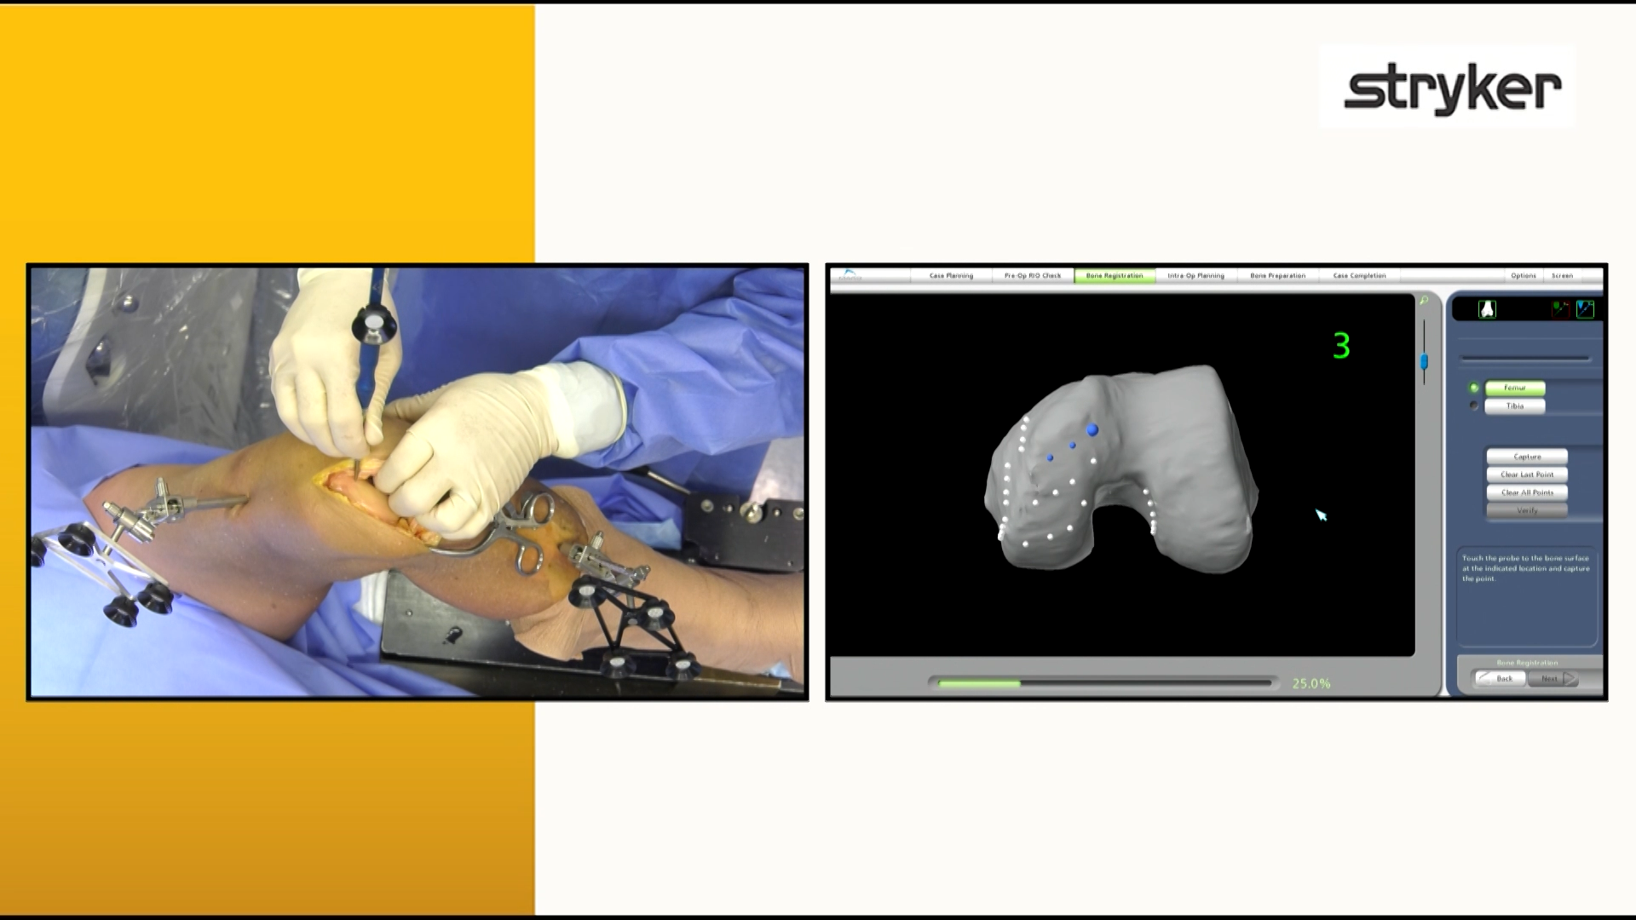
Robotic Assisted Arthroplasty
Mako Robotic System
23
Notes:
[Sources]
- https://hipkneeinfo.org/
- Visual on this slide was generated with Microsoft Copilot.
[/Sources]

Slide 24
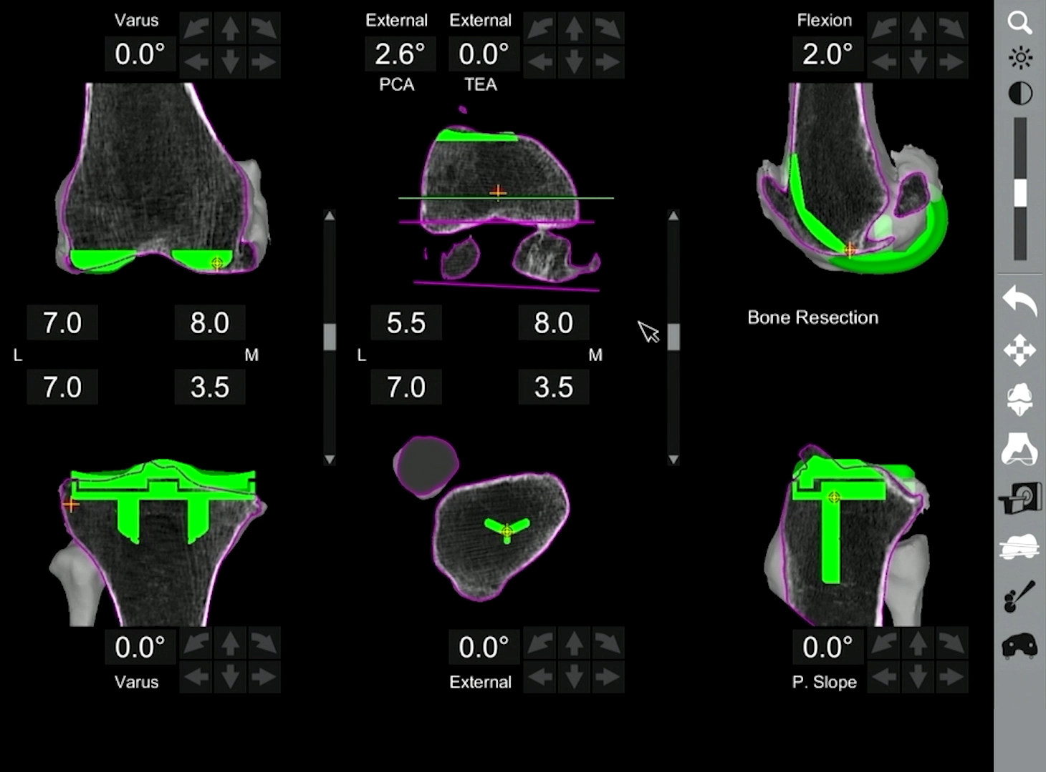
Robotic Assisted Arthroplasty
Mako Robotic System
24
Notes:
[Sources]
- https://hipkneeinfo.org/
- Visual on this slide was generated with Microsoft Copilot.
[/Sources]

Slide 25
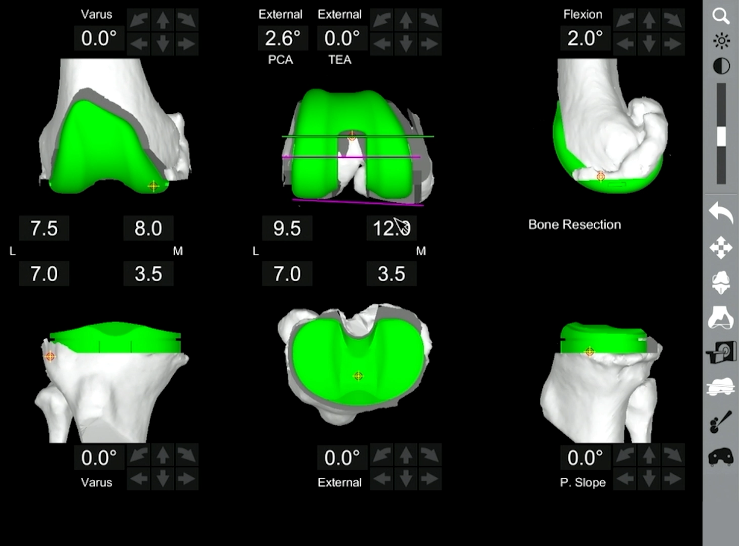
Robotic Assisted Arthroplasty
Mako Robotic System
25
Notes:
[Sources]
- https://hipkneeinfo.org/
- Visual on this slide was generated with Microsoft Copilot.
[/Sources]

Slide 26
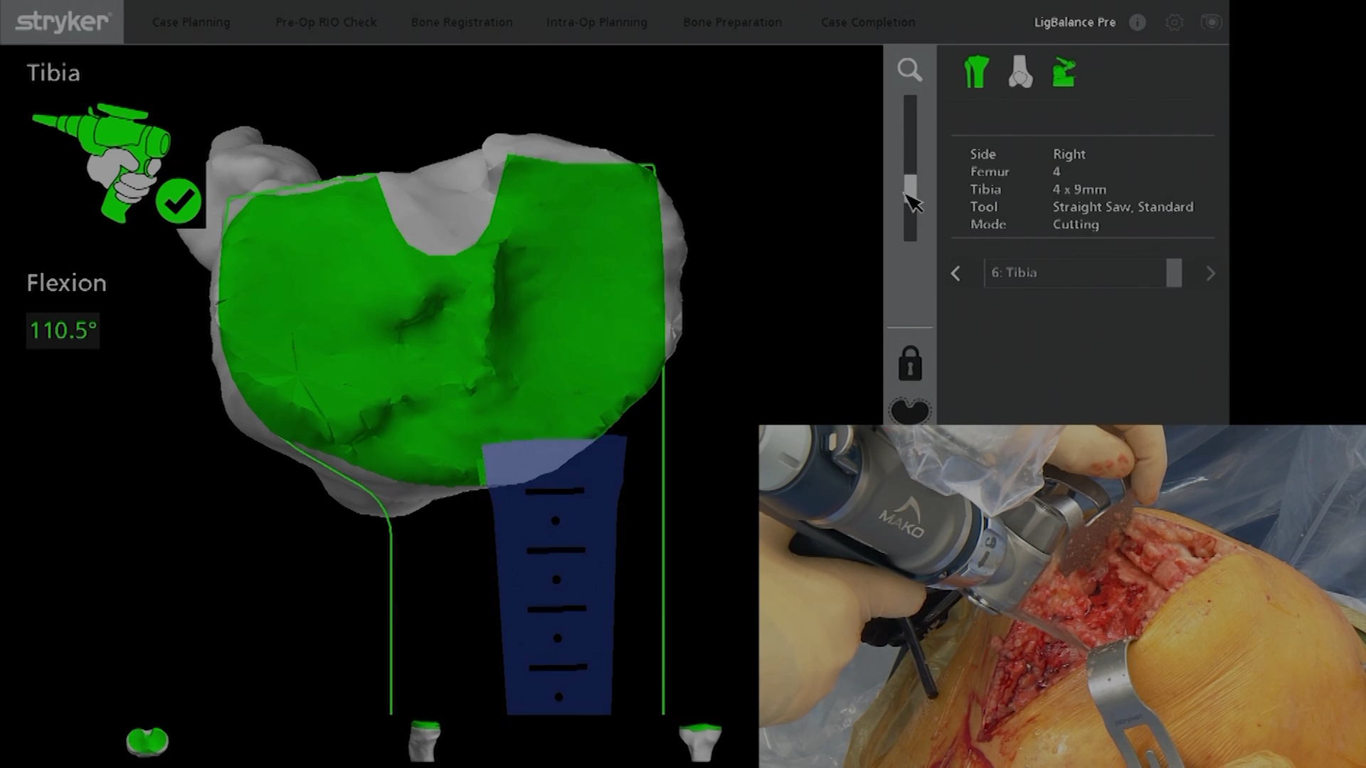
Robotic Assisted Arthroplasty
Mako Robotic System
26
Notes:
[Sources]
- https://hipkneeinfo.org/
- Visual on this slide was generated with Microsoft Copilot.
[/Sources]

Slide 27
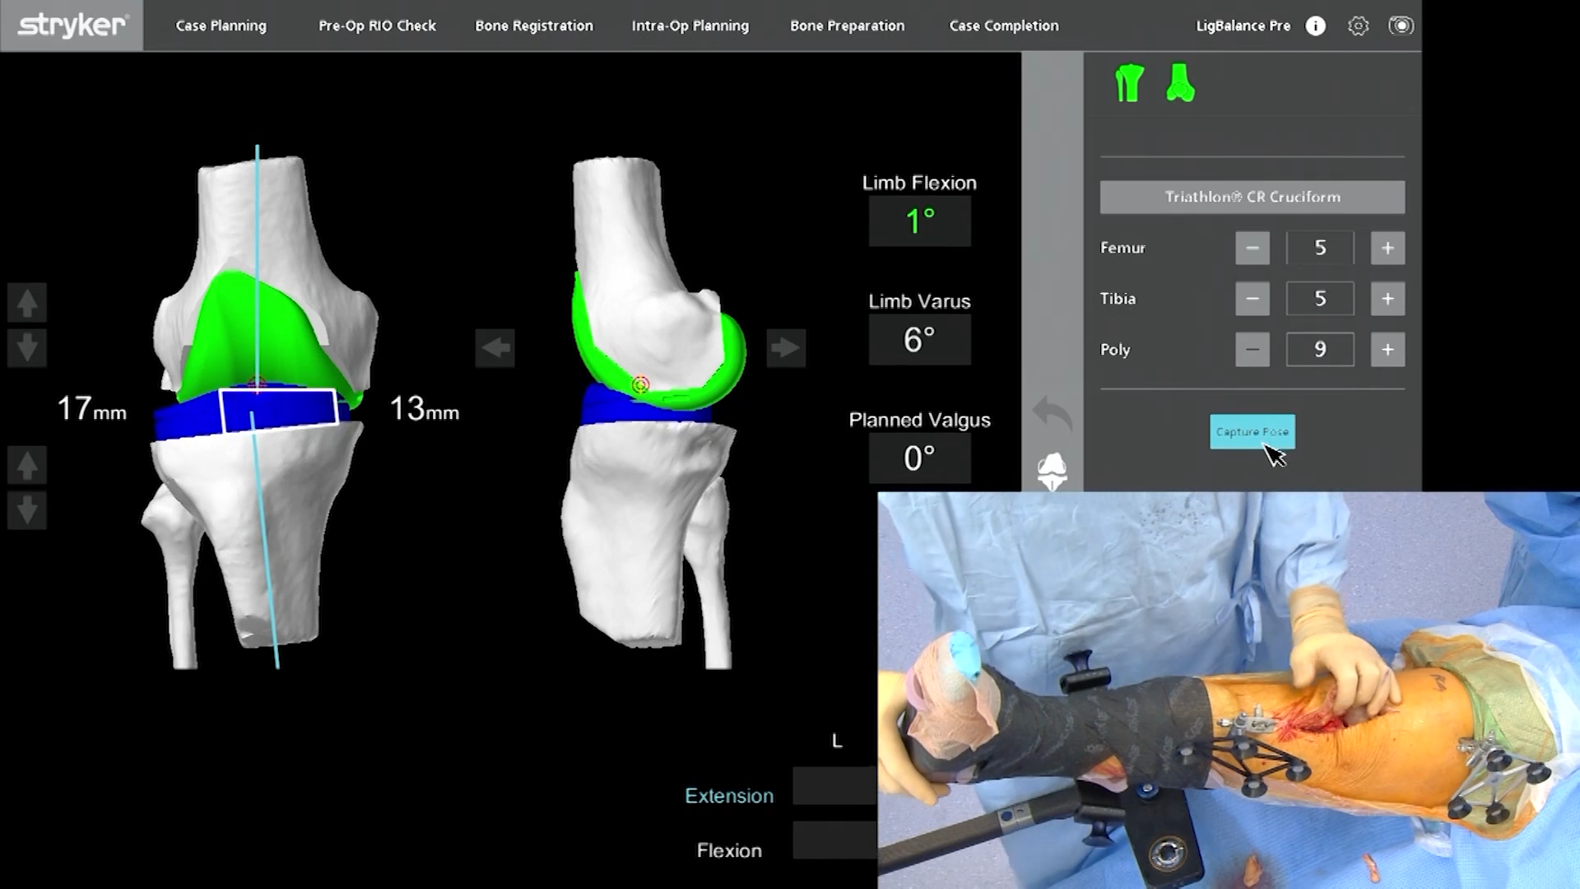
Robotic Assisted Arthroplasty
Mako Robotic System
27
Notes:
[Sources]
- https://hipkneeinfo.org/
- Visual on this slide was generated with Microsoft Copilot.
[/Sources]

Slide 28
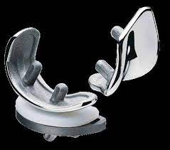
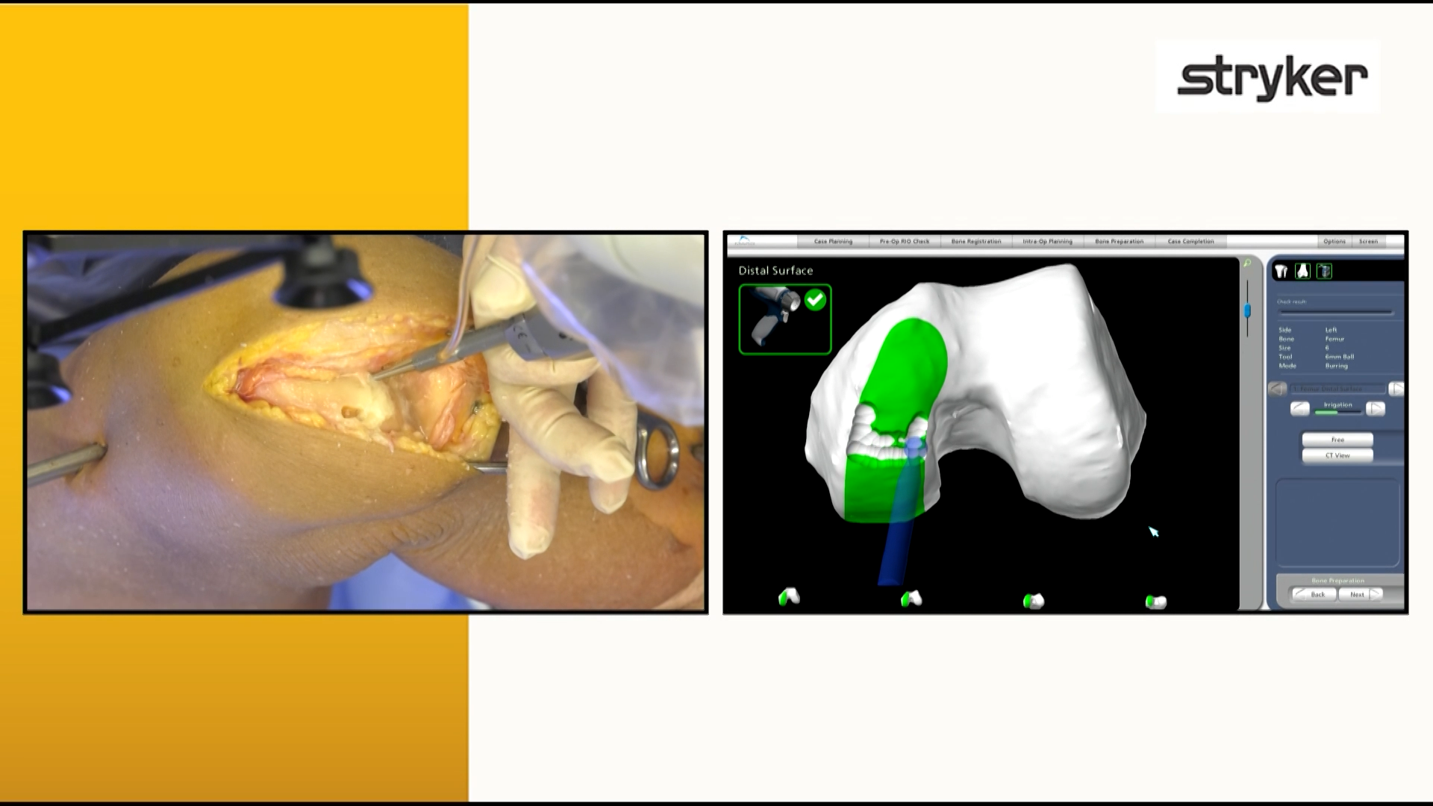
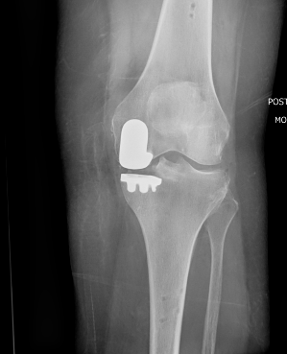
Robotic Assisted Arthroplasty
Partial Knee Replacement
28
Notes:
[Sources]
- https://hipkneeinfo.org/
- Visual on this slide was generated with Microsoft Copilot.
[/Sources]

Slide 29
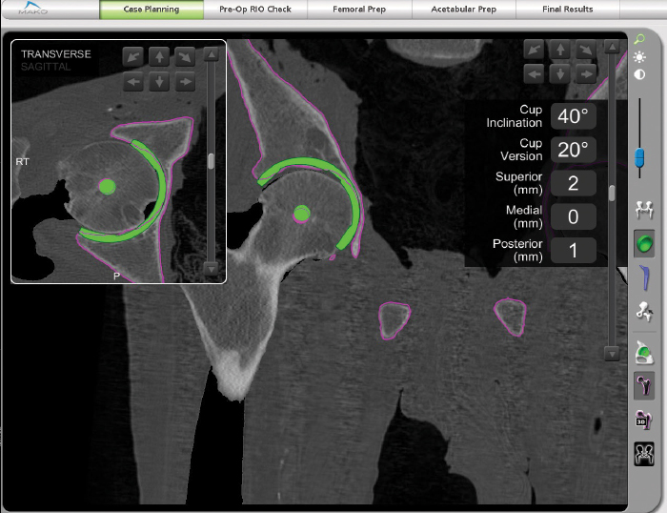
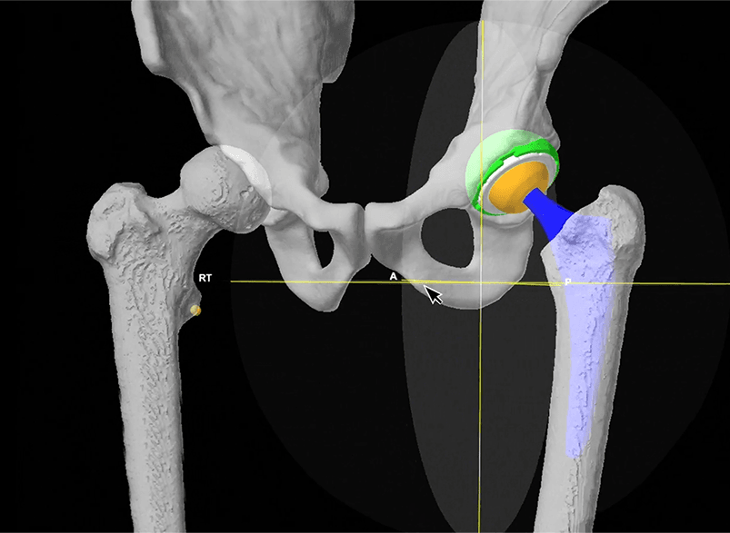
Robotic Assisted Arthroplasty
Hip Replacement
29
Notes:
[Sources]
- https://hipkneeinfo.org/
- Visual on this slide was generated with Microsoft Copilot.
[/Sources]

Slide 30
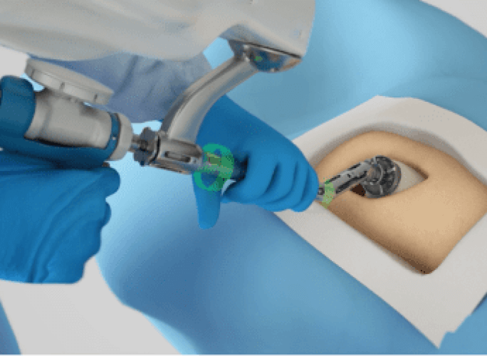
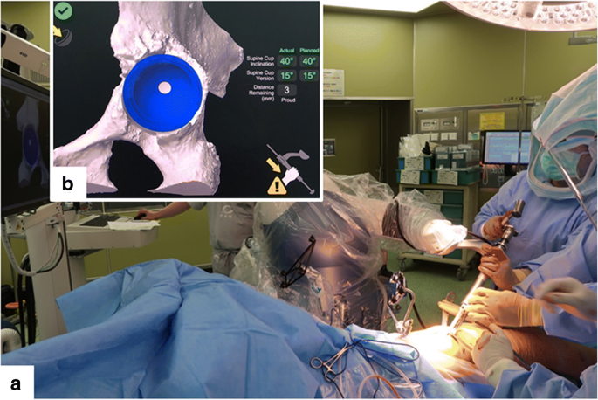
Robotic Assisted Arthroplasty
Hip Replacement
30
Notes:
[Sources]
- https://hipkneeinfo.org/
- Visual on this slide was generated with Microsoft Copilot.
[/Sources]

Slide 31
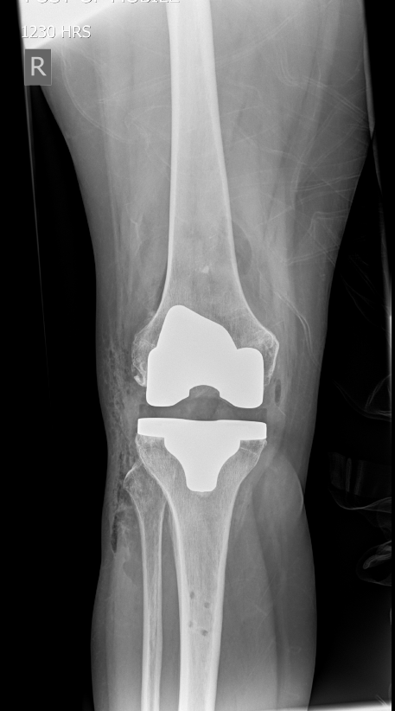
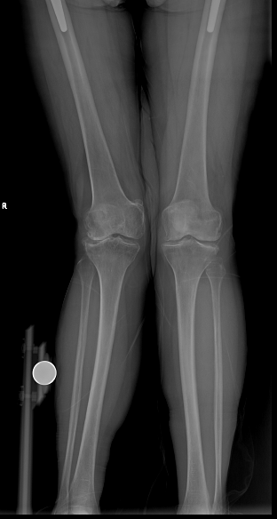
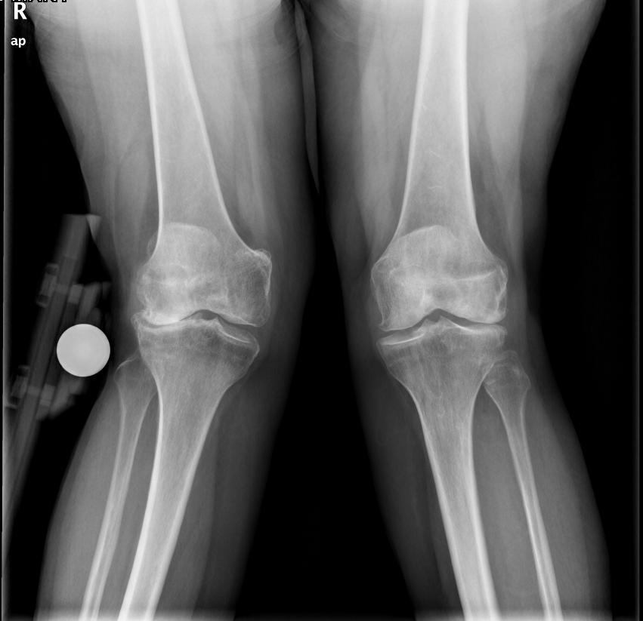
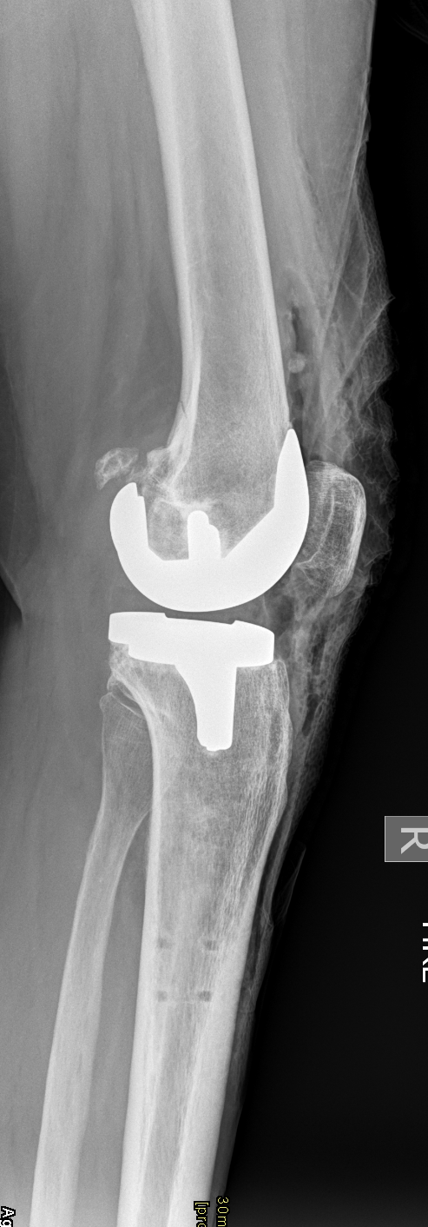
Robotic Assisted Arthroplasty
Complex Arthroplasty Cases
31
Notes:
[Sources]
- https://hipkneeinfo.org/
- Visual on this slide was generated with Microsoft Copilot.
[/Sources]

Slide 32
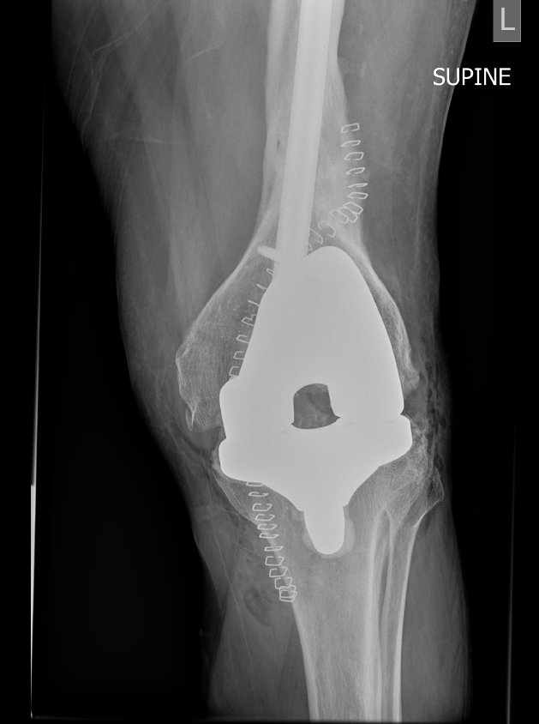
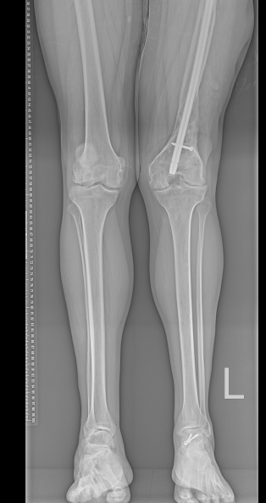
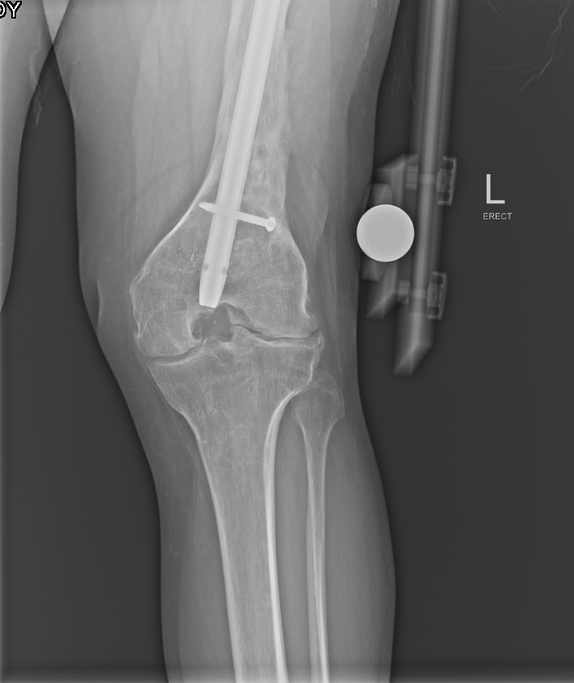
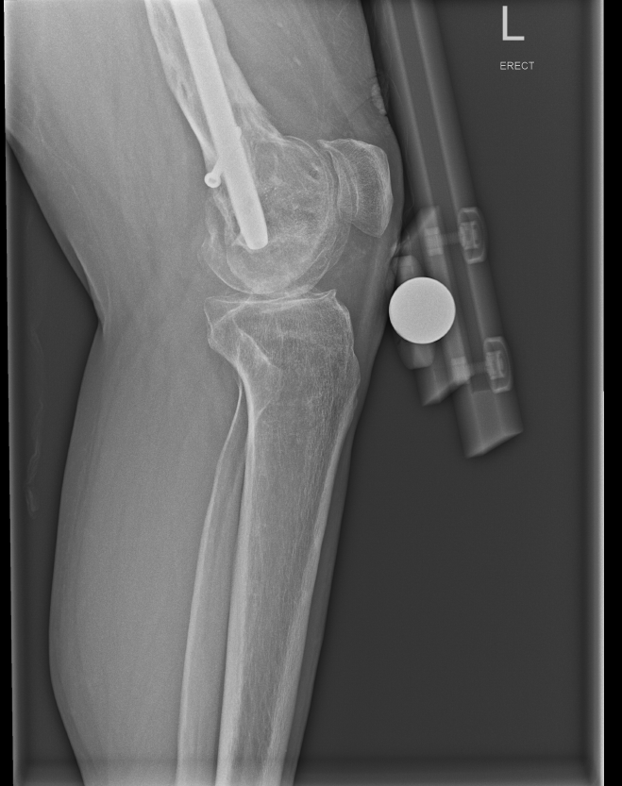
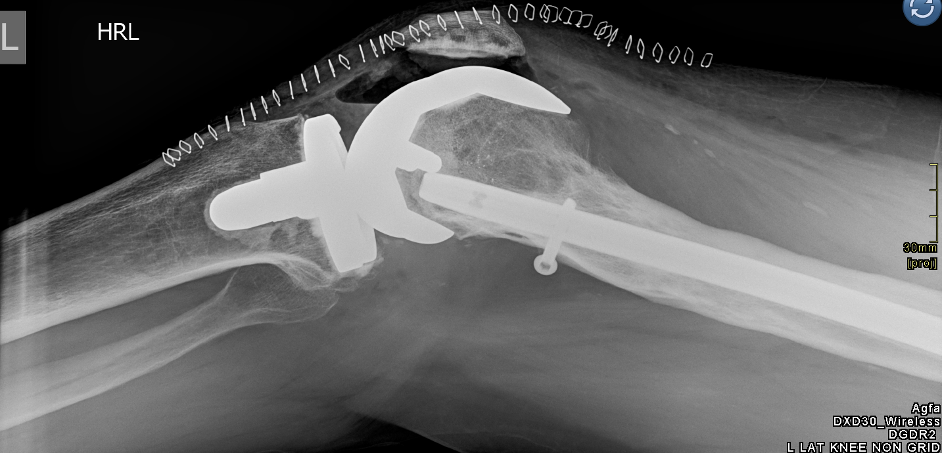
Robotic Assisted Arthroplasty
Complex Arthroplasty Cases
32
Notes:
[Sources]
- https://hipkneeinfo.org/
- Visual on this slide was generated with Microsoft Copilot.
[/Sources]

Slide 33
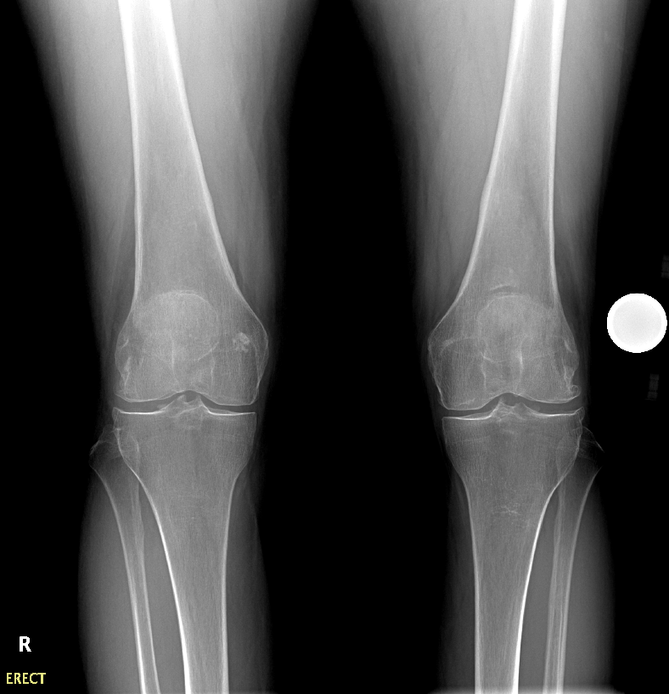



Robotic Assisted Arthroplasty
Complex Arthroplasty Cases
33
Notes:
[Sources]
- https://hipkneeinfo.org/
- Visual on this slide was generated with Microsoft Copilot.
[/Sources]

Slide 34
Pre-operative optimisation
Improve resilience and reduce avoidable risk
Medical
Metabolic
Behavioural
Cardiorespiratory review, anaemia, renal function and medication plan
Diabetes control, nutrition and weight support
Smoking cessation, alcohol risk and conditioning
Infection
Home
Expectation
Skin, dental or urinary issues when clinically indicated
Support, stairs, equipment, discharge and transport
Pain plan, rehabilitation commitment and realistic goals
Optimise modifiable risk while avoiding blanket exclusion from referral
Optimise modifiable risk while avoiding blanket exclusion from referral
Optimise modifiable risk while avoiding blanket exclusion from referral
34
Notes:
[Sources]
- https://www.nice.org.uk/guidance/ng226/chapter/Recommendations
- https://hipkneeinfo.org/
[/Sources]

Slide 35

Recovery and rehabilitation
Early mobilisation, progressive strengthening and milestone-based recovery
Day 0–2
Mobilise safely; control pain and nausea; meet discharge criteria
Weeks 1–3
Wound and swelling care; walking pattern; daily home exercise
Weeks 4–6
Strength and endurance; reduce aids when safe; graded return to work/driving
Weeks 7–12+
Confidence and capacity; return to valued activity; maintain strength
35
Notes:
[Sources]
- https://hipkneeinfo.org/
- Visual on this slide was generated with Microsoft Copilot.
[/Sources]

Slide 36
Thank you
The right patient. The right operation. The right time
Rapid Access OA Hip & Knee Service
Healthlink: Orthopaedics-Rapid Access Hip & Knee
Address referral to “Dear Consultant”

