Slide 1
Breast Health and Menopause: Safe HRT Prescribing in
The General Population
High-Risk Groups
Post Breast Cancer
Dr Reem Salman & Mr Terry Boyle
19/09/2026

Slide 2
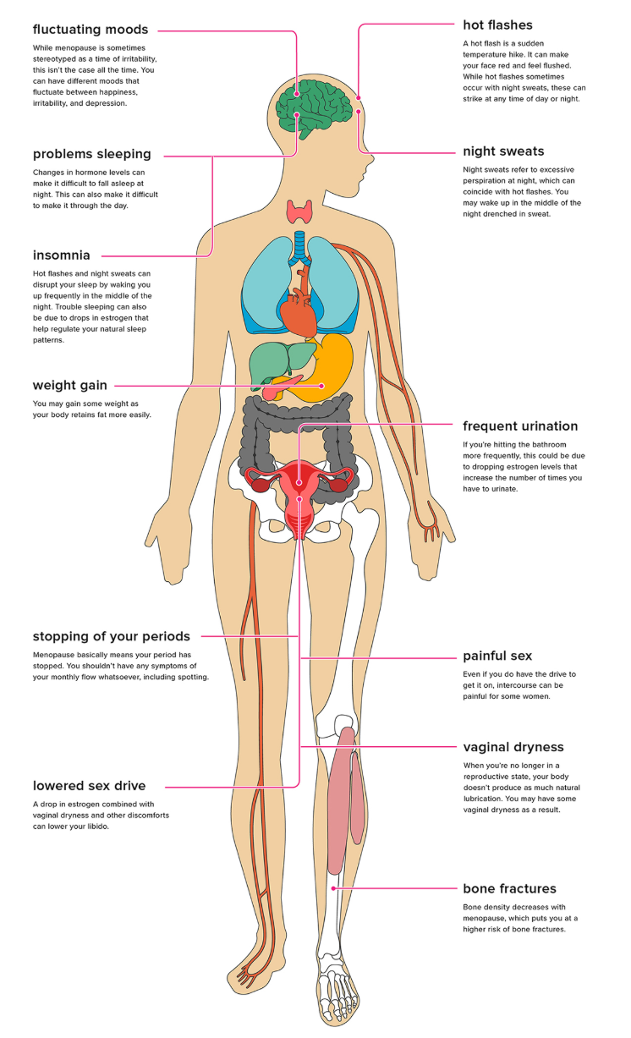
Menopause Affects the Whole Body
Menopause —
Induced menopause —
Premature ovarian insufficiency (POI) —
Menopausal symptoms significantly affect
  - Quality of life
  - Sleep
  - Mood
  - Cognition
  - Bone and Cardiovascular health
Notes:
Breast Cancer is the most common cancer among women 1:8
There is Modifiable or non modifiable risk for developing
Menopause — permanent cessation of menstruation for at least 12 consecutive months due to loss of ovarian follicular activity; the mean age in Ireland is 51.
Induced menopause — may be permanent after bilateral salpingo-oophorectomy or iatrogenic following chemotherapy, radiotherapy or GnRH analogue treatment.
Premature ovarian insufficiency (POI) — menopause before the age of 40.
Vasomotor — hot flushes, night sweats and sleep disturbance (~75%).
Psychological — low mood, anxiety, mood swings, depression, irritability and lethargy.
Musculoskeletal — general aches, pain and joint stiffness (~57%).
Genitourinary — vaginal dryness, dyspareunia, urgency, frequency and UTIs (~70%).
Sexual — altered sexual function and low libido.
Other — brain fog, dry skin and eyes, and hair loss

Slide 3

Breast Cancer Risk is Multifactorial
NON-MODIFIABLE
• Genetics and age
• First-degree family history
• BRCA1/BRCA2: breast and ovarian cancers
• Lynch syndrome
MODIFIABLE
• Lifestyle, diet and environmental factors
• Alcohol and obesity, both associated with higher sex hormone levels
HRT represents only one component of an individual’s overall risk profile
Notes:
Breast cancer risk is multifactorial
Age remains the strongest risk factor
Obesity, alcohol consumption,
mammographic density
genetic predisposition are major contributors
HRT represents only one component of an individual’s overall risk profile
Not all HRT carries the same risk
Oestrogen-only HRT has little or no increase in breast cancer risk
Combined oestrogen-progestogen HRT is associated with a small increase in breast cancer diagnoses that rises with duration of use
Contemporary prescribing increasingly favours transdermal oestradiol and micronised progesterone where appropriate.
Vaginal oestrogen is not associated with increased breast cancer risk
Absolute risk matters more than relative risk
Most women substantially overestimate the breast cancer risk associated with HRT
Risk discussions should focus on absolute excess risk rather than relative risk percentages
Lifestyle factors often contribute as much or more risk than HRT itself

Slide 4

Breast Cancer Treatments Cause Estrogen Deficiency
Up to 80% of breast cancers are hormone receptor positive.
Endocrine therapies frequently cause menopausal symptoms.
Symptoms can be more severe than natural menopause.
Poor symptom control contributes to reduced adherence to endocrine therapy.
GPs play a key role in symptom recognition, initial management and referral.
Treatment | Effect
Chemotherapy | Ovarian damage, POI, early menopause
GnRH agonists (goserelin) | Ovarian suppression
Aromatase inhibitors (letrozole, anastrozole, exemestane) | Profound estrogen deprivation
Tamoxifen | Anti-estrogenic effects in some tissues

Slide 5
Menopause Affects the Whole Body
Vasomotor — hot flushes, night sweats and sleep disturbance (~75%).
Psychological — low mood, anxiety, mood swings, depression, irritability and lethargy.
Musculoskeletal — general aches, pain and joint stiffness (~57%).
Genitourinary — vaginal dryness, dyspareunia, urgency, frequency and UTIs (~70%).
Sexual — altered sexual function and low libido.
Other — brain fog, dry skin and eyes, and hair loss
Notes:
Breast Cancer is the most common cancer among women 1:8
There is Modifiable or non modifiable risk for developing
Menopause — permanent cessation of menstruation for at least 12 consecutive months due to loss of ovarian follicular activity; the mean age in Ireland is 51.
Induced menopause — may be permanent after bilateral salpingo-oophorectomy or iatrogenic following chemotherapy, radiotherapy or GnRH analogue treatment.
Premature ovarian insufficiency (POI) — menopause before the age of 40.
Vasomotor — hot flushes, night sweats and sleep disturbance (~75%).
Psychological — low mood, anxiety, mood swings, depression, irritability and lethargy.
Musculoskeletal — general aches, pain and joint stiffness (~57%).
Genitourinary — vaginal dryness, dyspareunia, urgency, frequency and UTIs (~70%).
Sexual — altered sexual function and low libido.
Other — brain fog, dry skin and eyes, and hair loss

Slide 6

Why this Matters
Improved diagnosis and treatment mean more women are living longer after cancer.
Managing menopause after cancer can be complex and may affect:
- Quality of life — including work and relationships.
- Genitourinary health — symptoms affect more than 70% of women.
- Long-term health — cardiovascular disease, osteoporosis and related morbidity.
- Cognitive health — increased dementia risk, particularly in women under 40.
Fear of breast cancer remains one of the commonest barriers to HRT use.
A family history of breast cancer is not, in itself, a contraindication to HRT.
Increased breast density from HRT use can increase benign changes such as cysts and increase recall rate and reduce the sensitivity of mammography.
Modern menopause care is centred on risk stratification and shared decision-making.
Notes:
Menopausal symptoms significantly affect quality of life, sleep, mood, cognition, bone and cardiovascular health.
Fear of breast cancer remains one of the commonest barriers to HRT use.
Much of this concern stems from the Women's Health Initiative (WHI) study published in 2002.
Two decades of follow-up data have provided a more nuanced understanding of HRT-associated breast cancer risk.
A family history of breast cancer is not, in itself, a contraindication to HRT.
Modern menopause care is centred on risk stratification and shared decision-making.
Menopausal symptoms significantly affect quality of life, sleep, mood, cognition, bone and cardiovascular health.
Fear of breast cancer remains one of the commonest barriers to HRT use.
Much of this concern stems from the Women's Health Initiative (WHI) study published in 2002.
Two decades of follow-up data have provided a more nuanced understanding of HRT-associated breast cancer risk.
A family history of breast cancer is not, in itself, a contraindication to HRT.
Modern menopause care is centred on risk stratification and shared decision-making.

Slide 7

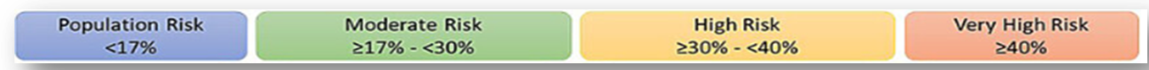
HRT Prescribing According to Breast Cancer Risk
Risk Category | HRT Consideration | Surveillance | Referral to Breast Clinic
Population Risk | Standard counselling | BreastCheck 50-69 | No routine referral
Moderate Risk | HRT appropriate after discussion | Annual mammography 40-49 | Consider breast/family history clinic if uncertainty
High Risk | Individualised counselling | Annual Mammography ± MRI | Breast clinic + genetics referral
BRCA1/2 | Specialist-led care | Annual MRI ± mammography | Specialist breast/genetics service

Slide 8
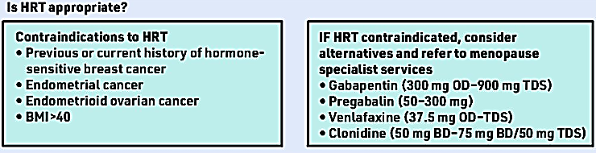
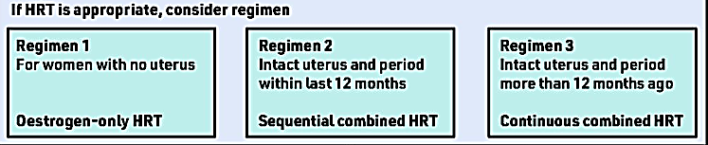

Slide 9
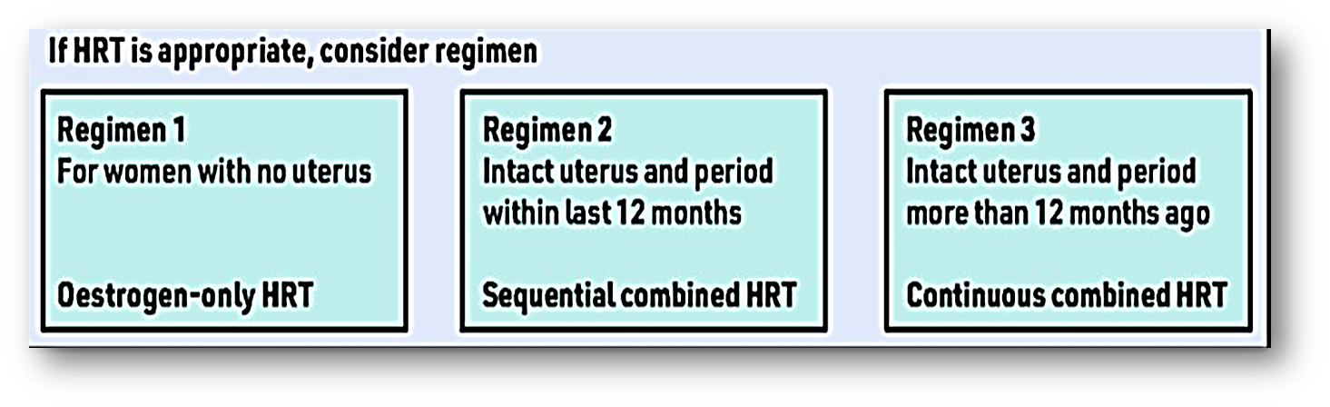
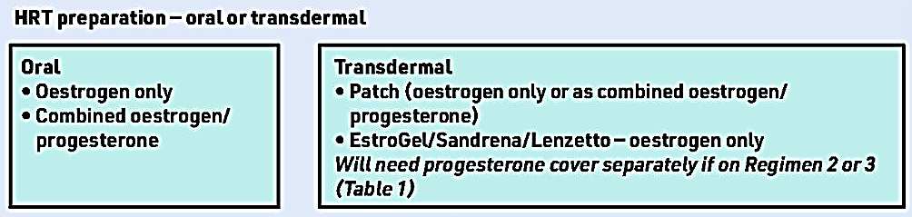

Slide 10
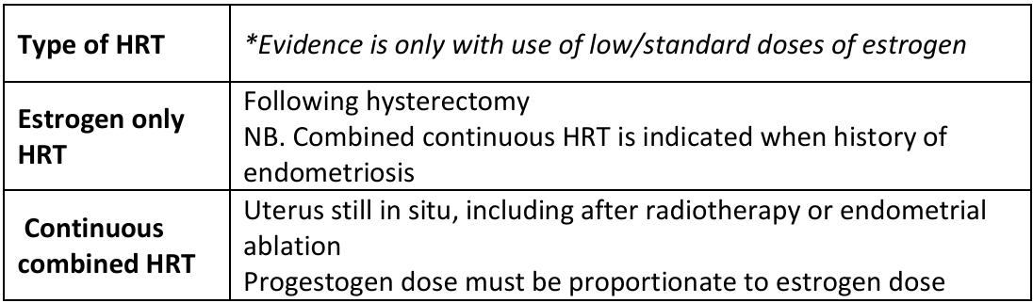
Hormonal Menopause Management
COMPLEX MENOPAUSE CLINIC
Modern menopause care is centered on risk stratification and shared decision-making.

Slide 11

Unopposed estrogen
• Is associated with little or no change in risk
• There is no evidence of a dosage effect
• Risk is not increased with vaginal estrogen
• Risk may be increased in past users
Combined HRT
• Can be associated with a duration-dependent increased risk
• Although continuous combined HRT confers a greater risk than sequential HRT, the absolute excess risk is small (i.e. 10 additional diagnoses per 1000 women aged 50 to 59 with up to 14 years use). This should also be weighed against the risk of endometrial cancer, which is significantly decreased by long-term, continuous combined HRT
• Risk may be increased in past users

Slide 12
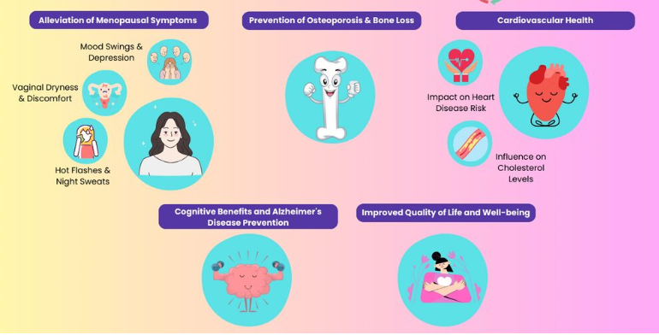
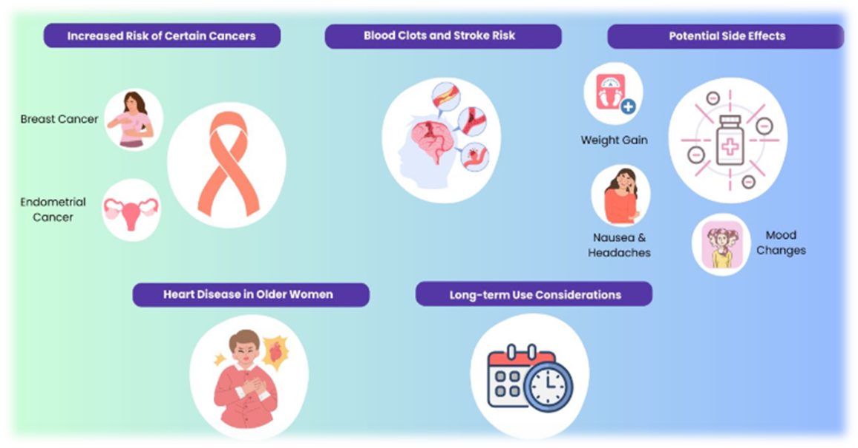

Potential Benefits of HRT
Potential Drawbacks and Risks of HRT

Slide 13
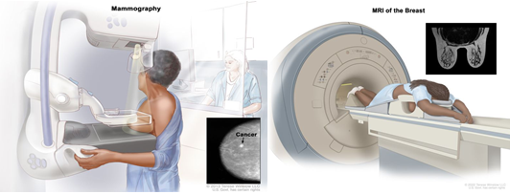
HRT & Breast Cancer Risk
Not all HRT carries the same risk
Oestrogen-only HRT has little or no increase in breast cancer risk
Combined oestrogen-progestogen HRT is associated with a small increase in breast cancer diagnoses that rises with duration of use
Contemporary prescribing increasingly favours transdermal oestradiol and micronised progesterone where appropriate.
Vaginal oestrogen is not associated with increased breast cancer risk
Absolute risk matters more than relative risk
Most women substantially overestimate the breast cancer risk associated with HRT
Risk discussions should focus on absolute excess risk rather than relative risk percentages
Lifestyle factors often contribute as much or more risk than HRT itself
(BMS, 2025)

Slide 14
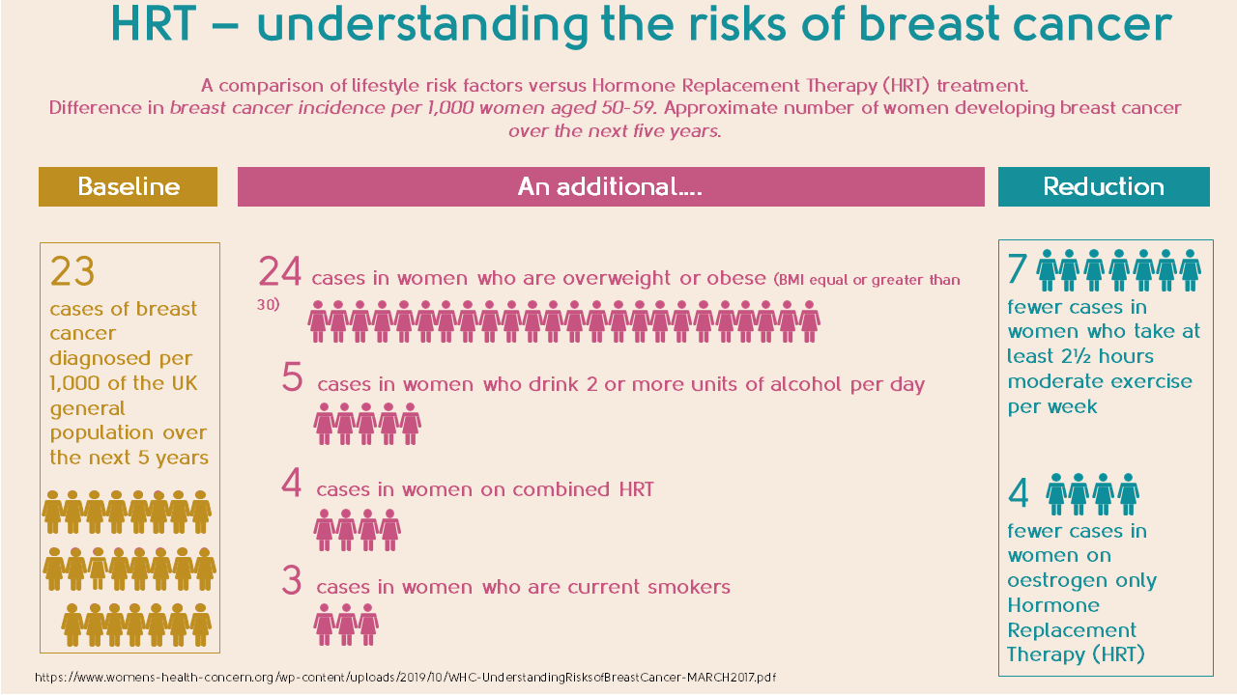

Slide 15

HRT and the Risk of Being Diagnosed with Breast Cancer
• In women with a low underlying risk of breast cancer (i.e. most of the population), the symptomatic benefits of HRT use for up to five years will exceed potential harm
• Where risk with HRT is estimated to be elevated, the degree conferred is considered Small and Most women will not be diagnosed with breast cancer as a result of their exposure to HRT
• In women with premature ovarian insufficiency years of HRT exposure should be counted from the age of 50 and not the age at which HRT is commenced
• There is insufficient evidence to recommend time from menopause should influence decision-making when commencing HRT
• Risk is not increased in overweight or obese women who use HRT

Slide 16
Family History of Breast Cancer - A Practical Risk Based Approach to HRT
- FAMILY HISTORY ≠ CONTRAINDICATION TO HRT
- Most women with a family history of breast cancer can be considered for HRT following an individualised assessment of:
Family history pattern
Baseline breast cancer risk
Genetic risk (BRCA1, BRCA2, TP53)
Severity of menopausal symptoms
Comorbidities and overall health status
Patient values and preferences
- Current NICE and British Menopause Society guidance supports risk stratification rather than blanket avoidance of HRT.

Slide 17

HRT and Women at Increased Risk of Breast Cancer
Most women (~90% of the female population) have a low lifetime risk of breast cancer
Overall, there is no strong evidence for an additive effect of HRT upon risk of diagnosis in women at elevated personal risk due to a family history of breast cancer or personal diagnosis of a high-risk benign breast condition (i.e. lobular carcinoma in situ, atypical hyperplasia)
Risk conferred by HRT will be dependent on the baseline risk in these higher risk women
It is recommended to avoid HRT in women at high risk, with the exception of BRCA1 and BRCA2 mutation carriers, who have had prophylactic oophorectomy
High risk symptomatic women at an elevated risk of breast cancer should be referred to a menopause specialist for advice
Notes:
• Most women (~90% of the female population) have a low lifetime risk of breast cancer
• Overall, there is no strong evidence for an additive effect of HRT upon risk of diagnosis in women at elevated personal risk due to a family history of breast cancer or personal diagnosis of a high-risk benign breast condition (i.e. lobular carcinoma in situ, atypical hyperplasia)
• Risk conferred by HRT will be dependent on the baseline risk in these higher risk
Women
• It is recommended to avoid HRT in women at high risk, with the exception of BRCA1 and BRCA2 mutation carriers, who have had prophylactic oophorectomy. Here add back HRT can be used for symptom management until the age of 50 as this has not been associated with an increased risk of breast cancer diagnosis. After 50, lifestyle changes and non-hormonal alternatives should be used
• High risk symptomatic women at an elevated risk of breast cancer should be referred to a menopause specialist for advice

Slide 18

Special Considerations: BRCA1/2 Mutation Carriers
Following risk-reducing salpingo-oophorectomy (RRSO):
  - Premature menopause can significantly affect cardiovascular, bone, cognitive and sexual health.
Current international guidance supports HRT until the average age of natural menopause (~51 years) in women without a personal history of breast cancer.
Available evidence has not demonstrated a clinically significant increase in breast cancer risk with short-term HRT use in this setting.
Shared decision-making remains essential.
(Servayge et al., 2023)

Slide 19
Post Menopausal Hormone Therapy in BRCA gene Mutation Carriers to Whom and Which?
Major concerns, acute symptoms, long term health issues
Absolute risk of breast cancer with HRT ( R Chlebowski JAMA 2015)
0.1% @ 2 years use ( HRT excess risk 1/1000)
0.4% @ 5 years use ( HRT excess risk 1/250)
  Observational studies and meta-analyses
predominantly unopposed oestrogen
risk per year of use 2.3% and increase significantly with long-term use
no difference by hormonal type or dose
Risk falls following HRT cessation
Notes:
2020 grandi Acute symptoms hot flushes,artherlgia, insomnia, GU symptoms, Foggy brain, low libido 78%
Weight gain 83%, CVD 77%, osteoporosis 65%, dementia

Slide 20
What Does Contemporary Evidence Show ?
In an epidemiological modelling study examining women with varying degrees of family history:
Both family history and HRT independently influence breast cancer risk.
Baseline familial risk contributes more to lifetime breast cancer risk than HRT exposure alone.
Even in women with a strong family history, the additional risk associated with HRT remained modest in absolute terms.
These findings support individualised counselling, risk stratification and informed shared decision-making regarding HRT.
(Huntley et al, 2024)

Slide 21
Menopausal Symptoms Management
LIFESTYLE & BEHAVIOURAL:
Limit alcohol, exercise regularly and aim for a healthy weight (BMI 18.5–24.9).
Cognitive behavioural therapy (CBT)
Vitamin D, 1,000 IU/day
CBT and Mindfulness approaches
Sleep optimisation
Smoking cessation
NON-HORMONAL PHARMACOLOGICAL OPTIONS:
SSRIs (citalopram, escitalopram) or SNRIs (venlafaxine)
Avoid fluoxetine and paroxetine with tamoxifen, as they may reduce efficacy
Fezolinetant (NK3 antagonist) for moderate to severe vasomotor symptoms
Oxybutynin; pregabalin or gabapentin

Slide 22
HRT After Breast Cancer: 2026 Practical Approach
Non-hormonal alternative must be used as a first line management
General Rule
Systemic HRT is not routinely recommended after breast cancer
However, BMS, NICE and recent international consensus acknowledge:
Some women have severe symptoms despite optimal non-hormonal treatment
Shared decision-making is essential
Risks and benefits should be individualised
Potentially Relevant Factors
ER status
Time from diagnosis
Current endocrine therapy
Recurrence risk
Patient priorities and quality of life
Notes:
HRT might be needed in individual cases with severe and refractory symptoms only for symptoms relieve

Slide 23

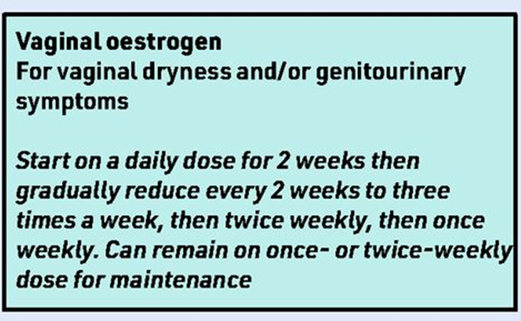
Genitourinary Syndrome of Menopause (GSM)
Symptoms
Vaginal dryness, Dyspareunia, Burning, Urinary urgency, Recurrent UTIs
First-line management
Start with water-based lubricants and bioadhesive moisturisers.
Discuss options with the breast cancer specialist.
If symptoms persist, consider low-dose vaginal oestrogen.
Avoid vaginal oestrogen with aromatase inhibitors (AIs). •
Sexual health counselling where appropriate
Vaginal oestrogen may be used for as long as needed
Vaginal DHEA (prasterone 6.5 mg).
Ospemifene (SERM), 60 mg orally, for women uncomfortable with vaginal delivery.
Notes:
New Evidence
2025 systematic review and meta-analysis:
No increase in breast cancer recurrence
No increase in breast cancer-specific mortality
No increase in overall mortality

Slide 24
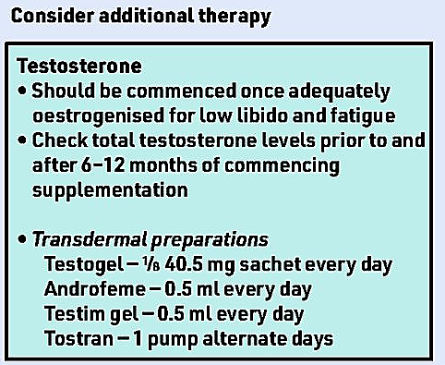

Slide 25

Arthralgia: A Common Cause of Treatment Discontinuation
Typical presentation
Morning stiffness (hands, wrists, knees, hips, shoulders)
Most commonly associated with aromatase inhibitors.
Management
Exercise
Resistance training
Weight loss where appropriate
Regular movement after rest
Paracetamol, NSAIDs if suitable
If severe, oncology/breast team may consider switching between aromatase inhibitors, or switching to tamoxifen
Do not alter endocrine therapy in primary care without specialist input.

Slide 26

Final Take-Home Messages
A family history of breast cancer is not a contraindication to HRT.
Risk stratification and surveillance are more important than blanket avoidance of HRT.
Most women can be considered for HRT following individualized assessment and shared decision-making.
Ask about symptoms routinely.
Start with lifestyle and non-hormonal therapies, Treat GSM proactively.
Keep care evidence-based.
Support endocrine therapy adherence and refer early for specialist menopause care.
Offer individualized counselling before and after treatment, with active shared decision-making.

Slide 27
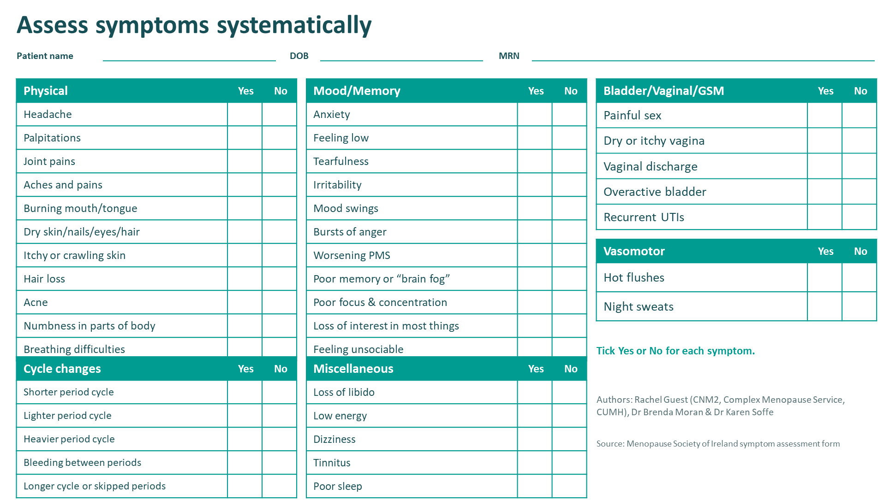

Slide 28


Slide 29


Slide 30
Thank you

Slide 31
References
Hamoda H. Management of the Menopause. British Menopause Society, 7th edition.
British Gynaecological Cancer Society & British Menopause Society. Management of menopausal symptoms following treatment of gynaecological cancer. August 2024.
British Menopause Society Consensus Statement 2025: Management of Symptoms After Breast Cancer
Hickey M, et al. “Managing menopause after cancer.” The Lancet. 9 March 2024; pp. 984–996.
Menopause society of Ireland – resources.
British Menopause Society: HRT & Breast Cancer Risk Factsheet 2025
NICE Guideline NG23. Menopause: Diagnosis and Management (updated 2024)
Huntley C et al. Breast cancer risk assessment for prescription of menopausal hormone therapy in women with a family history of breast cancer: an epidemiological modelling study. Br J Gen Pract. 2024;74(746):e610-e618.
Servayge et al., 2023. Clinical Guidelines for managing menopausal symptoms in women with a history of breast cancer.
BMS Non-hormonal Management Consensus Statement 2026

