Slide 1

Neurosurgery in Stroke & TIAs
Prof Mohsen Javadpour
Consultant Neurosurgeon
Beacon Brain Institute – Beacon Hospital

Slide 2
Neurosurgery in Stroke & TIAs
Mohsen Javadpour
National Neurosurgical Centre, Beaumont Hospital
Beacon Brain Institute, Beacon Hospital

Slide 3
Role of Neurosurgery in Stroke & TIAs
Malignant MCA infarction
Cranioplasty
Spontaneous intracerebral haematoma (ICH)
Selected TIAs – Cerebral revascularisation

Slide 4
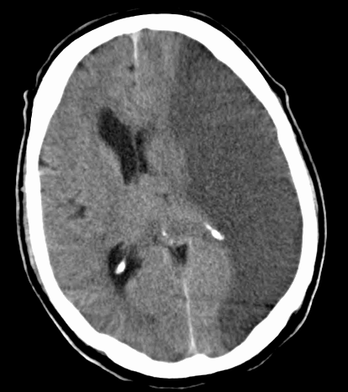
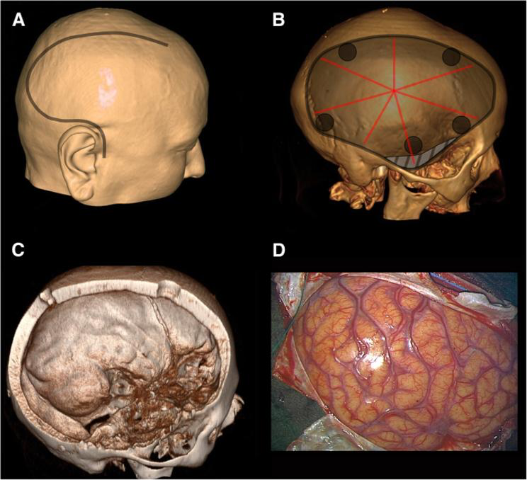
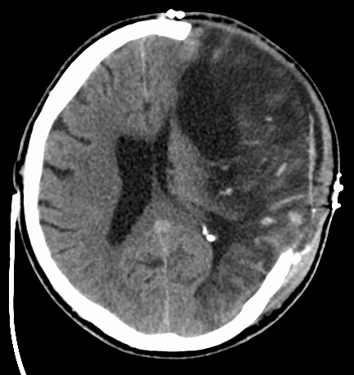
“Malignant” MCA infarction – Decompressive Craniectomy
> 50% of MCA territory
Cerebral Oedema over 2-5 days
Mortality without surgery 80%
RCTs - DECIMAL / DESTINY / HAMLET
Patients ≤60
treated within 48 hours
Mortality
Conservative 71%
Craniectomy 22%
Survival may be associated with significant disability
However surgery also increased the chance of survival with independent walking (mRS≤3)
Vahedi K et al. Lancet Neurol 2007;6:215–222.

Slide 5
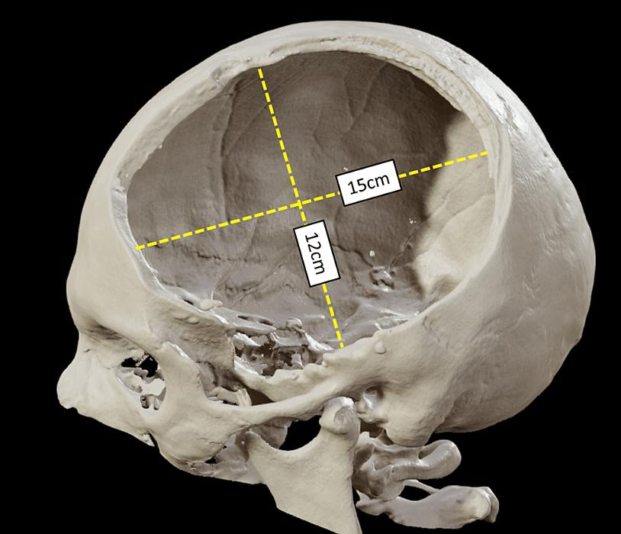
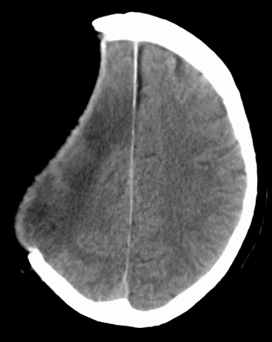
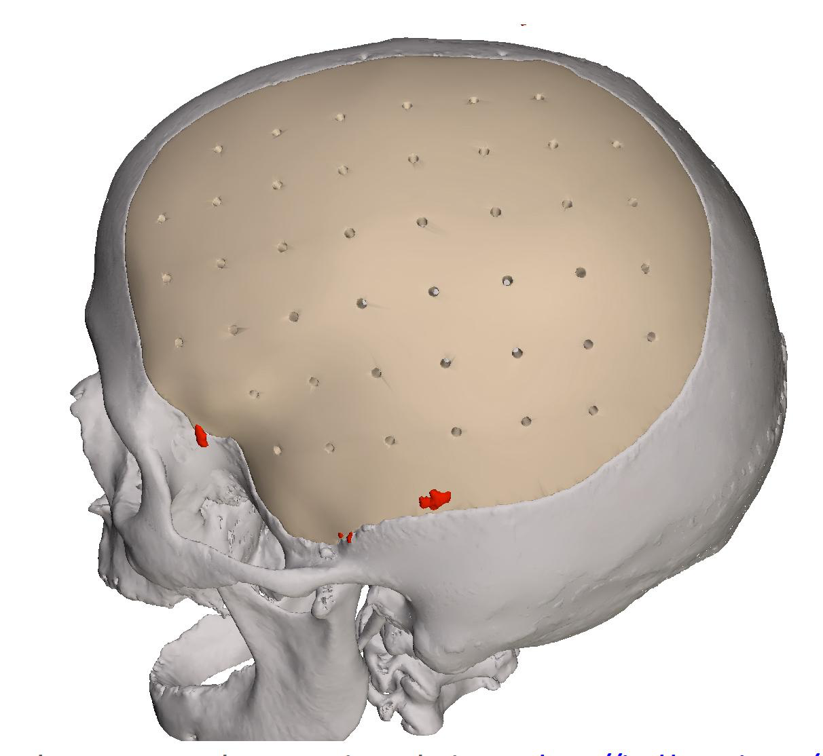
After decompressive craniectomy – What should the GP look out for?
Before Craniotplasty:
Skull defect / Injury risk
Syndrome of the Trephine (sinking skin flap syndrome)
After Craniotplasty:
Wound infection / Breakdown
CSF leak
If concerned – Refer back to Neurosurgery

Slide 6
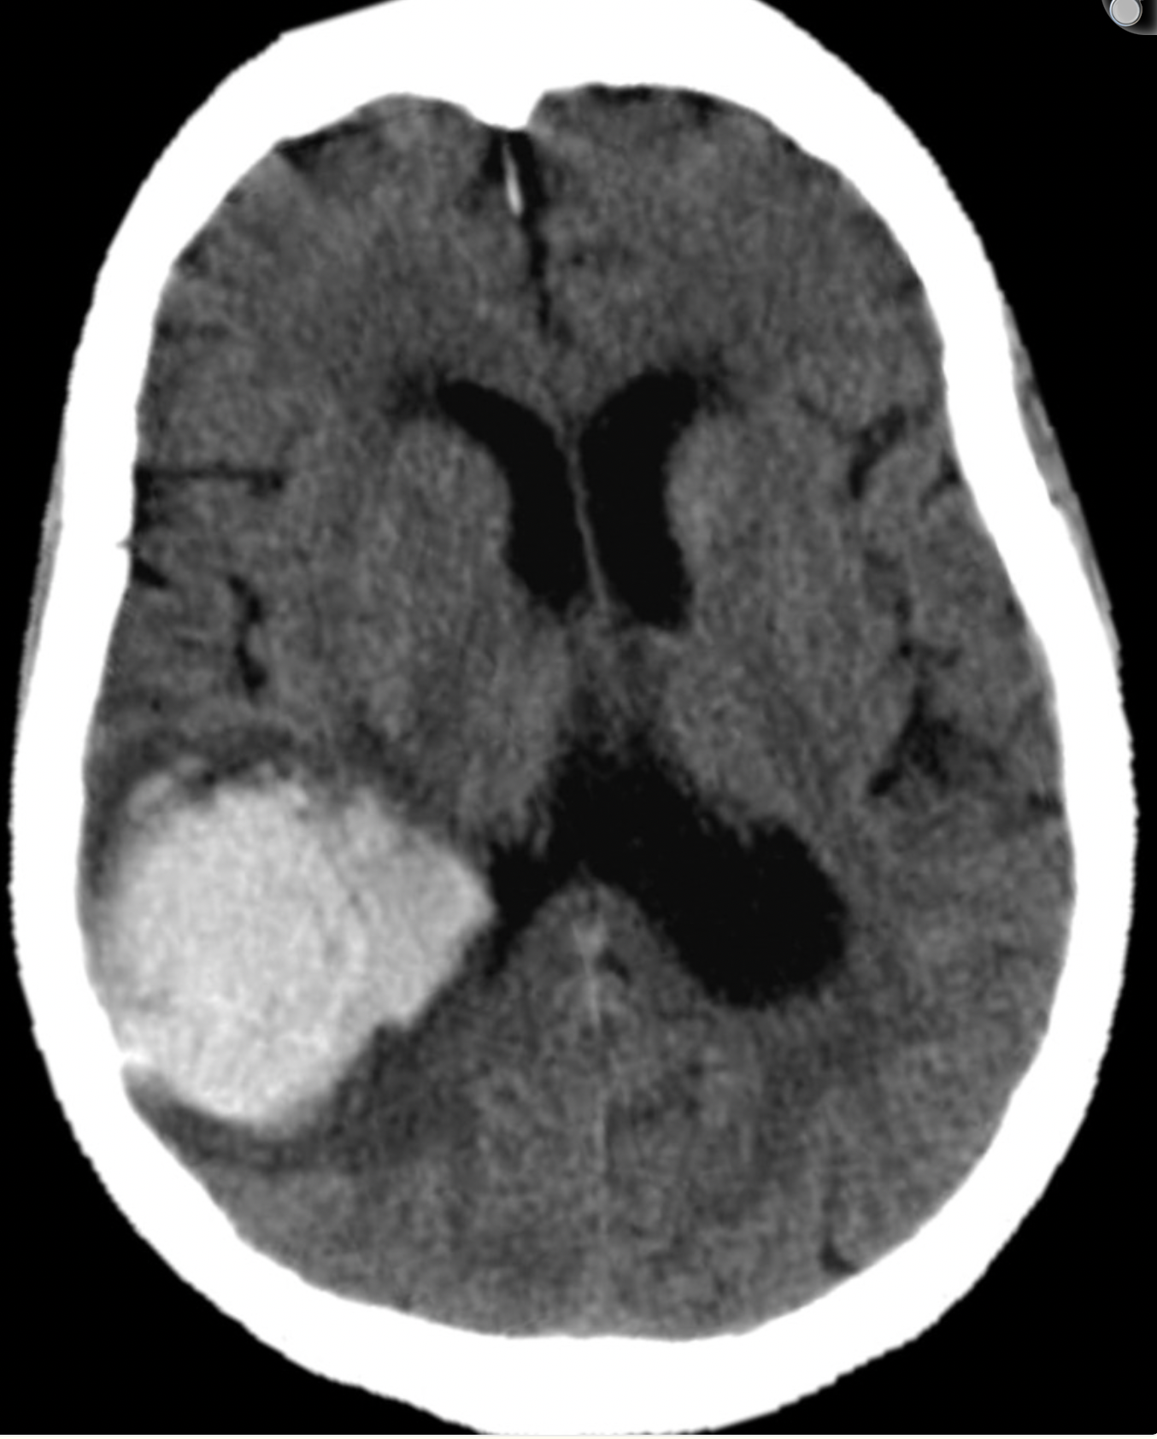
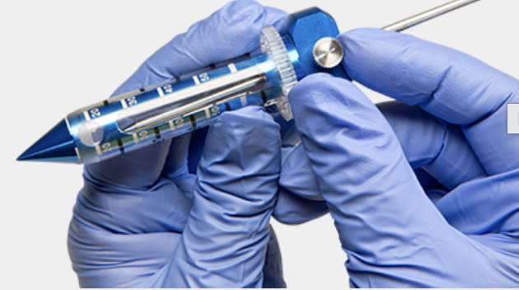
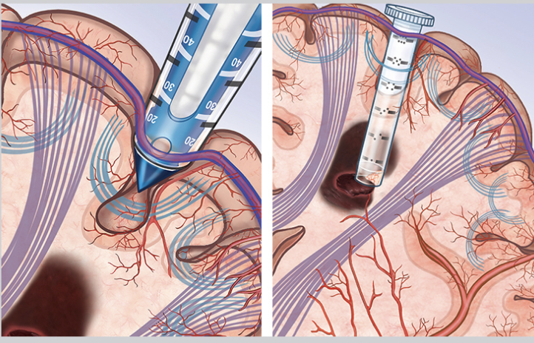
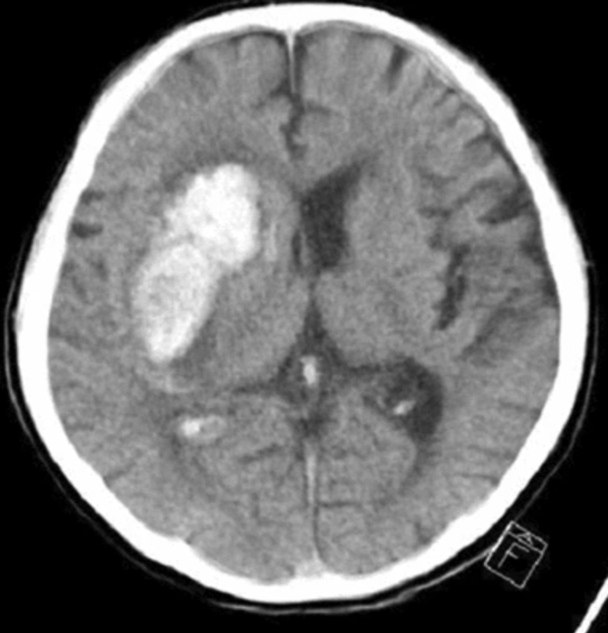
Intracerebral Haemorrhage (ICH)
NEJM 2024 | 300 patients
ENRICH RCT (n=300)
Spontaneous ICH 30–80 mL
Minimally invasive evacuation within 24 h
Post-Discharge care
Risk factors
  BP
  Smoking
  Diabetes
  Lipids
Medication management
  Antiplatelets
  Anticoagulants
Rehab / cognition / Mood
Driving
LOBAR Haematoma
Better functional outcome at 180 days
30-day mortality:
9.3% surgery
18.0% medical
Take-home: Early minimally invasive evacuation improves outcome in selected patients with large lobar ICH.
Pradilla G et al. N Engl J Med. 2024;390:1277–1289.

Slide 7
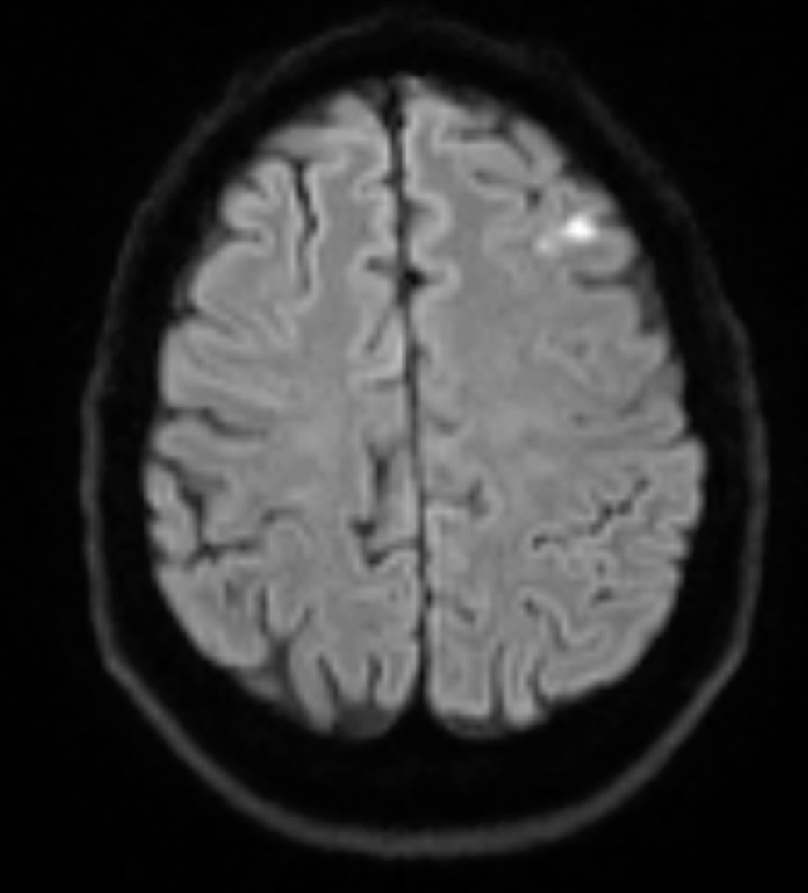
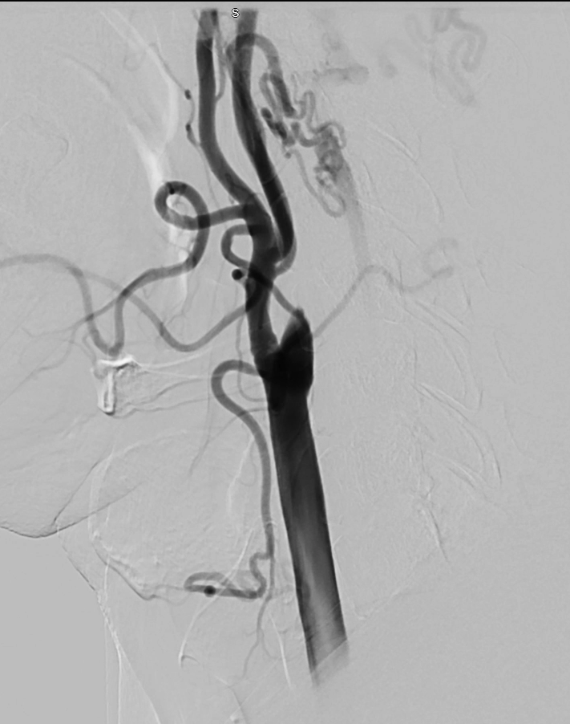
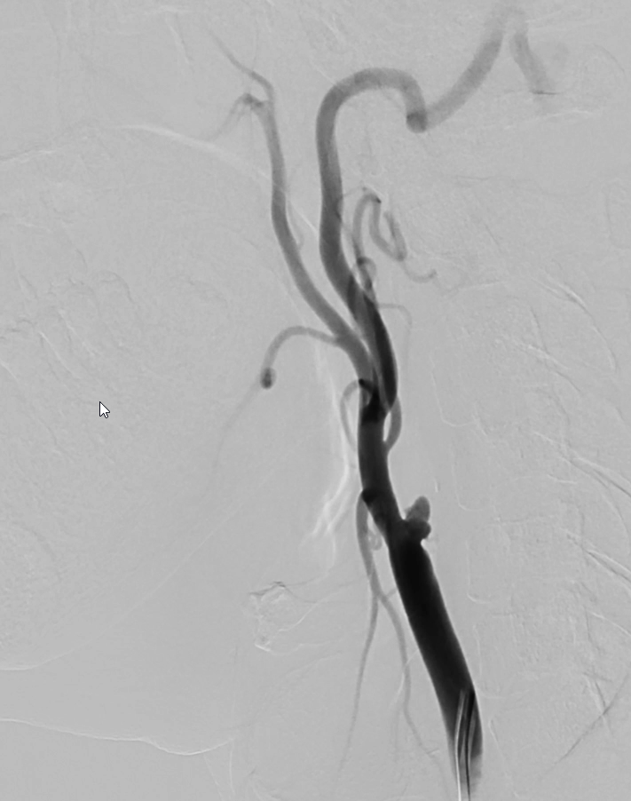
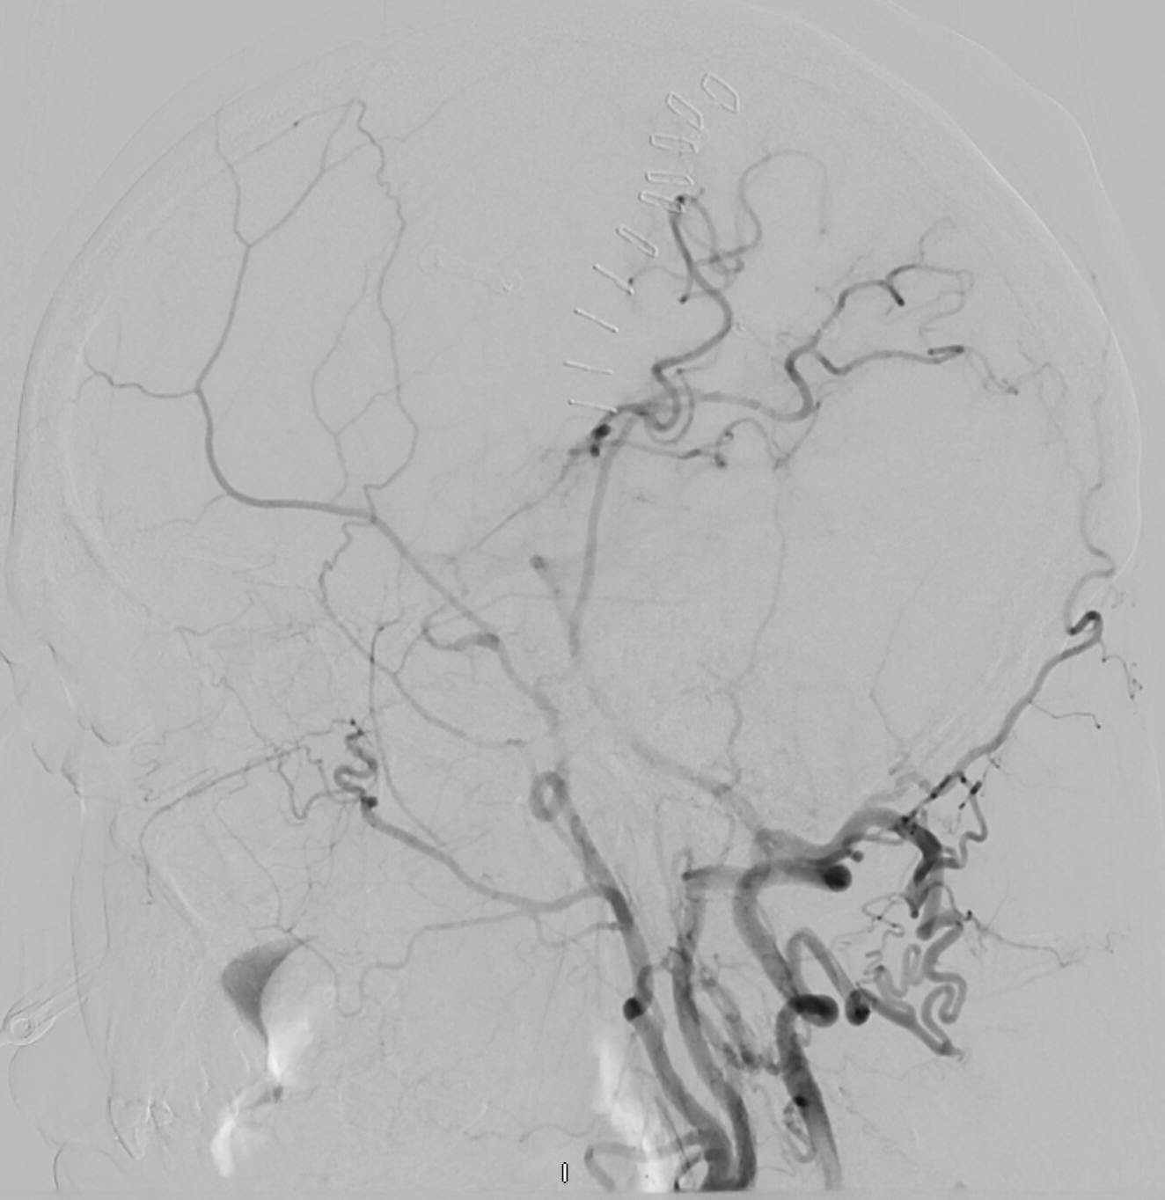
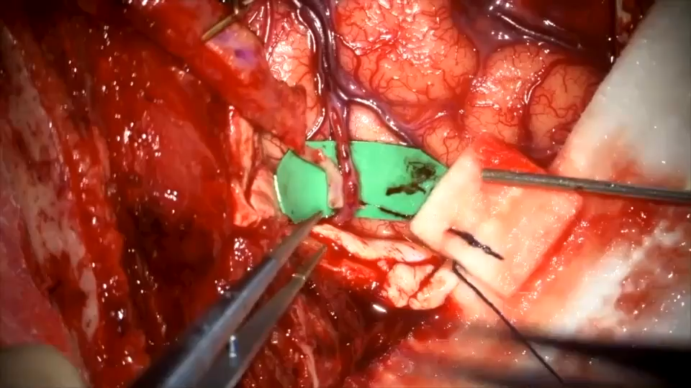
Cerebral revascularization (Extracranial-Intracranial Bypass)
52-year–old male
Recurrent episodes of right arm/leg shaking
TIA OR SEIZURE?
PMHx: HTN, ischaemic stroke x 2 (2016 & 2024), CEA in 2024
On Aspirin and Dipyridamole
Bilateral ICA occlusion
Bilateral subclavian occlusion
Left VA occlusion

Slide 8
Take home message
1. Malignant MCA infarction
Decompressive craniectomy can be lifesaving.
2. Survival comes with a trade-off
Functional outcome matters—not just mortality.
3. Wound issues after Cranioplasty
Refer back.
4. Spontaneous ICH
Selected lobar haemorrhages now have RCT evidence supporting early surgical evacuation.
5. Limb-shaking TIA
Think cerebral hypoperfusion, not just focal epilepsy – But this is rare

Slide 9
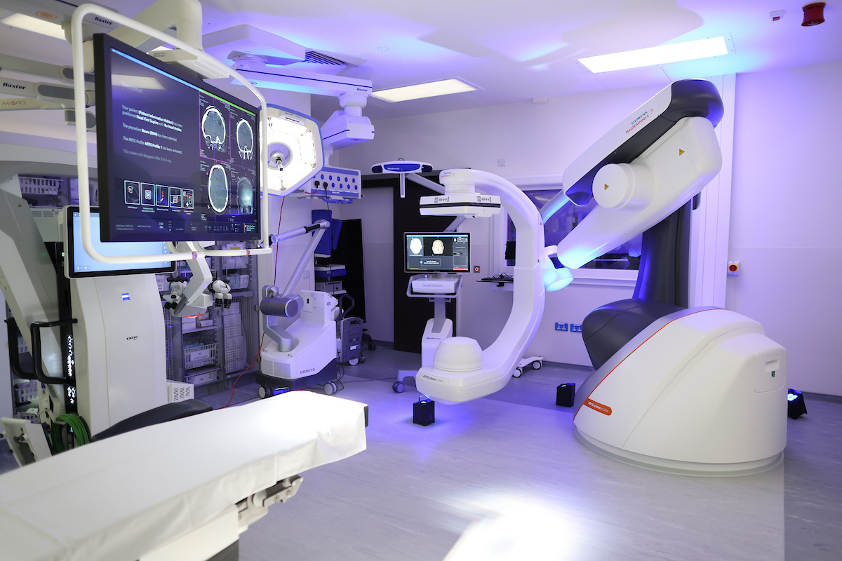
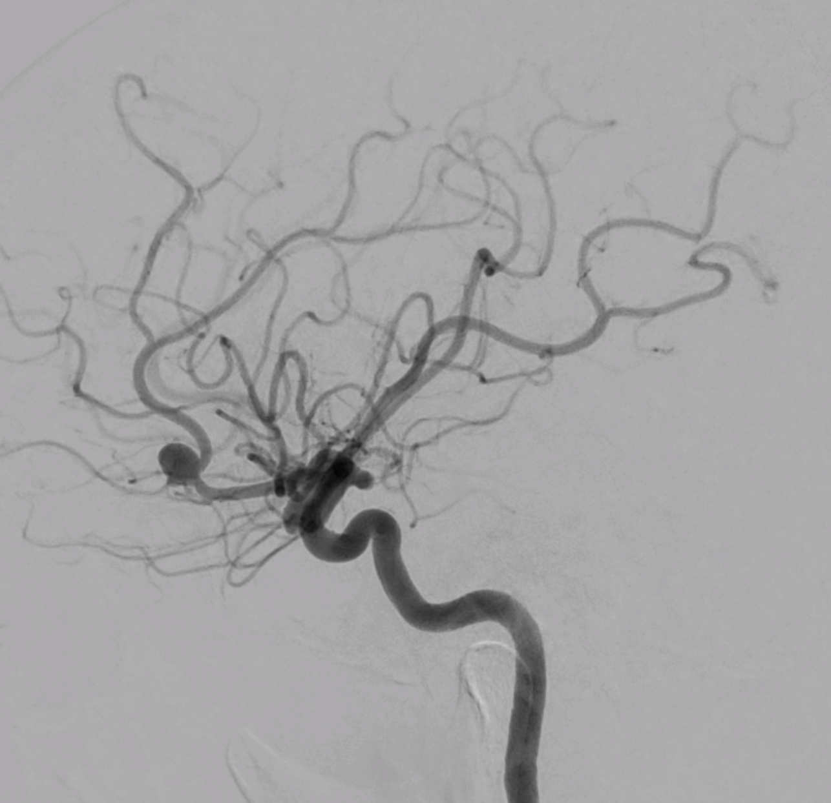
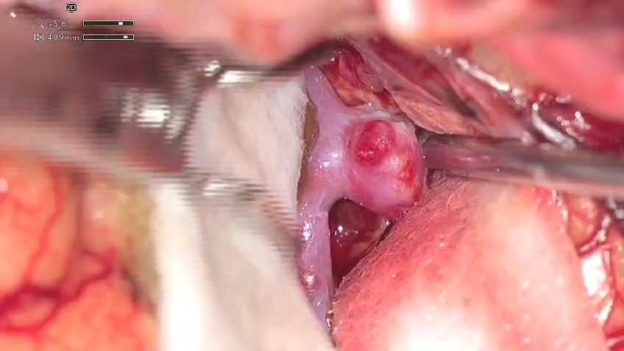
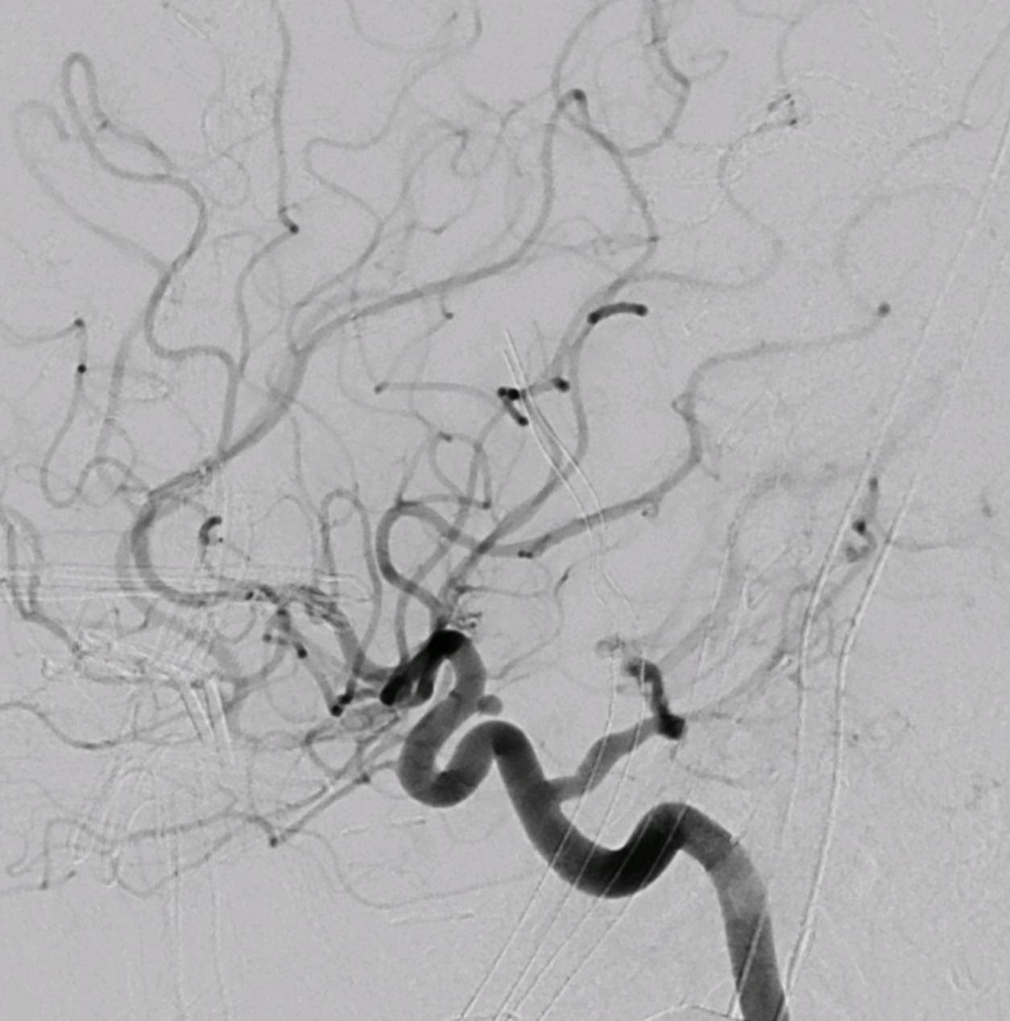
Beacon Brain Institute
Hybrid Neurosurgery / Neurovascular Operating Theatre
Neurovascular
  Brain Aneurysm Clipping
  Brain AVM excision
All Brain Tumours
  Malignant & Benign
  Pituitary & Skull base
  Craniotomy / Biopsy
Hydrocephalus
Trigeminal Neuralgia
Hemifacial Spasm
SAFER SURGERY
Intraoperative angiography
Intraoperative Cone Beam CT

Slide 10
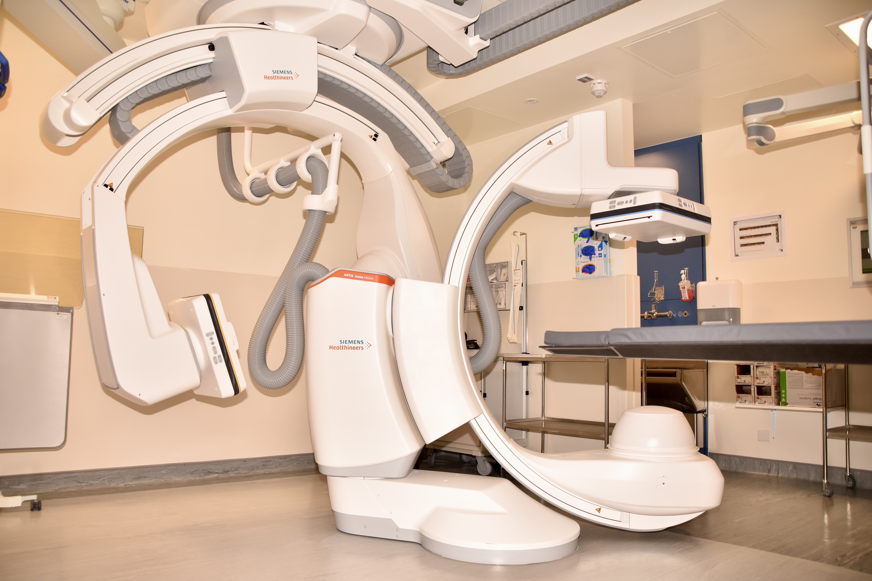
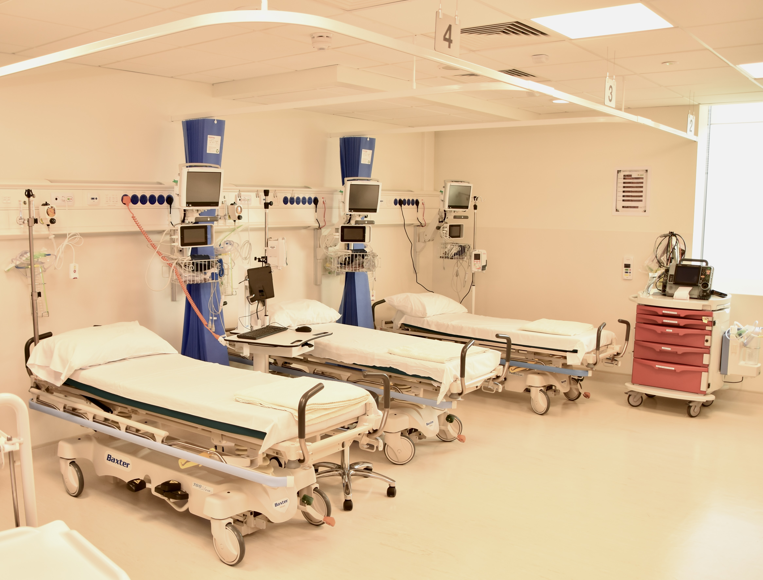
Beacon Brain Institute
Neuro Interventional Radiology Suite
Diagnostic Cerebral Angiography
Elective endovascular treatment for:
  Brain aneurysms (coiling, stents)
  Brain AVMs (glue embolisation)
  Carotid artery stenosis (stent)
Spinal percutaneous procedures:
  Nerve root blocks
  Myelograms
  Vertebroplasty
What we can NOT accept:
Traumatic Brain Injury
Acute Stroke
Acute Intracranial Haemorrhage

Slide 11
THANK YOU

