Slide 1
Food Allergy in Children, Highlights from 2026
Prof David Coghlan, Consultant Paediatrician

Slide 2
Five papers → three practical shifts
PREVENT
DESENSITISE
PROTECT
Earlier allergen introduction
+ identify infants at risk
Earlier peanut OIT
+ lower maintenance doses
Biologics for multifood allergy
+ new adrenaline delivery
Selected for clinical relevance, study quality and direct implications for paediatric food-allergy care.
1 Koplin et al. • 2 Islam et al. • 3 Klevebro et al. • 4 Upton et al. • 5 Wood et al.
Primary papers: JAMA Pediatr 2026; Lancet Reg Health Eur 2026; J Allergy Clin Immunol Pract 2026. Guideline context: EAACI 2024 / prevention update 2021.
2
Notes:
The old "3-2-1" avoidance approach
Cow's milk: avoid until 1 year
Egg: avoid until 2 years
Peanut, tree nuts, fish/shellfish: avoid until 3 years
The rationale was that delaying exposure would allow the infant immune system and gut barrier to mature and therefore reduce sensitisation and allergy.

Slide 3
PAPER 1 • PREVENTION
After earlier-introduction guidance, population egg-allergy prevalence was lower
Koplin JJ et al. JAMA Pediatrics, 8 June 2026
Egg allergy at ~12 months
34.6% → 21.9%
2007–11
9.2%
egg allergy in infants with early eczema
2018–19
7.6%
after guideline change
Adjusted absolute difference −1.6 percentage points
•
7,209 infants across two population cohorts.
•
Observational before/after comparison: association, not proof of individual causation.
•
Median egg introduction moved from 8 to 6 months.
Support timely introduction of well-cooked egg as part of complementary feeding; eczema is a major prevention opportunity.
Koplin JJ et al. Egg Allergy Prevalence Before and After Guidelines for Earlier Egg Introduction. JAMA Pediatr. 2026. doi:10.1001/jamapediatrics.2026.2080. EAACI prevention guideline update. Pediatr Allergy Immunol. 2021;32:843–858.
3
Notes:
The Australian population study compared infants before and after implementation of guidelines recommending earlier egg introduction. After adjustment for confounding factors, egg allergy prevalence fell from 9.2% to 7.6%, an absolute reduction of 1.6 percentage points. This suggests that translating evidence from clinical trials into public health recommendations can reduce food allergy burden.
Biggest benefit in Eczema group
A major shift in allergy prevention has occurred. Earlier guidelines often advised delaying allergenic foods, but the EAACI update concluded that there is evidence in favour of introducing egg during infancy. The 2026 data add real-world confirmation that moving away from avoidance strategies may reduce allergy development.
Australia introduced early egg introduction recommendations in 2016 through revised ASCIA infant feeding guidelines. The 2026 Koplin et al. study compared infants born before (2007-2011) and after (2018-2019) implementation of these recommendations and found a significant reduction in egg allergy prevalence

Slide 4
PAPER 2 • RISK
What predicts food allergy? Eczema remains the clearest signal
Islam N et al. JAMA Pediatrics, 2026 | 190 studies | 2.8 million participants
Atopic dermatitis in year 1
OR 3.88
Strongest clinically actionable signal
Increased skin water loss
OR 3.36
Supports the skin-barrier pathway
Peanut introduced after 12 months
OR 2.55
Delay associated with higher risk
Family history
~OR 1.7–2.4
Useful context; not diagnostic
Important: antibiotic exposure, caesarean delivery and demographic factors were associations in observational data — not reasons to alter necessary clinical care.
Recognise infants with early eczema as a high-risk group; avoid unnecessary delay in allergen introduction.
Avoid unnecessary delay in complementary allergen introduction, and use history not “risk-factor panels”, to diagnose allergy.
Islam N et al. Risk Factors for the Development of Food Allergy in Infants and Children: A Systematic Review and Meta-Analysis. JAMA Pediatr. 2026;180(5):486–499. doi:10.1001/jamapediatrics.2025.6105.
4
Notes:
Systematic Review and Meta-analysis
Food allergy confirmed by OFC
Risk up to age 6 years
Scale of the Review
The final review included:
190 studies
Approximately 2.8 million participants
Studies from 40 countries
176 studies contributed to risk-factor analyses
342 individual risk factors were evaluated.

Slide 5
PAPER 3 • EARLY OIT
Peanut OIT in toddlers: slow up-dosing, low maintenance
SMACHO RCT | 75 children aged 1–3 years | 3 years treatment
82%
5000 mg
0.7%
sustained unresponsiveness
median tolerated dose
of OIT doses had AEs
≥750 mg after 4–6 weeks off peanut
vs 3 mg after avoidance
most were mild
•
Maintenance dose: 285 mg peanut protein; up-dosing every 4–6 weeks.
•
6 children had 8 severe dose-related events; home epinephrine used 3 times in 2 children.
Very promising specialist therapy in preschoolers, however OIT still requires structured protocols, supervision and emergency planning.
Klevebro S et al. Safety and efficiency of peanut oral immunotherapy in preschool children with slow up-dosing and low maintenance dosing: a randomised controlled trial. Lancet Reg Health Eur. 2026;66:101690. doi:10.1016/j.lanepe.2026.101690.
5
Notes:
SMACHO ( Small Children Oral Immunotx Study) randomized trial of peanut OIT in Pre-school children with peanut allergy.
‘switch off’—holy grail
Younger children greater Immune Plasticity
Rapid updose—big maintenance—big s/e including anaphylaxis
82% sustained unresponsiveness after 3 years treatment

Slide 6
PAPER 4 • DOSE
Peanut OIT: could a much lower daily dose be enough?
Upton JEM et al. | 51 peanut-allergic children | median age 10 years
30 mg maintenance
300 mg maintenance
76.5%
58.8%
tolerated ≥443 mg
tolerated ≥443 mg
41.2% tolerated ≥1043 mg
47.1% tolerated ≥1043 mg
Safety signal: systemic adverse events were fewer with 30 mg than 300 mg.
Very-low-dose OIT produced substantial desensitisation with fewer systemic reactions; larger studies are needed to define the optimal maintenance dose.”
Upton JEM et al. Peanut Oral Immunotherapy Using 30 and 300 mg Maintenance Doses. J Allergy Clin Immunol Pract. 2026;14(1):223–232.e7. doi:10.1016/j.jaip.2025.10.007.
6

Slide 7
NEW IN PRACTICE
EURneffy: nasal adrenaline for anaphylaxis
EU-authorised needle-free adrenaline route|“neffy” in the US, EURneffy in Europe
≥4 years
1 mg / 2 mg
~10 min
age
dose strengths
second dose
and body weight ≥15 kg
1 mg: 15–<30 kg • 2 mg: ≥30 kg
if no improvement, or symptoms return/worsen
At first sign of a severe allergic reaction:
1
Spray into one nostril
IRELAND
HPRA: both strengths authorised
Marketing availability: “Unknown”
2
Seek emergency medical help immediately
3
Carry two devices; use second if needed
EMA EURneffy EPAR, updated 1 Jun 2026: emergency treatment of anaphylaxis; age ≥4 years and ≥15 kg; two sprays to be carried; second dose after ~10 min if needed. HPRA: EURneffy 1 mg authorised 27 Mar 2026; 2 mg authorised 22 Aug 2024; marketing availability listed as “Unknown”. Allergy UK EURneffy FAQs, 2025.
8
Notes:
Learning curve- welcome that doesn’t involve injection-not on DPS
Less data than adults
Another product in develop[pment besides EUR neffy
Schools don’t have experience with it
See Post marketing data- gain valuable experience regarding effectiveness and practical use through using them and passage of time– real life data
Not changing my practice currently– Teens if improved compliance

Slide 8
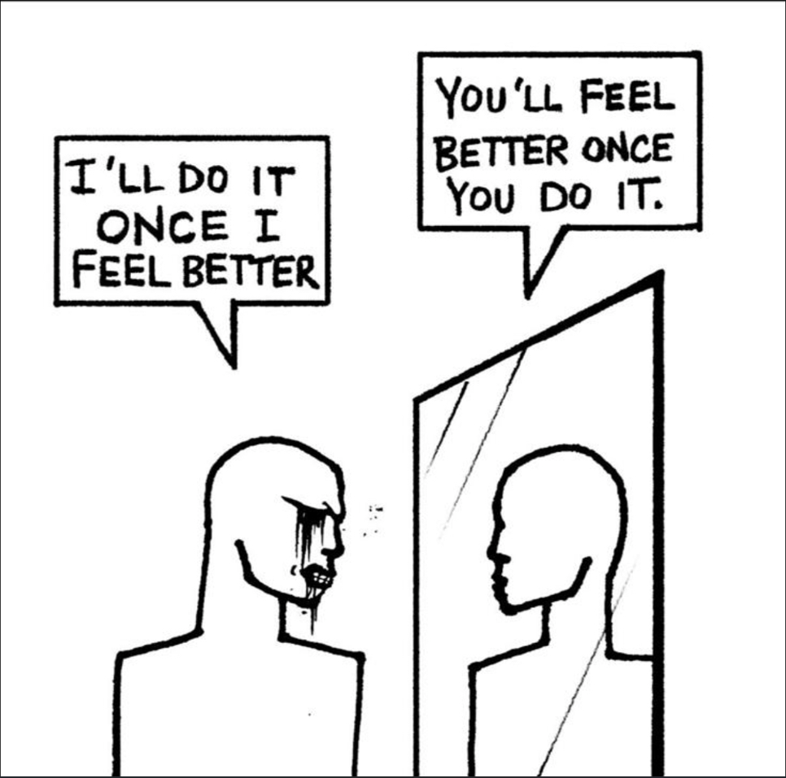

Slide 9
PRACTICAL APPLICATION
What might you do differently on Monday?
1
PREVENT
Introduce well-cooked egg and age-appropriate peanut during complementary feeding; do not delay without a reason.
2
DIAGNOSE
Start with the clinical history. Build risk profile.Use targeted SPT/sIgE; avoid indiscriminate food panels.
3
REFER
OIT and biologics are specialist therapies. Improve access.
4
PROTECT
Give a written action plan, check adrenaline-device technique/carrying, and optimise asthma control.
Core principle: confirmed allergy ≠ avoidance of every sensitised food. Maintain tolerated foods and avoid only the relevant trigger(s).
EAACI prevention guideline update. Pediatr Allergy Immunol. 2021;32:843–858. EAACI Guidelines on the Management of IgE-Mediated Food Allergy. Allergy. 2024. IFAN: Diagnosis & Management in Primary and Community Care; Medication for Food Allergy / emergency plans (accessed Sep 2026).
9

Slide 10
Thank you
10

