Slide 1
When to Refer to Ophthalmology
Ms. Treasa Murphy, Consultant Paediatric and Adult Ophthalmic Surgeon

Slide 2
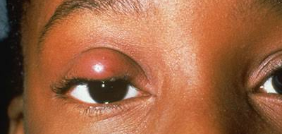
Chalazion
Notes:
Amblyopia/ astig
No oral abx unless preseptal cellulitis/ conjunctivitis
If non resolving x 3/12, odds of resolving are minimal
Needs I and c

Slide 3
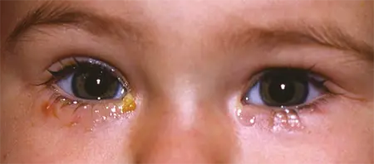
Congenital Nasolacrimal Duct Obstruction
Notes:
Conservative x 3/12, provided no excoriation/ dacryocystocele/ conjunctivitis
If any need to be seen, refer, I’ll see them urgently
Need urgent surgery

Slide 4
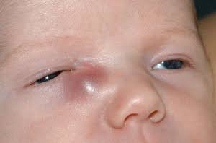
Congenital Dacryocystocele

Slide 5
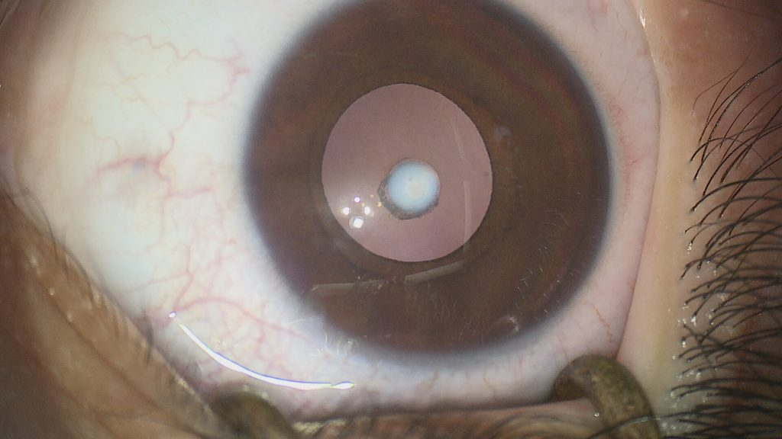
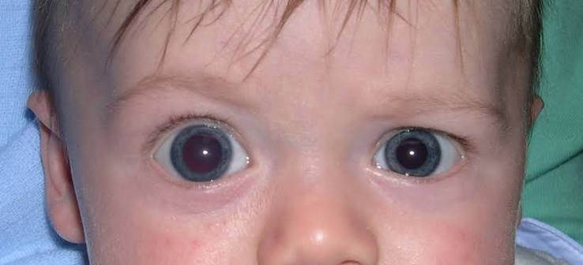
Congenital Presentation
Congenital Cataract
Congenital Glaucoma
Notes:
Balloon, expanding globe
Photosenstiive, watery, larger eye

Slide 6
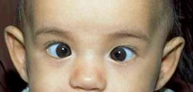
Infantile Esotropia
Notes:
Ideally refer if present > 6mo
Operate x 1 y/o for depth perception
Latest age at which functional benefit possible 15 mo
Any age for cosmesis

Slide 7
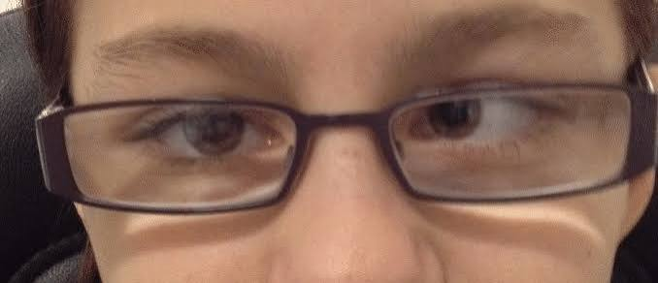
Esotropia
Notes:
3 groups- fully corrected with gls, partially or non responsive to glasses
I see all 3 groups, fully accom- monitor yearly for glasses rx, partially responsive and non responsive need surgery
Functionality- prevent amblyopia, restore depth perception, stop diplopia
Cosmesis

Slide 8
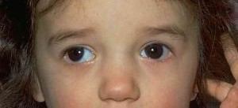
Exotropia
Notes:
Peak incidence 3-5 yo
Intermittent/ constant
Can cause amblyopia/ loss of stereopsis but over a longer period of time, rather than with the acute loss that happens with esotropia
Historically glasses/ patching, latest evidence no benefit
Only corrective measure is surgery

Slide 9
Main Red Flags of Strabismus
Diplopia/ covering one eye constantly
Restriction in eye movements
Headache/vomiting/pulsatile tinnitus

Slide 10
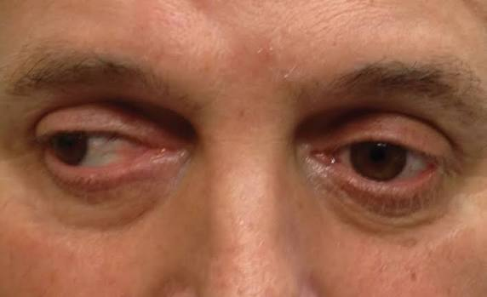
Adult Strabismus

Slide 11
Thank you

