Slide 1
Beacon Rapid Access Prostate Clinics &
Focal Therapy for Prostate Cancer - An Update
Mr Mohammud Shakeel Inder
MD. MCh. FRCS(Urol)
Clinical Lead Rapid Access Prostate Clinic & Director of Focal Therapy Programme

Slide 2
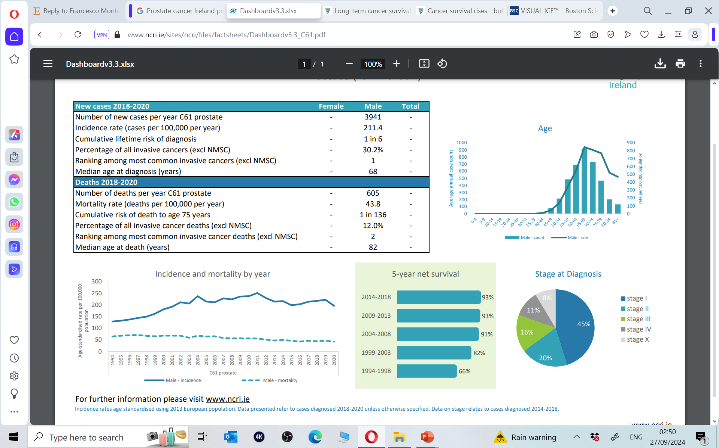
Prostate Cancer
Prostate Cancer is the most prevalent cancer in men in Ireland
1 in 8 men diagnosed in their lifetime
30% of all newly diagnosed cancer in men
4000 cases diagnosed yearly in Ireland - increasing

Slide 3
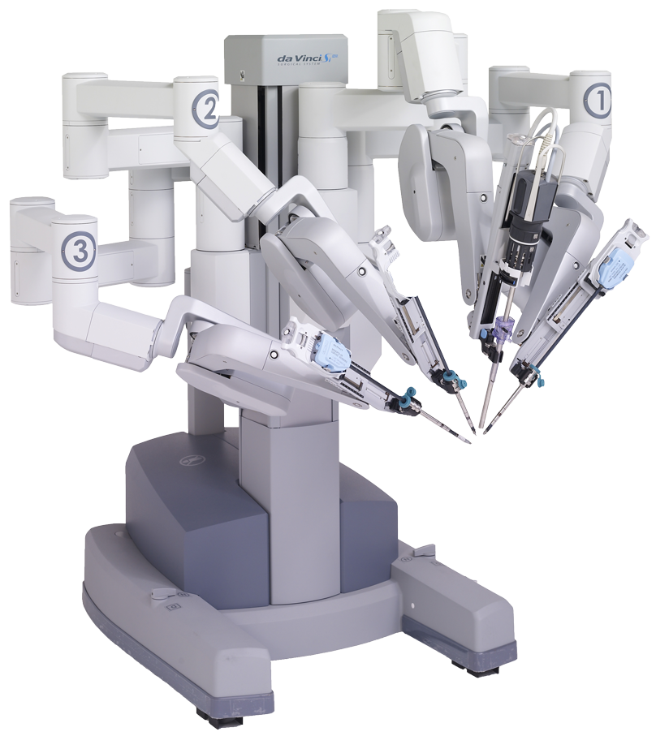
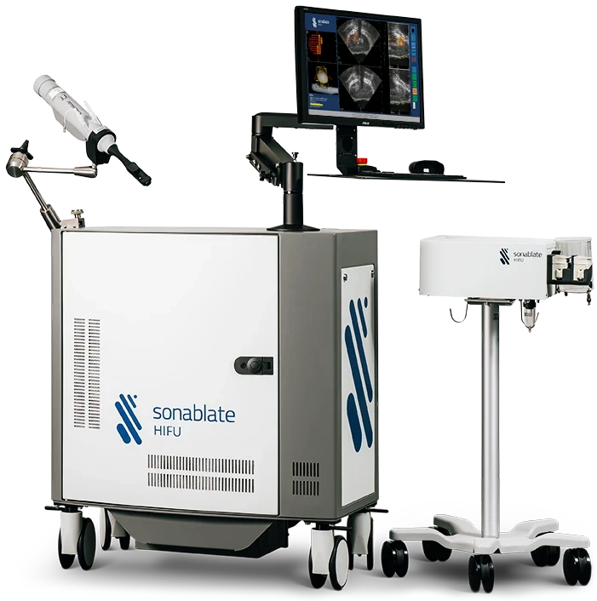
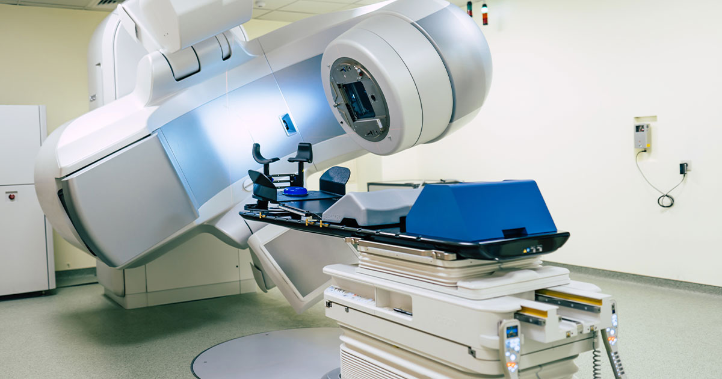
Prostate Cancer
Highest prostate cancer incidence rates in Europe
Joint second most common cause of cancer death in males
41% diagnosed under the age of 65
Early diagnosis is key- Aim for treatment with curative intent

Slide 4
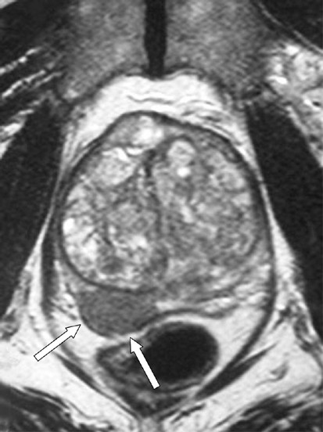
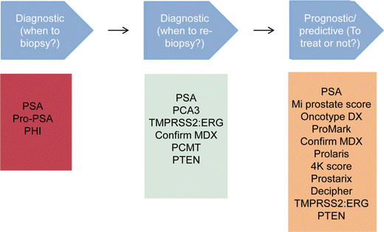
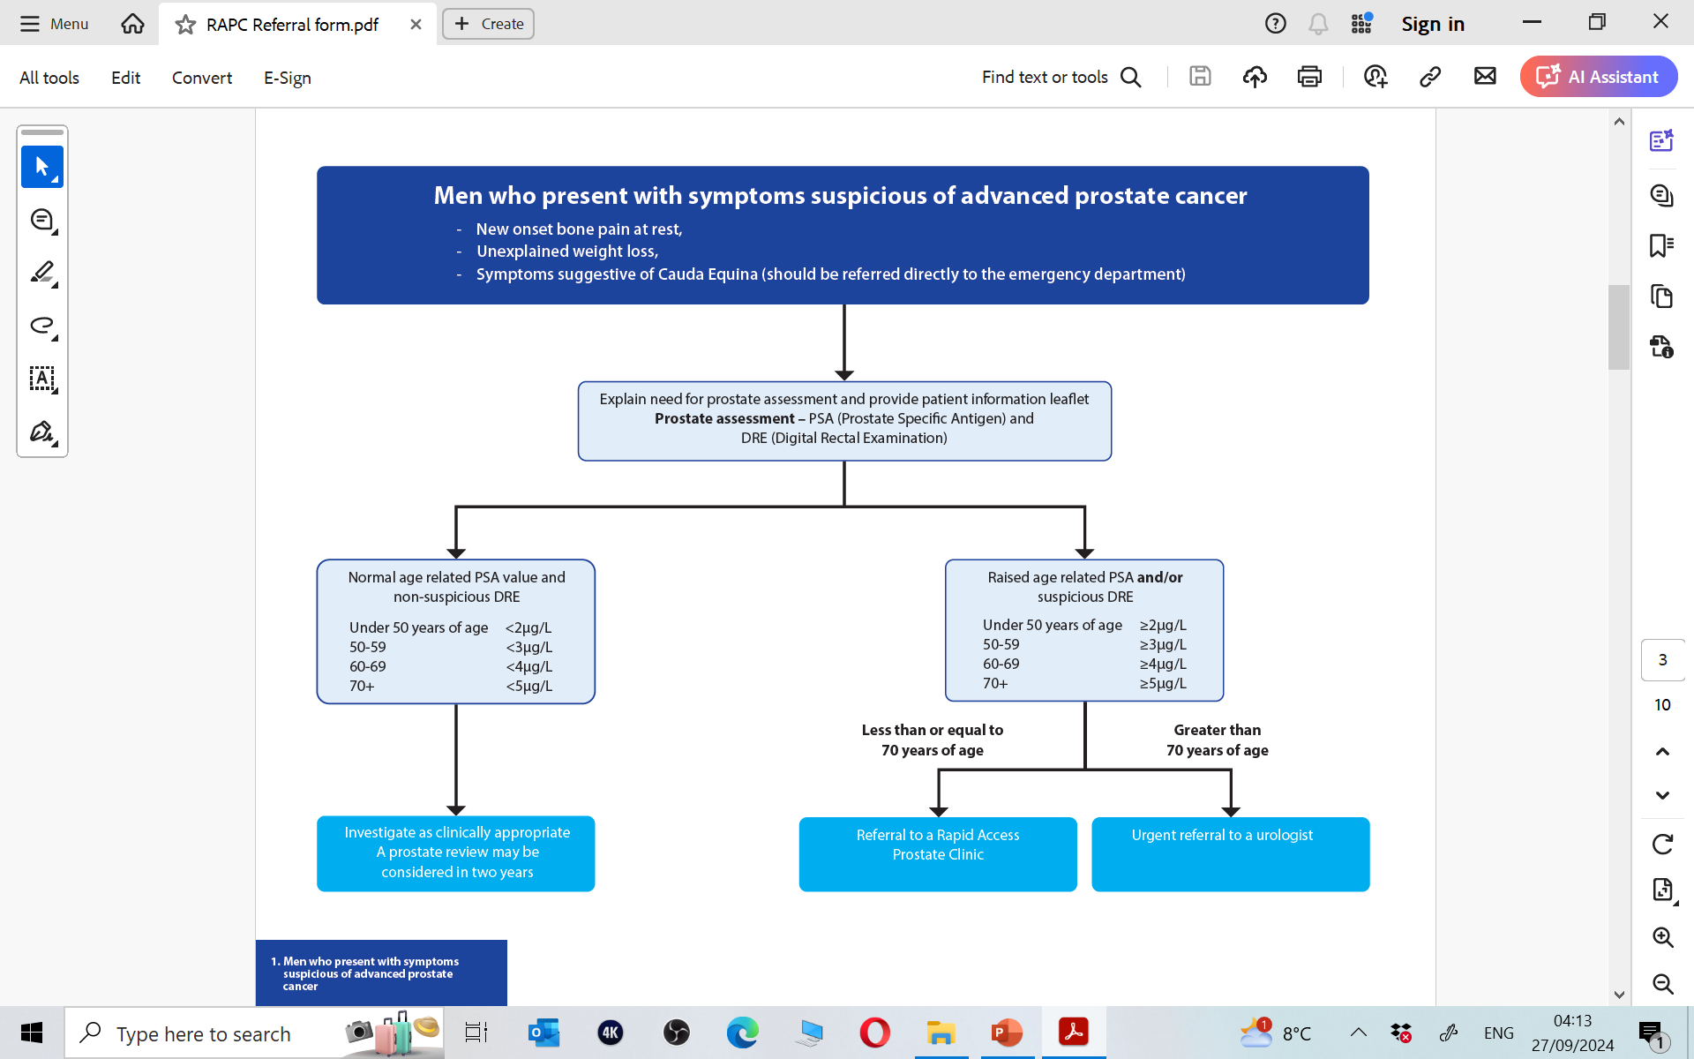
Prostate Cancer- Diagnosis
Clinical suspicion
PSA bloods test and Urine analysis +/- Biomarkers
MRI Prostate and Prostate Biopsy

Slide 5
Beacon Rapid Access Prostate Clinics

Slide 6
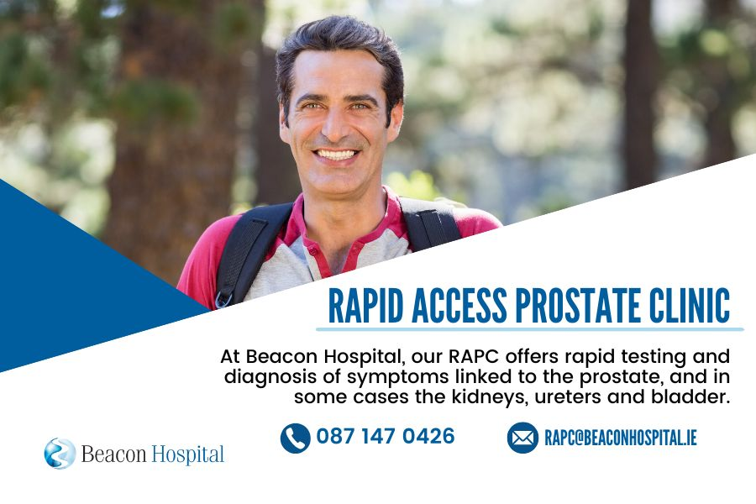
Beacon Rapid Access Prostate Clinics
Launched in 2025
Healthlink RAPC Referral
Patient-Centered Care
Easy Access
Timely Diagnosis & Treatment

Slide 7
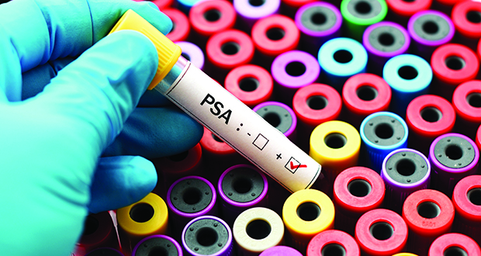
Beacon Rapid Access Prostate Clinics - Referral Criteria
PSA
Digital Rectal Examination
Rapidly rising PSA Kinetics
Strong family history
Clinical concern

Slide 8
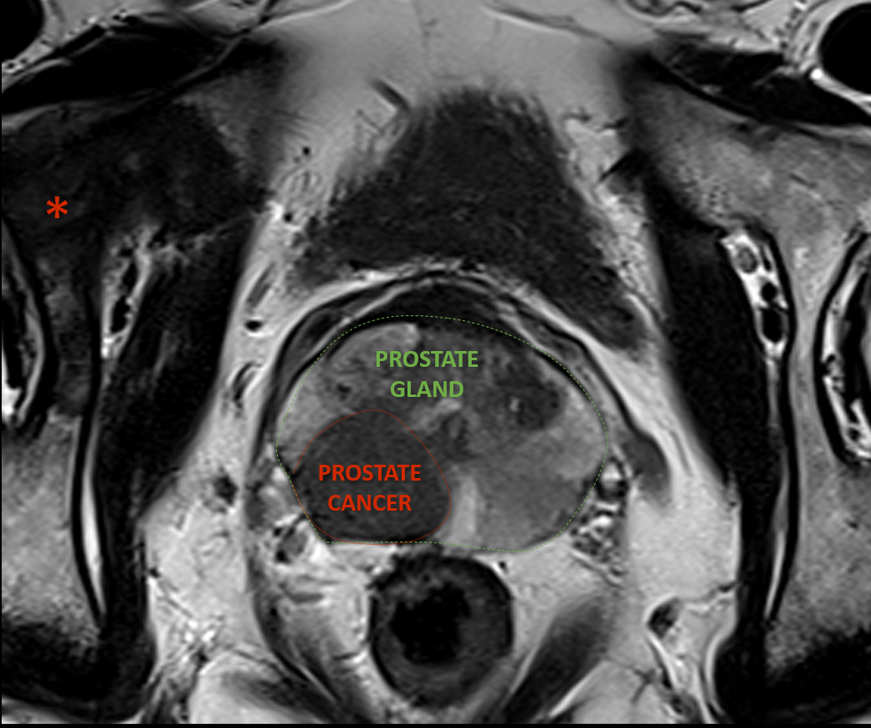
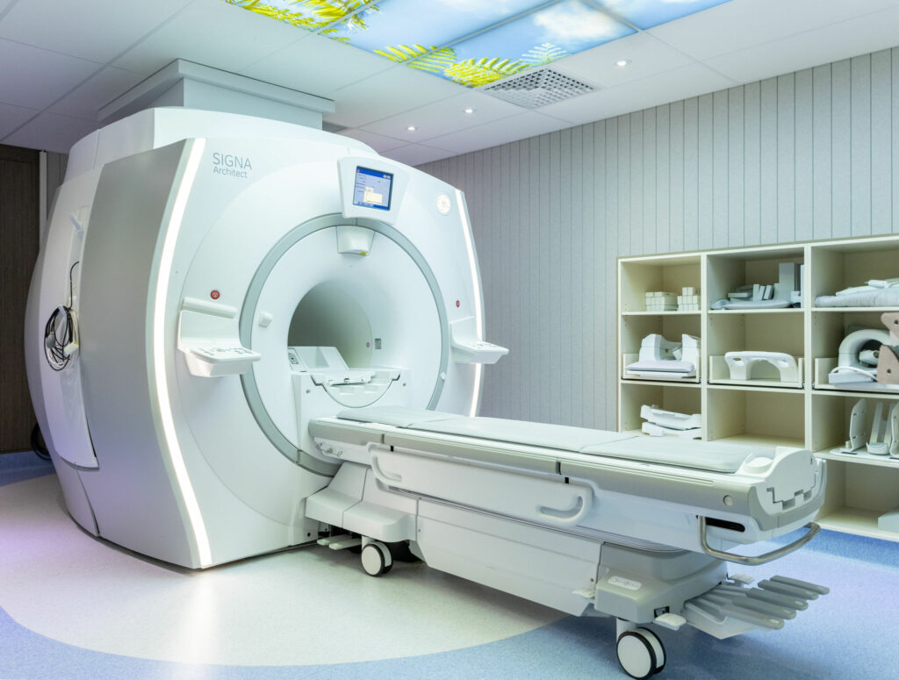
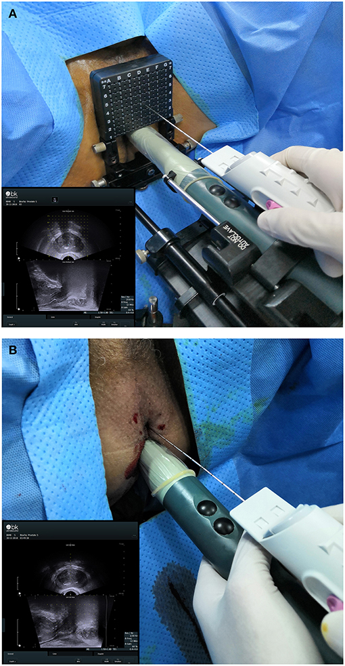
Beacon Rapid Access Prostate Clinics - Pathway progression
Electronic RAPC Referral Triage
Day 0-3
RAPC Nurse Telephone Clinic
Day 3-7
Consultation with MRI results
Day <10
Prostate Biopsy Results
Day <14
MDT and Diagnosis
Day <28
Treatment
Day <62

Slide 9
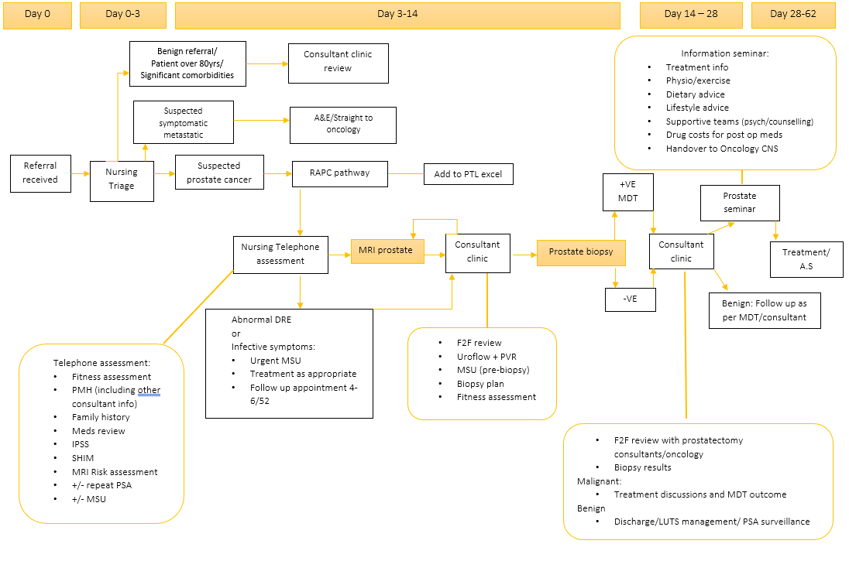

Slide 10
Focal Therapy- High Intensity Focused Ultrasound (HIFU)

Slide 11
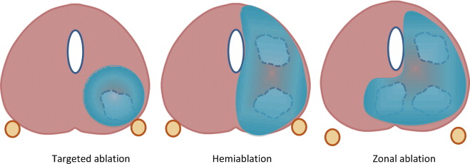
Focal Therapy- High Intensity Focused Ultrasound (HIFU)
Minimally Invasive Surgical Treatment for prostate cancer
Treat only areas of the prostate gland with proven cancer and preserve remaining of prostate tissue

Slide 12

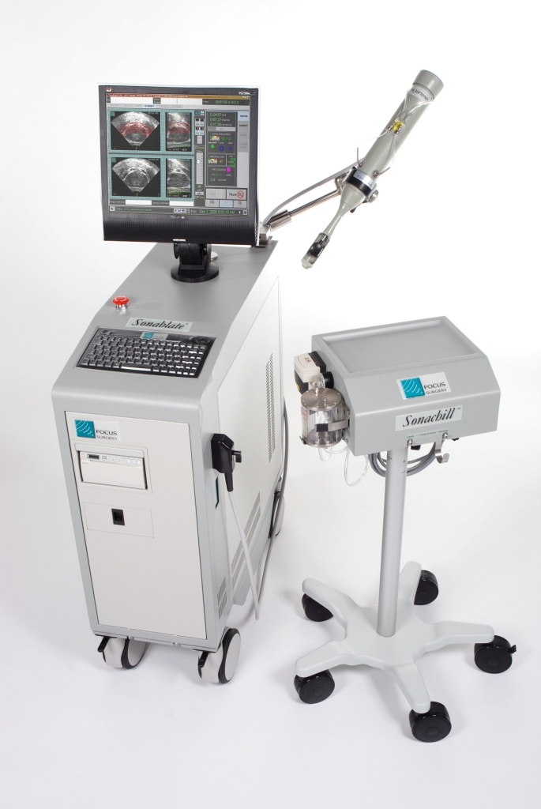
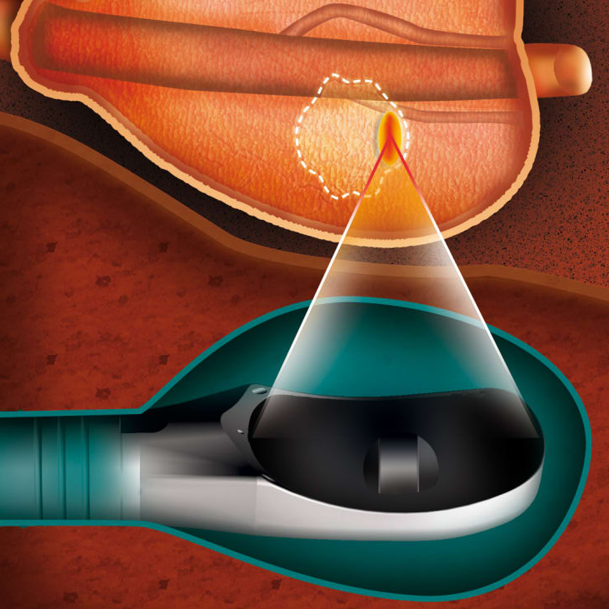
Focal Therapy- High Intensity Focused Ultrasound (HIFU)
Delivery of high intensity ultrasound energy- Lead to a Rapid rise in intracellular temperature and thus leading to instant cell death, while preserving surrounding tissues

Slide 13
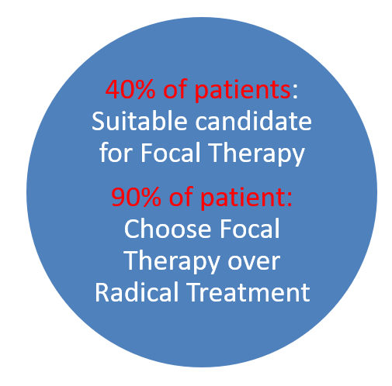
Focal Therapy- High Intensity Focused Ultrasound (HIFU)
Clinical
PSA </=20ng/ml
Radiological T3aN0M0
Lesion no more than one quadrant on MRI
Histology
Gleason 7 (4+3 or 3+4)
Maximal Gleason 4+4 on targeted biopsies
provided lesion is Gleason 7 is permitted
Gleason 3+3=6 if >/=6mm and MRI lesion 3, 4 or 5

Slide 14
Focal Therapy cases at Beacon Hospital
Mean Age | 66 years
Average PSA level | 7.5
Mean Prostate Volume | 37.5 cc
Gleason Grade - Intermediate Risk Gleason 7 | 100 %
Disease Location Unilateral Gleason 7 Contralateral Gleason 6 | 68 % 32 %
MRI Stage - T2 - T3a | 89 % 11 %
37 cases completed successfully over last 22 months
Complication Rate- 5%
Cystoscopy and TUR of Necrotic tissue for LUTS and Epididymitis
UTI/Epididymitis- Required IV Antibiotics

Slide 15
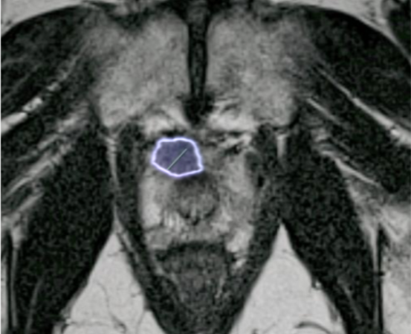
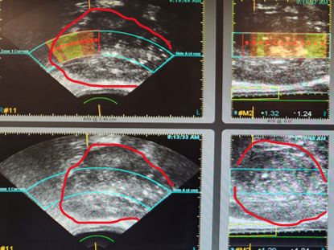
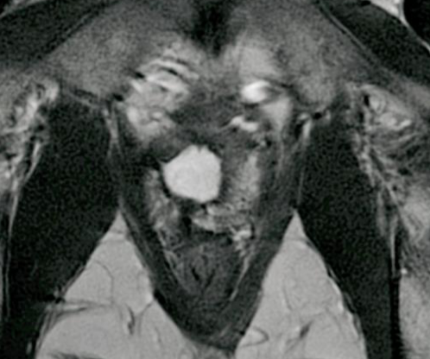
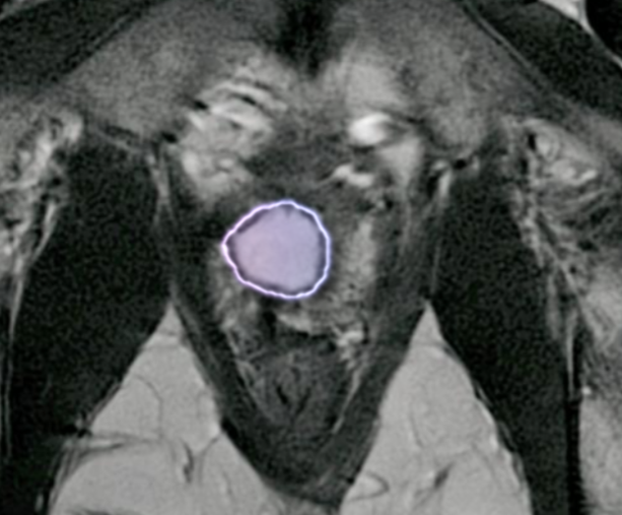
HIFU cases performed at Beacon Hospital
Case 1
57 years old
PSA 5.7; DRE: cT1c
MRI:10mm PI-RADS 4 lesion Right Anterior Apical
Histopathology:
Right Anterior Apex Target: 3/6 cores; G 3+4; 95% core involvement; MCL 5mm
Ablation: Right Extended Quadrant

Slide 16
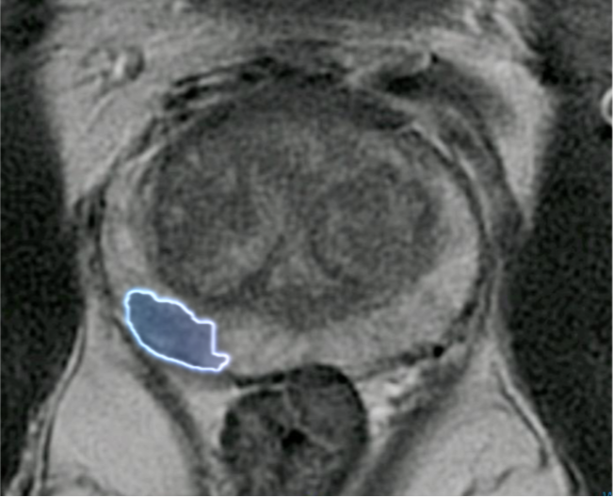
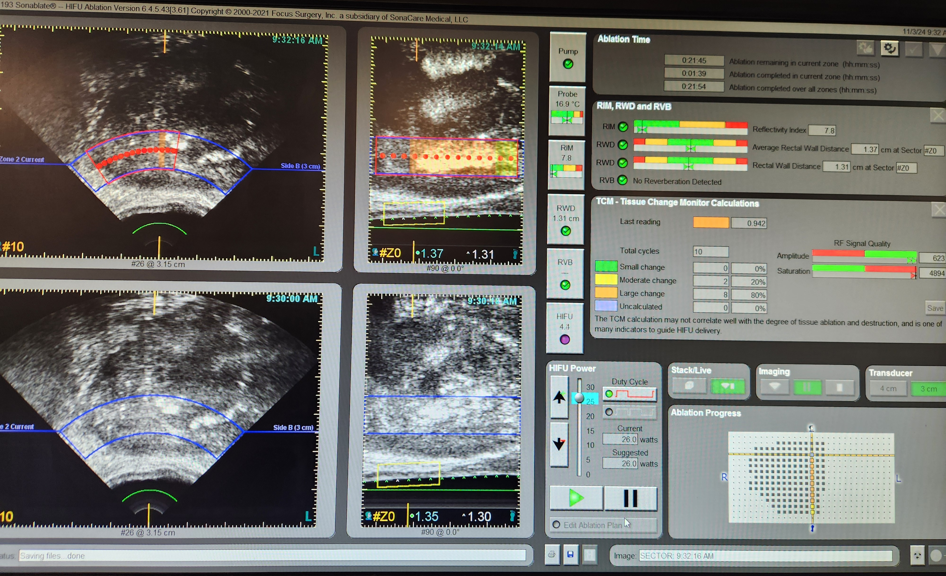
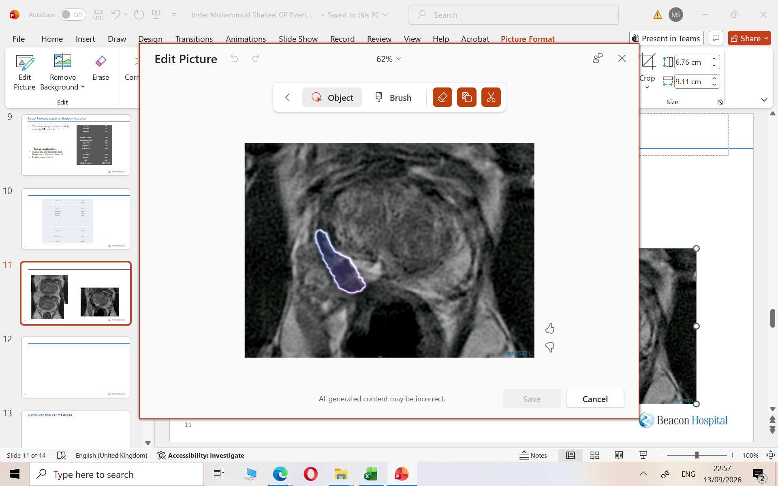
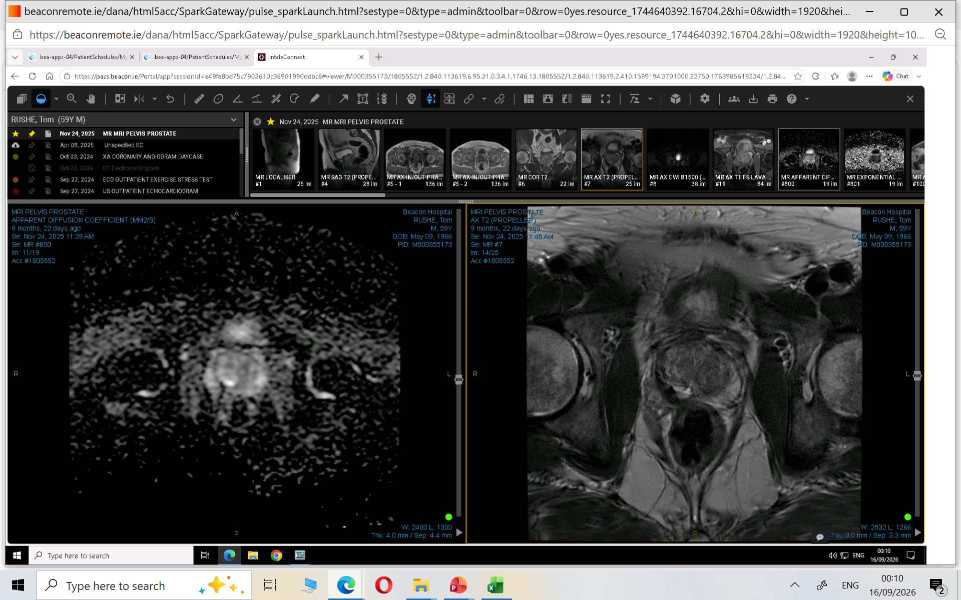
HIFU cases performed at Beacon Hospital
Case 2
58 years old Male
PSA 4.9; DRE: cT1c
MRI:11mm PIRADS 4 Nodule Right PZ Posterior MG
Histopathology:
Right Anterior (Apex): 2/2 cores; G 3+3; MCL 4mm
Right Posterior (Base): 3/6 cores; G 3+4; MCL 10mm
Ablation: Right Hemiablation

Slide 17
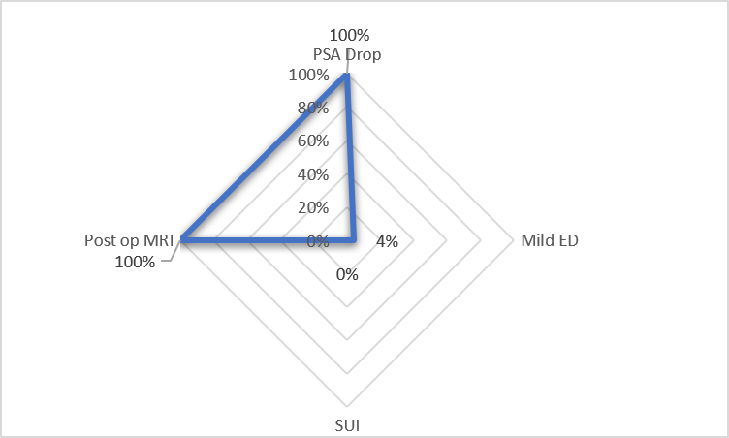
Focal Therapy- Prospective Data

Slide 18
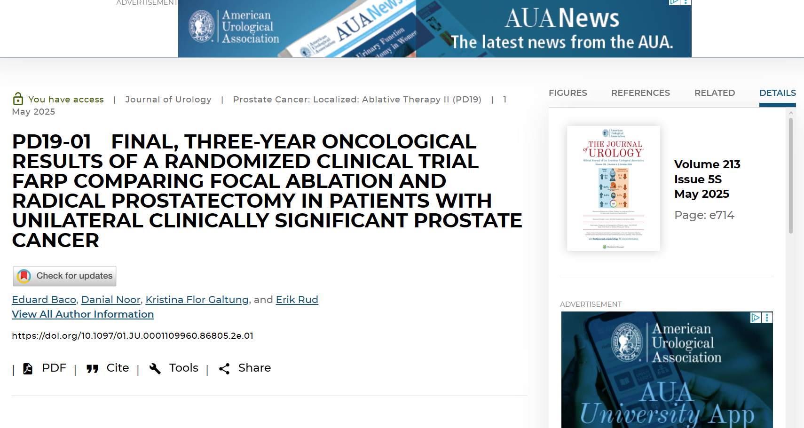
Focal Therapy- Up to Date Evidence
Oslo FARP Trial
Focal Ablation vs Radical Prostatectomy
RCT- Preliminary 3 years outcome
Baco et al. Journal of Urology 2025

Slide 19
Focal Therapy- Up to Date Evidence- FARP Trial
Randomized controlled, non-inferiority trial
213 patients
Unilateral clinically-significant prostate cancer
3 years Treatment Free Failure Rate
93.5%
Focal Ablation
Treatment Failure-Free
5.6–7.5%
Focal Ablation
Treatment Failure Rate
91.5%
Radical Prostatectomy
Treatment Failure-Free
6.0–7.9%
Radical Prostatectomy
Treatment Failure Rate

Slide 20
Focal Therapy- Up to Date Evidence- FARP Trial
Oncological Control:
✓ Equivalent oncologic control at 3 years between arms
✓ Treatment failure:
7.5% (FA) vs 6% (RP)
Not statistically different
Functional Outcomes:
✓ Better urinary continence (pad-free rates significantly higher)
✓ Better erectile function preservation
✓ Optimal trifecta outcomes in FA arm
Patient Preference:
✓ 25% refused radical surgery after RP randomization
✓ Opted for focal ablation instead
✓ Highlights strong preference for organ-sparing approaches

Slide 21
Focal Therapy- Up to Date Evidence- FARP Trial
Level 1 evidence from RCT validates focal ablation
FT is Oncologically Non-Inferior to RP at 3 years
Supports focal ablation for men who prioritize:
- Functional preservation
- Without compromising medium-term cancer control

Slide 22
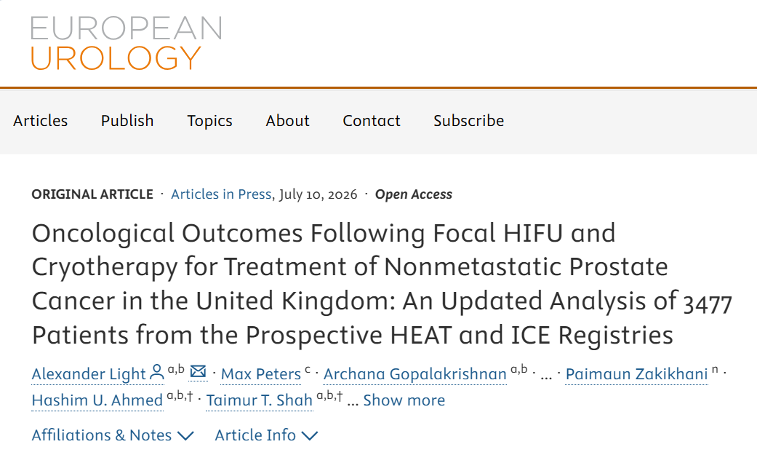
Focal Therapy- Up to Date Evidence - 10 years Outcome Focal HIFU and Cryotherapy
Updated analysis of 3477 patients from HEAT and ICE Registries UK
Largest long-term analysis of focal therapy for prostate cancer
3,477 patients from 14 UK centres (2004–2024)
Two prospective national registries:
- HEAT: High-intensity focused ultrasound (HIFU)
- ICE: Cryotherapy
Follow-up: up to 10 years
Published in European Urology, July 2026

Slide 23
Focal Therapy- Up to Date Evidence - 10 years Outcome Focal HIFU and Cryotherapy
3,477 Men
- Focal HIFU: 2,891 patients (83%)
- Focal Cryotherapy: 580 patients (17%)
Risk Stratification: (LR:IR:HR = 4%: 71% : 25%)
Favourable intermediate-risk: 48.2%
Unfavourable intermediate-risk: 22.7%
High-risk: 24.8%
99.9%
Cancer-Specific Survival
96.7%
Metastasis-Free Survival
0.13%
Cancer-Specific Mortality
12%
All-Cause Mortality

Slide 24
Focal Therapy- Up to Date Evidence - 10 years Outcome Focal HIFU and Cryotherapy
Per-Protocol* (10-year)
Local retreatment: → 13% (up to 2 focal sessions)
Radical treatment: → 8.9%
Key Insight: Organ preservation is a strategy, not a single procedure
Better reflects outcomes for patients committed to focal therapy pathway

Slide 25
Focal Therapy- Up to Date Evidence - 10 years Outcome Focal HIFU and Cryotherapy
✓ Functional outcomes superior to radical treatments:
  - Better urinary continence
  - Better erectile function
  - Faster recovery
✓ 10-year cancer-specific survival: 99.9%
✓ 10-year metastasis-free survival: 96.7%
✓ Durable oncological control and Better functional outcome
✓ Should be considered first-line option alongside radical treatments
✓ Era of calling focal therapy 'experimental' is ending

Slide 26
Conclusion
Prostate Cancer
Increasing Number of patients diagnosed on a yearly basis
Early assessment leads to treatment with curative Intent
Beacon Focal Therapy Unit
Advanced diagnostic tools
Expert Counselling
Bespoke management
Focal HIFU:
Non-Inferior Oncological Control
Better Functional outcome
Beacon Rapid Access Prostate Clinics
Patient-Centered Care
Streamlined Referral and Access
Prompt Investigations, Timely Diagnosis & Treatment

Slide 27
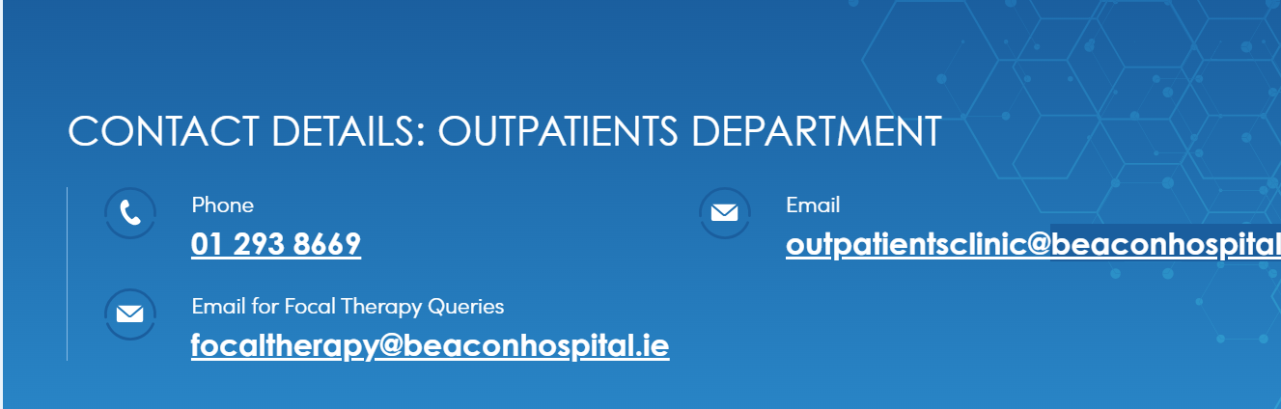
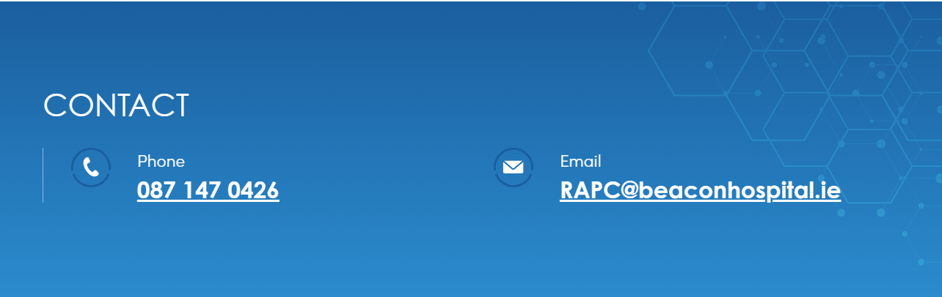
Beacon Focal Therapy and Rapid Access Prostate Clinics - Key information
✓ Functional outcomes superior to radical treatments:
  - Better urinary continence
  - Better erectile function
  - Faster recovery
Focaltherapy@beaconhospital.ie
A referral letter (GP or Urologist)
MRI report
Prostate Biopsy Pathology report
Details of hospital where MRI and biopsy were performed
RAPC@beaconhospital.ie
RAPC Nurse- Ms Claire McNally
Healthlink referral from GP

Slide 28
Thank you

