Slide 1
Polyendocrine Metabolic Ovarian Syndrome
A Gynaecological Perspective
Mr Kelvin Boos, Consultant Gynaecologist
FRCS(Eng) FRCPI FRCOG MD MSc(Med Law) MSc(Oxf) MSt(Cam)

Slide 2
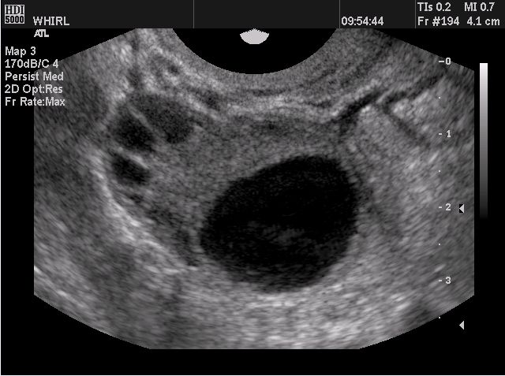
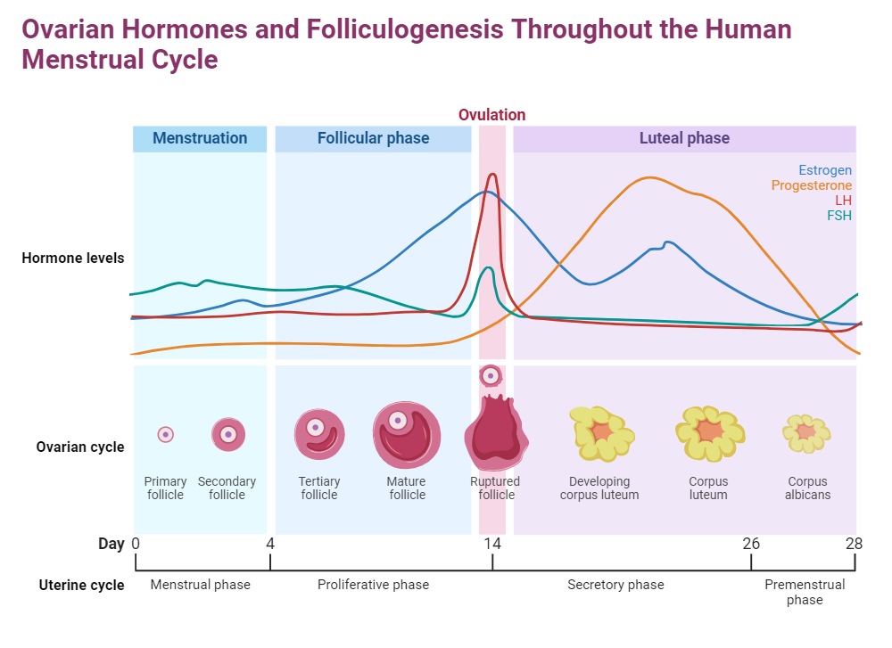
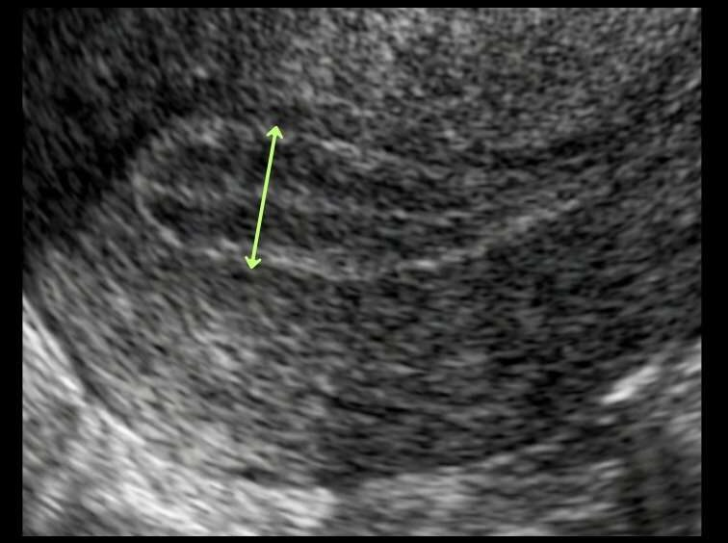
Normal ovarian function
Precise ovarian activity
Reproductive function
Normal development of follicles
Oestrogen dominance in follicular fluid
(99% Oestrogen v 1% Testosterone)
Endometrium primed by systematic ovarian hormonal activity
RESULT
Regular menstrual cycle & ovulation
Normal menstrual bleeding
Systemic hormonal homeostasis
“ I feel balanced ”

Slide 3
Polyendocrine Metabolic Ovarian Syndrome - A Gynaecological perspective
A ’spell’ is cast on the ovary – PMOS
Extremes of
Body Mass Index
Exercise
Stress
Cause unknown – Relatively normal BMI
In clinical practice
Elevated BMI
Normal BMI
Exercise and stress are transient and not sustained

Slide 4
Polyendocrine Metabolic Ovarian Syndrome - A Gynaecological perspective
Polyendocrine Metabolic effect
Raised BMI
Pancreas
Elevated Insulin levels
Cellular fatigue
Cellular ‘Insulin resistance’
Chronic long-term Hyperinsulinaemia (HIA)
Liver
Lowers SHBG - increases bioavailable androgens
Inhibit ovulation
Peripheral androgen effects – Hirsutism, Acne, Thin Hair
Pituitary
Suppress FSH
Arrests follicular development
Inhibit ovulation

Slide 5
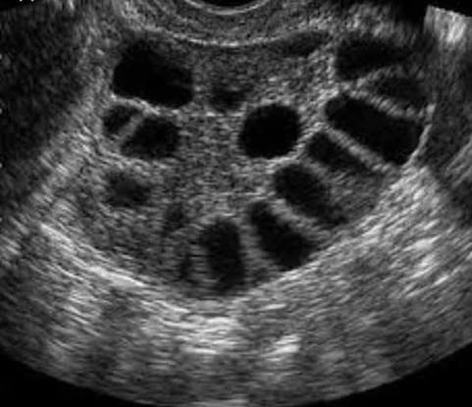
Polyendocrine Metabolic Ovarian Syndrome - A Gynaecological perspective
Ovary - arrested follicular development
Stimulates more follicles to join to compensate – Poly-follicle ovary
Increased pool of androgens in ovary
Threatens oestrogen dominance
Androgens leak into systemic circulation
  Inhibit ovulation
  Peripheral androgen effects
  Hirsutism, acne, thin hair

Slide 6
Polyendocrine Metabolic Ovarian Syndrome - A Gynaecological perspective
Uterus
Impaired ovarian precision – disordered progesterone priming of endometrium
Additional Adipose - potent source of oestrogen
  Stimulate polypoid endometrial growth
  Abnormal endometrial architecture
  Excessive abnormal spiral arterioles
  Endometrial hyperplasia
Result
  Abnormal uterine bleeding
  Embryo implantation failure
  (30% - 50% early miscarriage rates)
  Precancer cells

Slide 7
Polyendocrine Metabolic Ovarian Syndrome - A Gynaecological perspective
Effect on the individual woman
Impaired equipoise of all ovarian hormonal activity – levels, cadence, flow, patterns, pulses, tempo and rhythms
Every cell in the body reacts abnormally to a variable degree
Hormonal milieu and homeostasis disturbed
Failure of balance and equilibrium
“ I do not feel right doctor ”

Slide 8
Polyendocrine Metabolic Ovarian Syndrome - A Gynaecological perspective
Management
Based upon desire for fertility
If Desires fertility
Weight loss program
Ovulation induction agents
  Normal BMI – Clomid
  Raised BMI (chronic HIA) – Metformin
  Metformin
  Reverses HIA
  Increases Luteal phase serum Glycodelin
  Increase Insulin like growth factors on endometrium
  Improves endometrial function and receptivity
  Improves embryo implantation
  Improves later Feto-maternal interface

Slide 9
Polyendocrine Metabolic Ovarian Syndrome - A Gynaecological perspective
Management
Based upon Desire for fertility
Does not desire fertility
No treatment
Weight loss program
COC – Binds excess androgens
Metformin - Raised BMI (chronic HIA) or normal BMI

Slide 10
Polyendocrine Metabolic Ovarian Syndrome - A Gynaecological perspective
Weight loss with GLP 1 – Receptor Agonists
Metabolic therapies
Reduces insulin resistance
Improves chronic HIA
Appetite suppression
Improves metabolic response to exercise
Promotes Ovulation
By inference will reverse Androgen effects
By inference will promote fertility – ‘Ozempic babies’

Slide 11
Polyendocrine Metabolic Ovarian Syndrome - A Gynaecological perspective
Weight loss with GLP 1 – Receptor Agonists Metabolic Therapies
Controversies
Promotes Ovulation – uncertain degree
Women on the pill have a significantly increased likelihood of starting GLP-1 Agonist
Side effects of vomiting & diarrhoea may reduce efficacy of ‘pill’
Mounjaro may interact unfavourably with ‘pill’
  Unplanned pregnancies
  Difficult contraceptive planning if no desire for fertility
No clear evidence of:
Efficacy as an ovulation induction agent
Fetal wellbeing as an ovulation induction agent
Fetal wellbeing if used with Metformin or Clomid
Best to promote weight loss first then TTC?

Slide 12
Polyendocrine Metabolic Ovarian Syndrome - A Gynaecological perspective
Summary
Elevated BMI – Scale of chronic HIA and Polyendocrine metabolic dysfunction
Variable inhibition of ovulation and elevation of Androgens
Desires fertility (Ovulation induction)
Weight loss Metformin
Clomid
Does not desire fertility
Weight loss Metformin (But will induce ovulation so may need contraception)
COC
GLP-1 Receptor Agonists
Highly effective in weight loss
Research not yet available to clarify its place in PMOS & ovulation induction

Slide 13

Thank you

Slide 14
Thank you

