Slide 1
Bowel Cancer in Primary Care: Risk, Recognition & Referral
Mr James O’Riordan, Consultant General & Colorectal Surgeon
Saturday, 19th September 2026

Slide 2
Colorectal Cancer in Ireland
2nd most common cancer in men and 3rd in women
>2,500 cases diagnosed each year
1,500 men / 1,000 women
12.2% of all invasive cancers diagnosed
11.8% of cancer deaths
>90% over the age of 50 at diagnosis
20% of patients are still diagnosed at late stage
Overall 5-year survival rate is 62.6% (National Cancer Registry 2017)

Slide 3

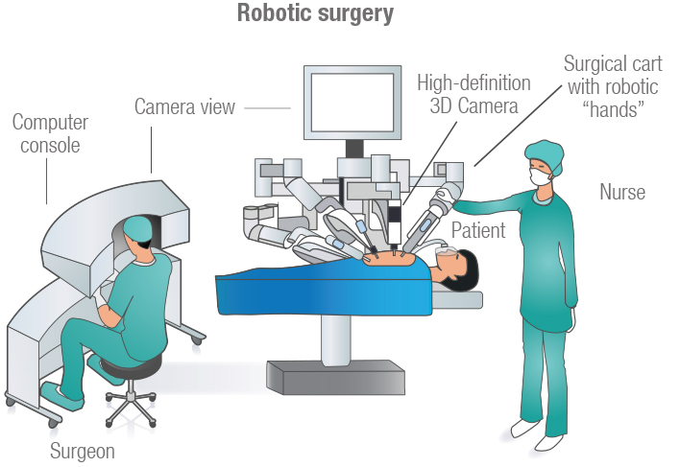
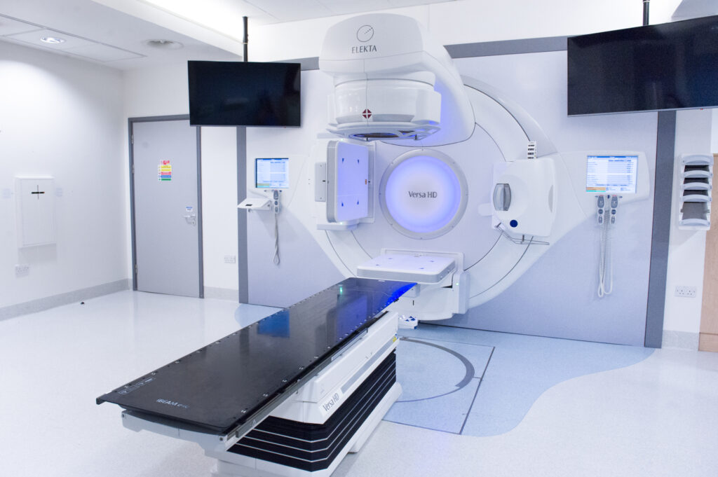
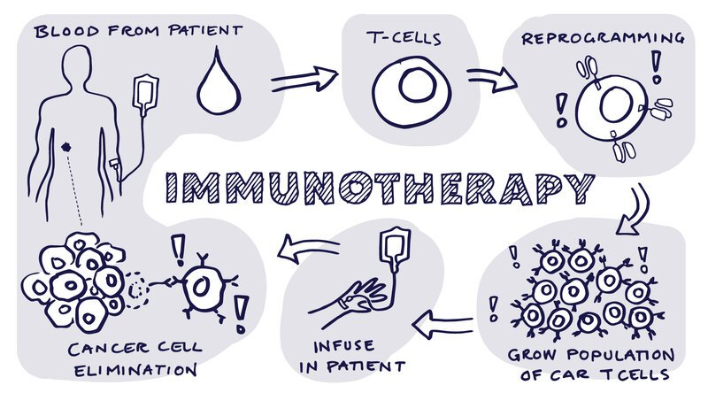
Notes:
Major advances in the treatment of patients who are diagnosed with colorectal cancer. Technological advances in Surgery but also in radiation oncology, medical oncology and we have improvements in diagnostic imaging also. But patients still have improved survival if diagnosed at an earlier stage.

Slide 4
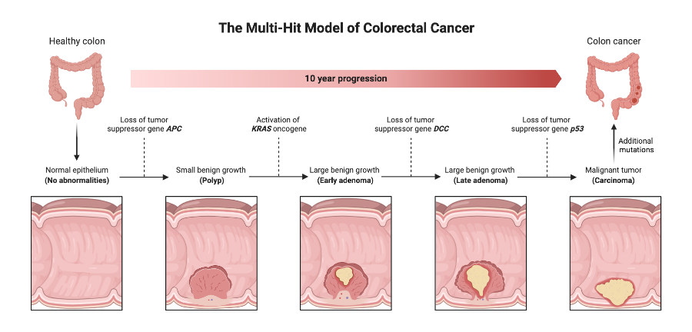

Slide 5
Risk Factors for Colorectal Cancer
Lifestyle Factors
Poor diet
Sedentary lifestyle
Obesity
Smoking
Heavy alcohol intake
Medical History
Age
Adenomatous polyps
Previous CRC
IBD
Type 2 DM
Family history of CRC
Inherited syndromes e.g. FAP, HNPCC
Notes:
Who is high risk ? Long standing ulcerative colitis/ crohn’s colitis. In terms of family history – first degree relative with CRC, particularly young age at diagnosis, multiple affected relatives. Risk factors modify the threshold for investigation – but they don’t replace symptoms.

Slide 6
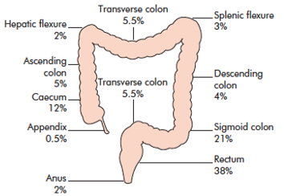
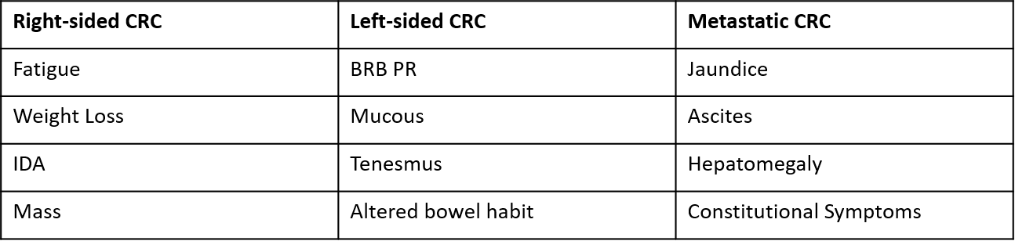
CRC RFs & PC
2nd most common cause of cancer death in men & women
Risk Factors include
  Age
  Pre-existing polyps
  Familial Hx (increased risk if first-degree relative)
  Genetics (Lynch syndrome, FAP, AFAP, MAP, PJS, JPS etc.)
  Chronic inflammation (UC/CD)
  Diet
  Sedentary lifestyle
Notes:
Who is at high risk ? Age increases risk. Symptoms matter more than any single risk factor. A normal examination does not exclude CRC

Slide 7
Who needs investigation – how can we make the referral work ?
Case 1:
63 yr old male
3 month history of altered bowel habits
Hb 10.7g/dl
Ferritin low
Examination unremarkable
Case 2:
38 yr old female
4 day hx
Bloody diarrhoea
No weight loss or anaemia and otherwise well.
Case 3:
46 yr old
“Haemorrhoids”
6/12 Hx rectal bleeding
New altered bowel habit
Family history CRC.
Notes:
The purpose of this talk is not to teach you how to diagnose colorectal cancer. It’s to make the decision to refer easier – and hopefully make the referral more useful and it has all the information when it arrives to us.

Slide 8

Indications for Colonoscopy

Slide 9


Slide 10
KPI’s for Colonoscopy
Caecal intubation rate
Polyp detection rate/SSL
Adenoma detection rate
Complication rate
Bowel prep quality
Withdrawal time
Comfort score
Sedation levels
J manoeuvre rectum
Patient satisfaction

Slide 11
Lower GI Endoscopy
Precious resource
Increasing population
Increasing number of patients
How to manage ?
How to prioritise?
How to triage ?

Slide 12
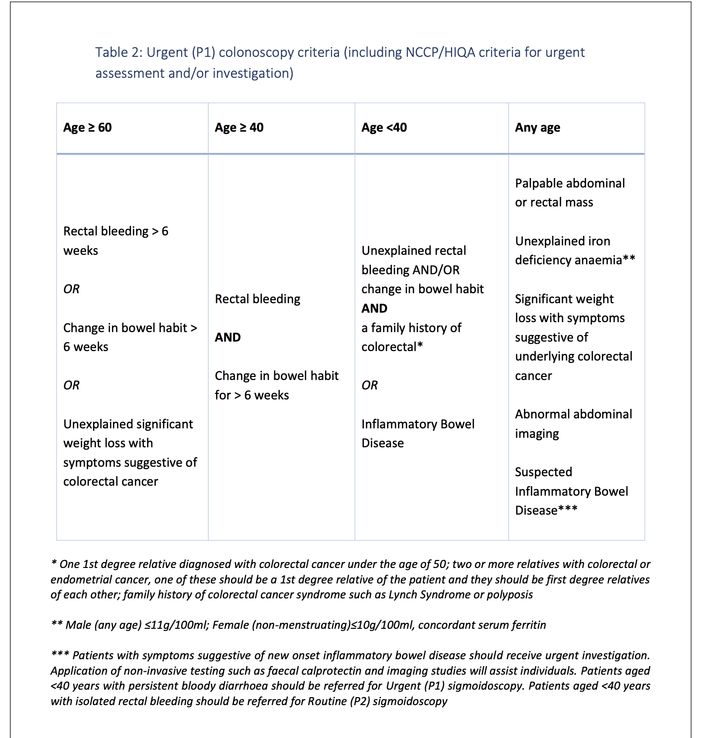

Slide 13
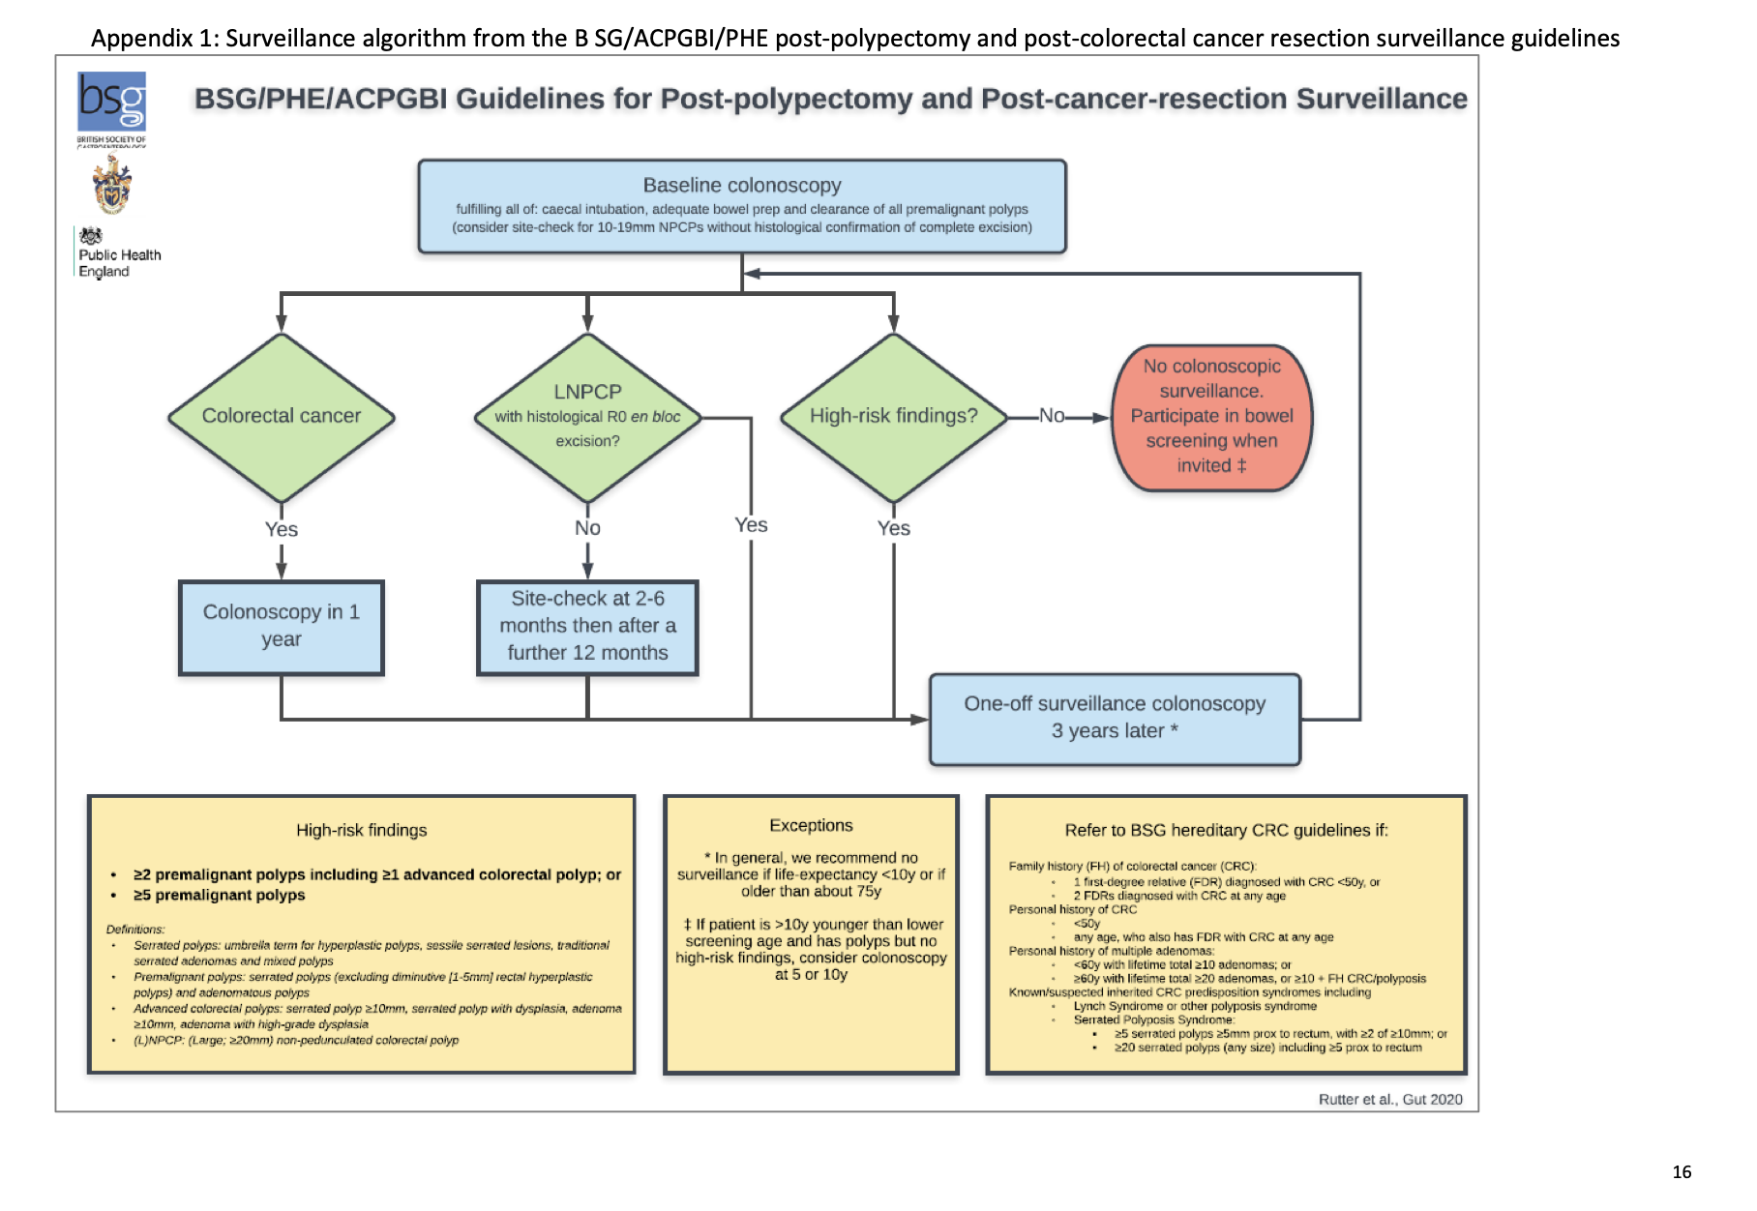

Slide 14
Red flags for Colorectal Cancer
Rectal bleeding
Change in bowel habits
Iron deficiency anaemia
Weight loss
Abdominal /rectal mass
Persistent unexplained abdominal symptoms
It’s the combination of symptoms & persistence that should concern

Slide 15
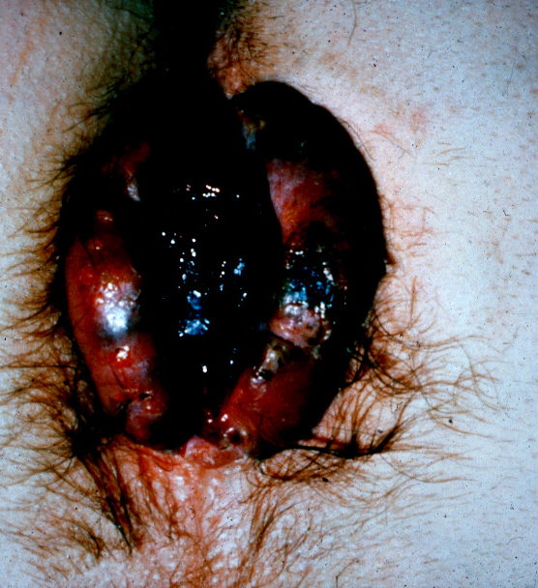
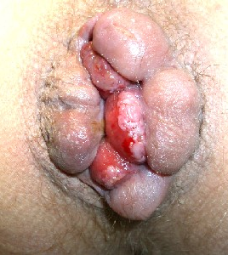
Hemorrhoids

Slide 16
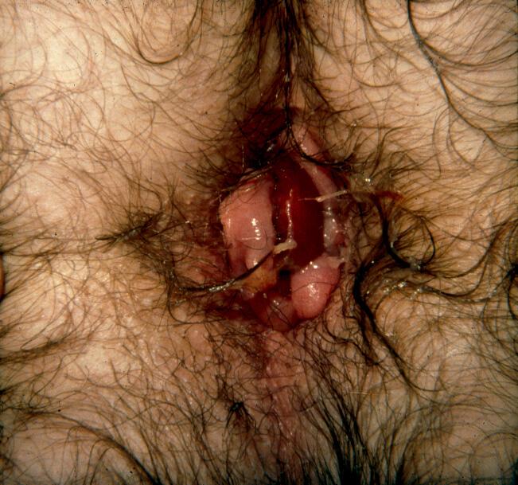
Hemorrhoids are serious business
Diagnostic Errors
Innocent bystanders
Patient Dissatisfaction
Pain
Complications
Incomplete symptom control
Recurrent symptoms
Notes:
Both under and over treatment can be the cause of significant patient disatisfaction.

Slide 17
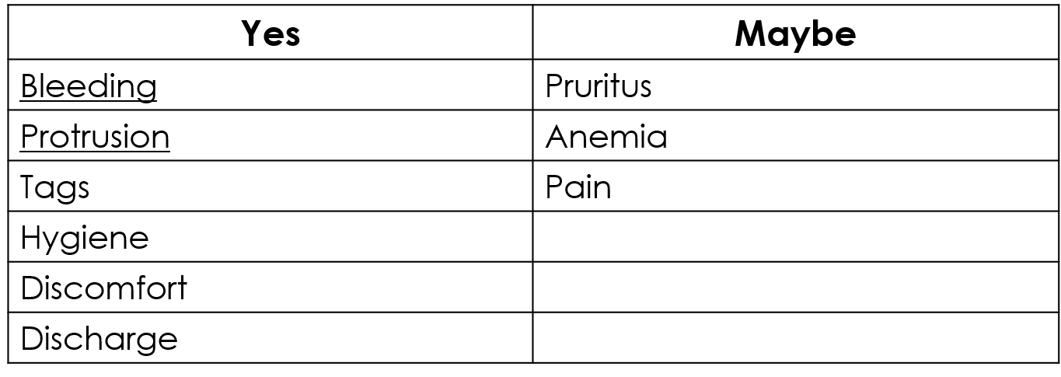
Hemorrhoidal disease: history
GI enquiry (increased bowel habits, abdominal pain, mucus, urgency, tenesmus)
Family history (IBD, CRC)
Coagulation and immunologic status

Slide 18
Blood per rectum
Investigate liberally
Haemorrhoids do not exclude proximal pathology
Selective non-investigation?
  Under 40
  No other symptoms
  Exclusively bright red blood
  Typical findings on examination
  No personal or family history of CRC or IBD
  Symptom responds to treatment
Notes:
Don’t let an alternative diagnosis explain away a red flag

Slide 19

Before referral
History
Bowel habit change/duration?
Bleeding ? Dark ? BRBPR
Weight loss. Pain
Appetite
Family history
Previous colonoscopy
Previous polyps/cancer/IBD
Examination and Bloods
Abdomen
DRE
FBC
Ferritin/iron studies where appropriate
No tumour markers/CEA pls !
Notes:
The national NCCP pathway states that FBC should be performed before referral, while imaging is not routinely required.

Slide 20

FIT Testing
National bowel screening program
Aged 58-70
Home test every 2 years
Free
Tests for blood in stool
FIT based
Not 100% sensitive
If +VE patient is referred for colonoscopy

Slide 21
Fit Testing in Symptomatic Patients
Useful Triage tool
Not a “rule out” cancer test
Exact pathway depends on local services and HSE arrangements
NICE FIT Study D’Souza et al Br Jr Gen Practice 2019
  Cut off 10µg/g
  Sensitivity for CRC 92.1%
  Specificity for CRC 85.5%
  False negative rate 10%
Probably has a role to triage low/moderate risk symptomatic patient
Notes:
I have colleagues who know a lot more about this than me

Slide 22
Who needs investigation – how can we make the referral work ?
Case 1:
63 yrs Male.
3 month history of altered bowel habit
Hb 10.7g/dl
Ferritin low
Examination unremarkable
Urgent colorectal assessment.
Case 2:
38 yr old female
4 day hx
Bloody diarrhoea
No weight loss, no anaemia and otherwise well.
Not automatically a suspected CRC referral.
Case 3:
46 yr old
“Haemorrhoids”
6/12 Hx rectal bleeding.
New altered bowel habit
Family history CRC.
Don’t be reassured. Investigate !!!

Slide 23

Referral Pathway Beacon
Consultant-led service
JAG Accredited centre
No waiting time
Refer via healthlink or
endoscopyappointments@beaconhospital.ie
01 2938656 or urgent queries 0872553744
Patients contacted within 48hrs for appointment
Age: 18-80 able to tolerate prep and fit for sedation
Reports sent to GP on day of procedure
Notes:
Shameless advertising !

Slide 24
Summary points
Think CRC when bowel habit changes
Beware of haemorrhoids as “innocent bystander”.
Unexplained Fe deficiency anaemia needs Investigation
Do a DRE but if it’s normal patient can still have CRC
CEA not a screening test for CRC.

Slide 25
Thank you

