Slide 1

Interventional Neuroradiology in the Treatment of TIA
Dr Sarah Power
Consultant Diagnostic & Interventional Neuroradiologist
Beacon Brain Institute – Beacon Hospital

Slide 2
Interventional Neuroradiology in the Treatment of TIA
Dr Sarah Power, PhD, MRCPI, FFR(RCSI)
Consultant Diagnostic & Interventional Neuroradiologist
Beacon Brain Institute – Beacon Hospital

Slide 3
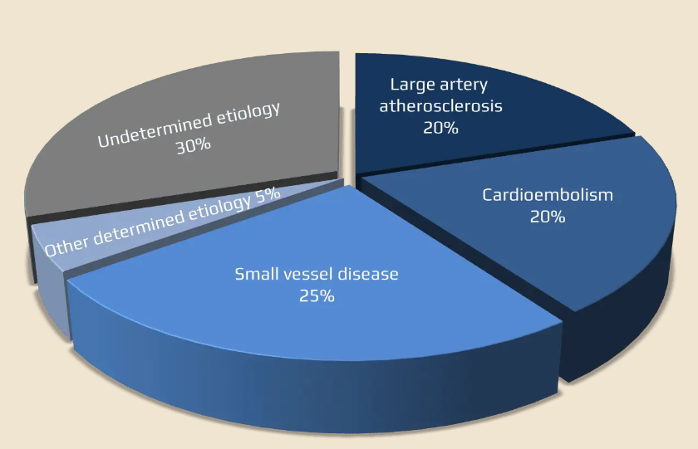

Classification of TIA/Stroke Aetiology
TOAST Classification
Mechanisms:
- Artery to artery embolus
- Large artery blocked
Anterior >>> Posterior
Circulation
TIA from
Carotid artery stenosis
Interventional Neuroradiology
role in secondary prevention

Slide 4
Symptomatic Carotid Stenosis: management following TIA/Stroke
Risk of further TIA/Stroke increases as severity of stenosis increases
European Stroke Organisation Guidelines on management of carotid stenosis:
Symptomatic:
Less than 50% stenosis: Best medical management
50 % - 69% stenosis: Suggest revascularization
70% - 99% stenosis: Recommend revascularization
Time frame:
Greatest risk reduction within two weeks of symptoms
Revascularization:
Carotid endarterectomy (CEA) vs Carotid Stenting (CAS)
Referral Pathway:
TIA clinic; Stroke Physician, Stroke neurologist, Medicine for Elderly,
Vascular surgery

Slide 5
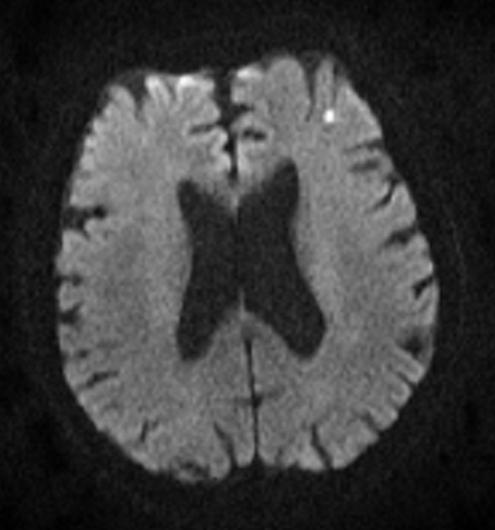
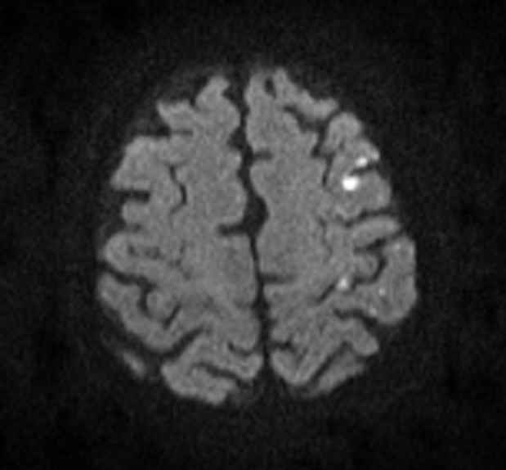
81 yr old male, TIA with right arm weakness which resolved
MRI brain: Diffusion weighted imaging

Slide 6
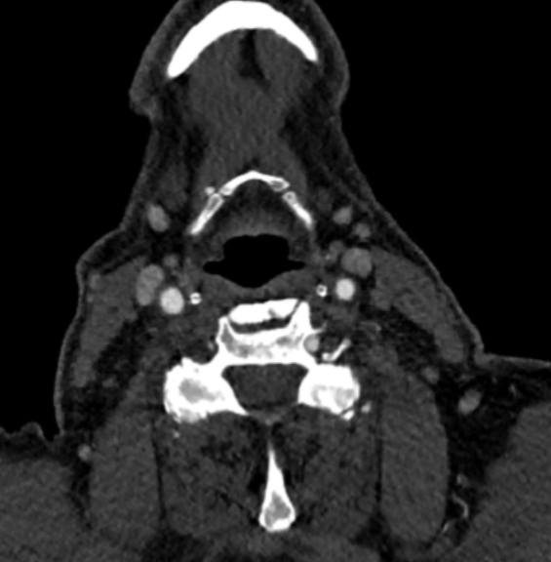
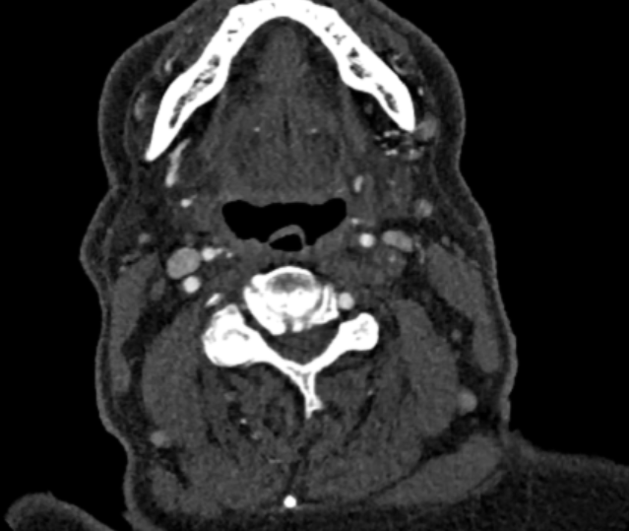
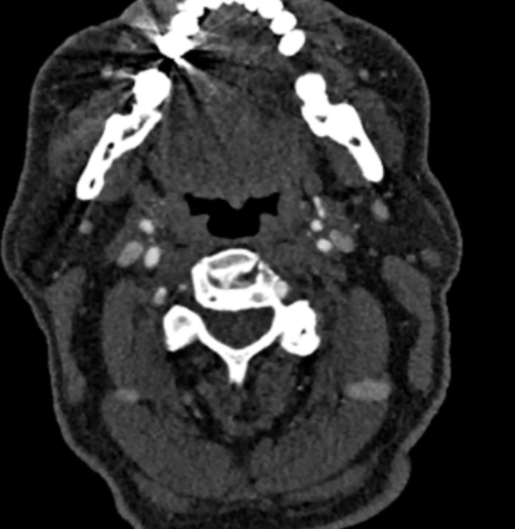
81 yr old male, TIA with right arm weakness which resolved
Carotid ultrasound duplex
CT Angiogram from aortic arch to top of head
MRI Angiogram from aortic arch to circle of Willis
Evaluation for carotid artery stenosis:
R
R
R

Slide 7
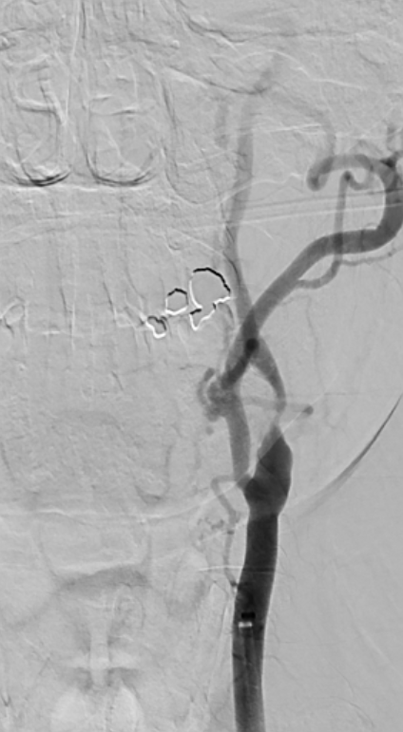
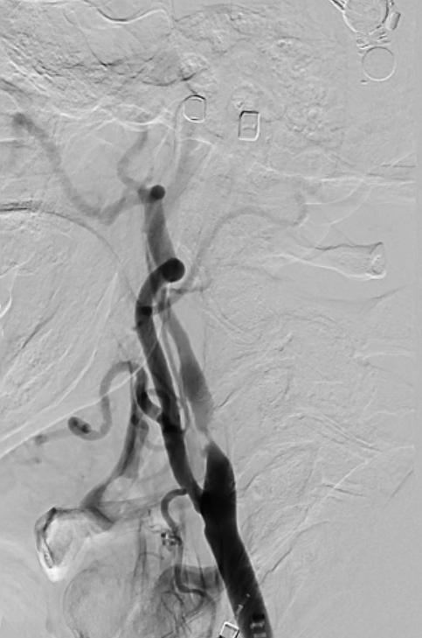
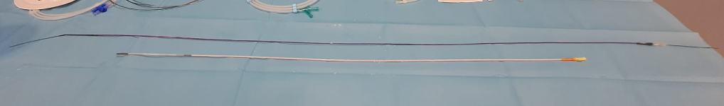
Preload with DAPT:
Aspirin & clopidogrel
Frontal View
Lateral View
Femoral artery access
Right radial artery access
Awake, local anaesthetic
IV heparin
Guide Catheter
8 Fr (0.092 inch)
90 cm length

Slide 8
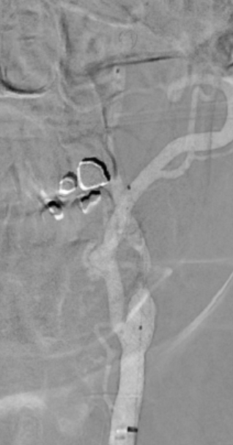
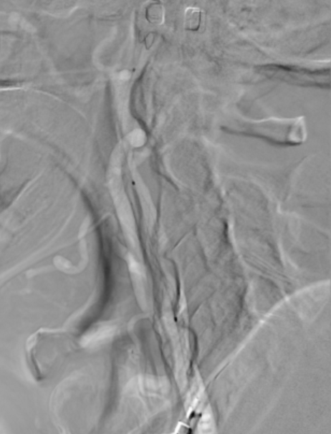
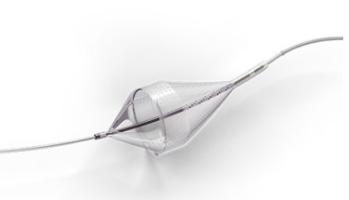
Frontal View
Lateral View
Distal Protection Device
Emboshield NAV6™ Embolic
Protection System
ABBOTT

Slide 9


Slide 10
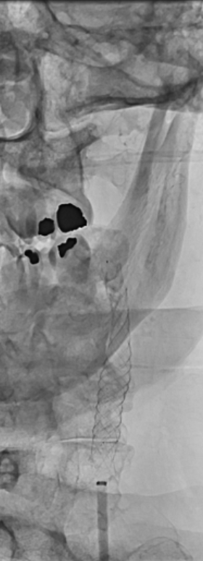
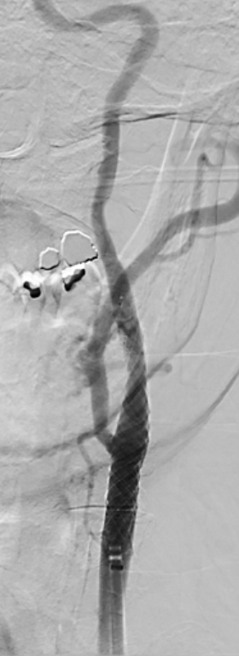
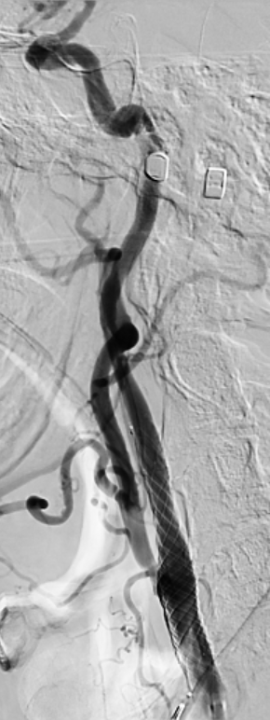
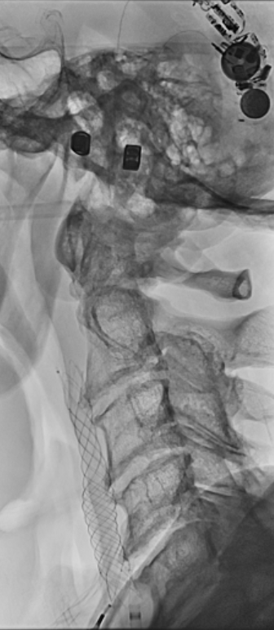
Frontal View
Lateral View
DAPT x 3 months, then aspirin long term

Slide 11
Carotid endarterectomy (CEA) vs Carotid Stenting (CAS)
Which procedure is the better one?
European Stroke Organisation Guidelines on management of carotid stenosis:
CEA gold standard for treatment of carotid stenosis
CAS may be considered in patients <70 yrs old with carotid stenosis ≥ 50 – 99%
Relative contraindications to CEA
“Hostile Neck” (e.g. Prior Neck Radiation)
Contralateral Vocal Cord Paralysis
High Lesions (Above C2 Vertebrae)
Low Lesions (Below Clavicle)
Recurrent Severe Stenosis
High Surgical Risk
Contraindications to CAS
Anaphylaxis to iodinated contrast
Not possible to pass through stenosis

Slide 12
Asymptomatic Carotid Stenosis: management following TIA/Stroke
Risk of TIA/Stroke increases as severity of stenosis increases
European Stroke Organisation Guidelines on management of carotid stenosis:
Asymptomatic:
Recommend CEA if stenosis ≥ 60% - 99% AND patient considered to be at increased stroke risk on best medical management alone

Slide 13
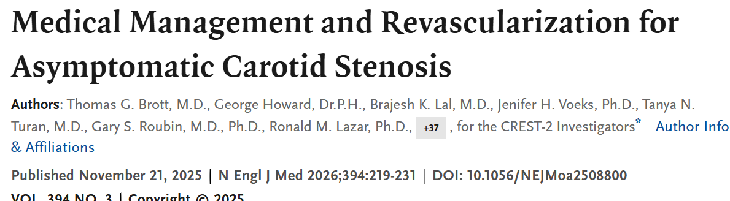
Asymptomatic Carotid Stenosis: management following TIA/Stroke
Asymptomatic high grade carotid stenosis
≥70%
Stenting trial: intensive medical management vs CAS + intensive medical management
Endarterectomy trial: intensive medical management vs CEA + intensive medical management
The addition of stenting led to a lower risk of a composite of perioperative stroke or death or ipsilateral stroke within 4 years than intensive medical management alone
Carotid endarterectomy did not lead to a significant benefit over medical management alone

Slide 14
Summary
Patients with symptomatic carotid stenosis can benefit from carotid revascularization when the degree is stenosis is 50% or greater
Main treatment options are open surgical ECA or minimally invasive carotid stenting
Patients with asymptomatic carotid stenosis can benefit from carotid revascularization if stenosis ≥ 60% AND patient considered to be at increased stroke risk on best medical management alone
- Current guidelines recommend this should be with CEA
- New evidence suggests this should be with carotid stenting

Slide 15
Thank you

