Slide 1
The new name for Polycystic Ovarian Syndrome- PCOS
Polyendocrine Metabolic Ovarian Syndrome- PMOS
Dr. Matilde Mijares Zamuner
Consultant Endocrinologist

Slide 2
What is PMOS? Polyendocrine Metabolic Ovarian Syndrome
PMOS is the most common endocrinopathy in women of reproductive age, affecting 1 in 8 women
PCOS
PMOS
Primarily perceived as a gynecological, fertility or ovarian disorder
PCOS implies the presence of pathological ovarian cysts and reflects only one organ
PCOS is more than a reproductive disorder… it is metabolic
Complex Syndrome: Metabolic, Reproductive, Psychological and Dermatological
Reduces stigma and confusion
PMOS includes multiple interacting endocrine abnormalities
Promotes a more personalised and comprehensive approach
Vs

Slide 3
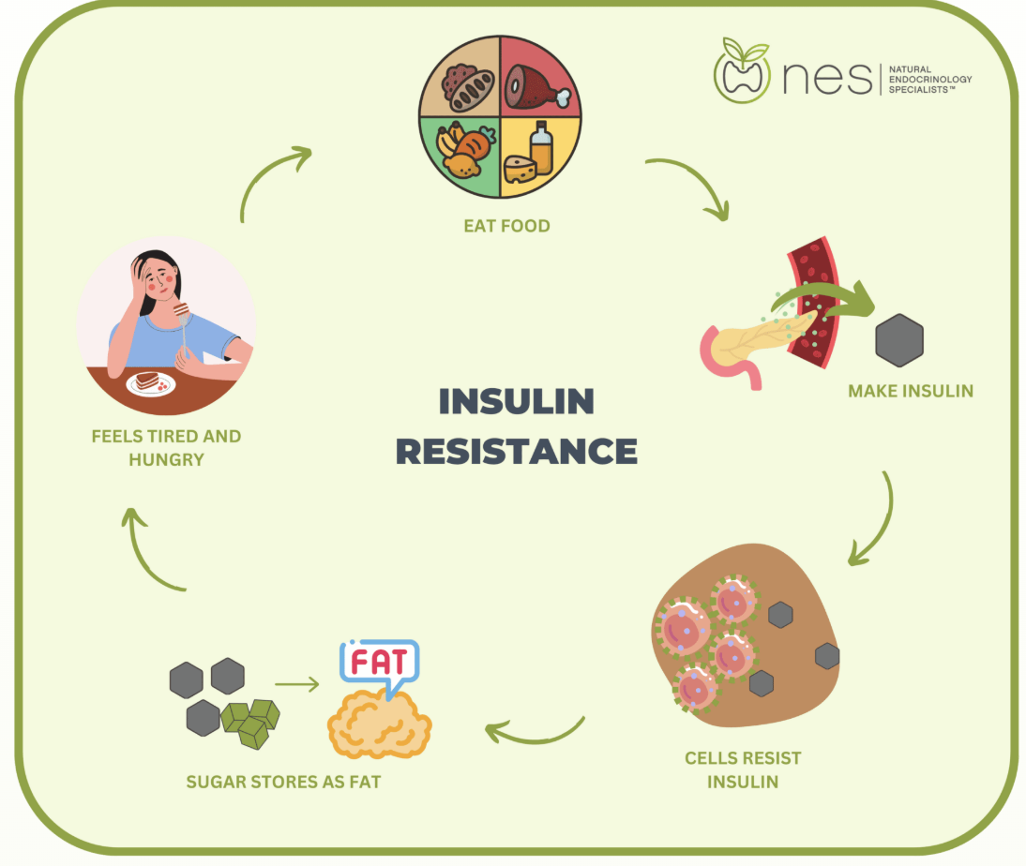
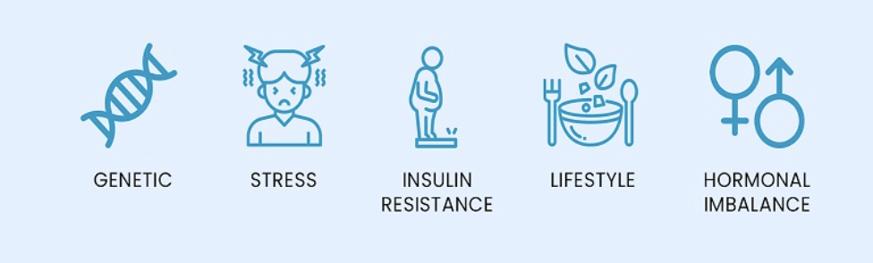
Risk Factors- PMOS
PMOS
Genetics
Family History
Lifestyle / Stress
Diet / Inactivity
Environment
Endocrine disrupting chemicals
Neuroendocrine
Insulin Resistance
Obesity

Slide 4
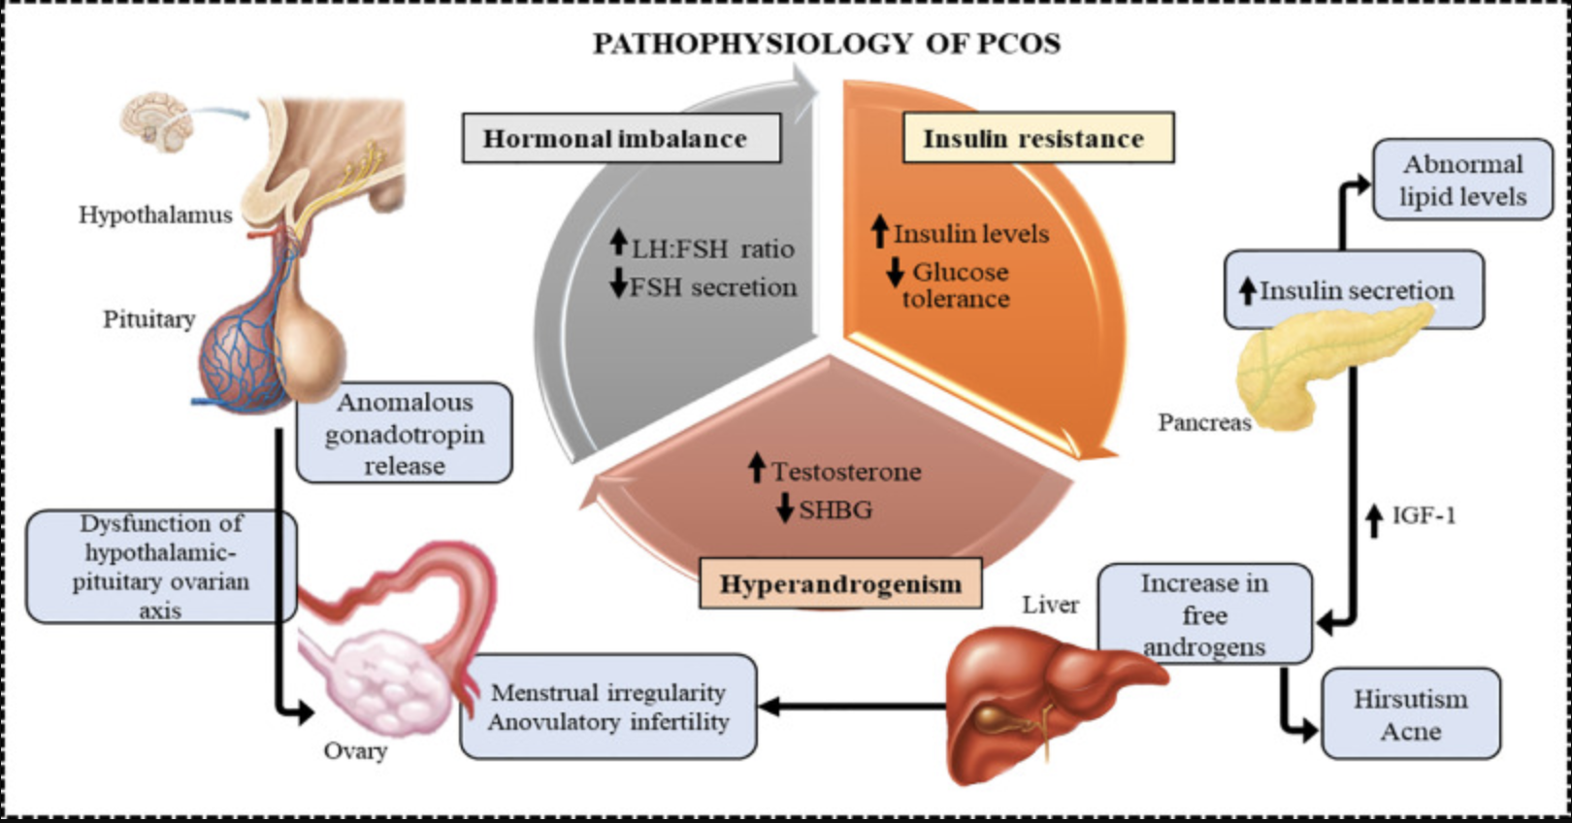
Pathophysiology of Polyendocrine Metabolic Syndrome
Neuroendocrine
Metabolic
Ovarian /
Reproductive
Notes:
Approximately one-half of patients with FOH have an abnormal degree of insulin-resistant hyperinsulinism (step 2). Insulin-resistant insulin excess acts on theca cells to aggravate hyperandrogenism, synergizes with androgen to prematurely luteinize granulosa cells, and stimulates fat accumulation. Obesity increases insulin-resistance and hyperinsulinism (step 3); it also increases proinflammatory cytokines, and these further aggravate hyperandrogenism (step 3). The hyperandrogenemia provokes LH excess (step 4), which then acts on both theca and luteinized granulosa cells to worsen hyperandrogenism (step 5). LH also stimulates luteinized granulosa cells to secrete estradiol (step 6), which suppresses FSH secretion. These insulin excess-initiated changes in
https://www.uptodate.com/contents/polycystic-ovary-syndrome-pcos-in-adolescents-clinical-features-and-pathogenesis/print?search=pmos&so... 31/39
31/08/2026, 19:16 Polycystic ovary syndrome (PCOS) in adolescents: Clinical features and pathogenesis - UpToDate
granulosa cell function further exacerbate PCOM and further hinder ovulation. In functionally typical PCOS, the FOH is caused by inherent abnormalities that up-regulate steroidogenesis. In functionally atypical PCOS, obesity either initiates FOH or is itself the source of testosterone production. The figure also does not depict other associated defects, such as the functional adrenal hyperandrogenism, that often accompanies the ovarian hyperandrogenism and the contribution of excess adiposity to peripheral androgen production and gonadotropin suppression. Bold and enlarged fonts represent greater severity.
FOH: functional ovarian hyperandrogenism; FSH: follicle-stimulating hormone; LH: luteinizing hormone; PCOM: polycystic ovary morphology; PCOS: polycystic ovary syndrome.
Adapted from: Rosenfield RL, Ehrmann DA. The pathogenesis of polycystic ovary syndrome (PCOS): The hypothesis of PCOS as functional ovarian hyperandrogenism revisited. Endocr Rev 2016; 37(5):467-520. doi: 10.1210/er.2015-1104. Adapted by permission of Oxford University Press on behalf of the Endocrine Society. Copyright © 2016 Oxford University Press.

Slide 5
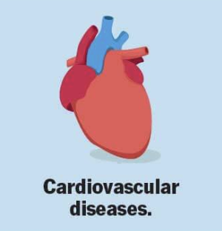
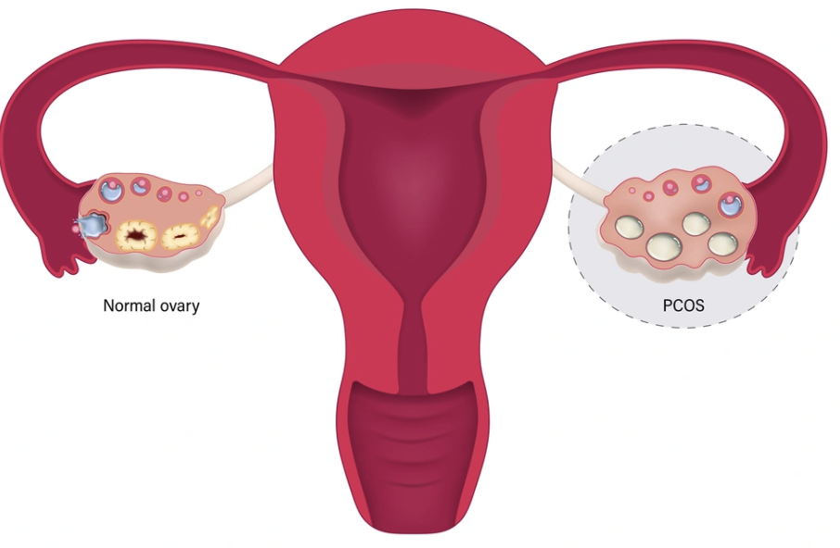


Polyendocrine Metabolic Ovarian Syndrome
Metabolic
Obesity, GDM, T2DM
Hypertension, DLP
MASLD, CV disease, OSA
Reproductive
Irregular menstrual cycles
Endometrial cancer
Infertility
Pregnancy complications
Psychological
Depression
Anxiety
Eating disorders
Dermatological
Acne
Alopecia
Hirsutism
Notes:
Common endocrinopathy
It is one of the most common endocrinopathies in women, affecting between 1 in 8 women.
The syndrome is characterized clinically by oligomenorrhea and hyperandrogenism, as well as the frequent presence of associated risk factors for cardiovascular disease, including obesity, glucose intolerance, dyslipidemia, and OSA.
Reproductiveabnormalities
Menstrual dysfunction characterized by infrequent or absent menses. However, some women with PMOS have abnormal uterine bleeding as a result of their chronic anovulation.
Typical polycystic appearance of the ovaries on TV US in the majority of women with irregular menses and hyperandrogenism. However, this ultrasound appearance is nonspecific, as it may also be seen in normal-cycling women
Hyperandrogenism: include clinical signs (hirsutism, acne, alopecia) and/or elevated serum androgen concentrations.
Metabolic issues A risk factors for diabetes and cardiovascular disease, including obesity (and insulin resistance), glucose intolerance, and dyslipidemia.
Other clinical manifestations that may be seen include OSA and MASLD (Metabolic dysfunction-associated steatotic liver disease)
Women with PCOS may be more likely to have mood disorders (depression, anxiety, and a possible increase in suicide attempts).
In addition, PCOS appears to be associated with an increased risk of eating disorders, in particular, binge eating

Slide 6
According to the Rotterdam criteria, PMOS comprises four phenotypes:
Phenotype A:
“Classic” PMOS
Hyperandrogenism Ovulatory Dysfunction “Polycystic” Ovaries
Phenotype B:
Non-Polycystic Ovary PMOS
Hyperandrogenism Ovulatory Dysfunction
Phenotype C:
Ovulatory PMOS
Hyperandrogenism “Polycystic” Ovaries
Phenotype D:
Non-Hyperandrogenic PMOS
Ovulatory Dysfunction “Polycystic” Ovaries
Insulin resistance in phenotypes C and D
Still occurs across these groups, varying by hormonal patterns.
Phenotype A
Typically shows the highest levels of insulin resistance and metabolic disruption
Phenotype B
It closely matches Phenotype A in its metabolic profile and insulin resistance

Slide 7
The choice of therapy depends on if the patient is pursuing pregnancy
Lifestyle modifications
Diet
Exercise
Sleep
Stress
Amelioration of hyperandrogenic features (hirsutism, acne)
COCP
Management of metabolic disease and reduction of CV risk factors
Metformin
Prevention of endometrial hyperplasia associated with chronic anovulation
Oral contraceptives
Medroxyprogesterone 10mg every 1-3 months to induce bleed
Ovulation induction for those pursuing pregnancy
Metformin
Spironolactone
Others: laser/electrolysis, topical creams for acne
GLP-1 RA
Statins
Antihypertensive medication
Letrozole
Clomiphene
IUD
Bariatric Surgery

Slide 8
Conclusion - Why Was the Name Changed?
Not just about ovarian cysts… It is a complex endocrine and metabolic disorder
Treatment will address not just fertility and periods, but also long-term metabolic health
Reduce stigma and confusion
Improve early recognition and treatment by helping patients and providers understand the full scope of the condition
What will change over time:
Greater emphasis on metabolic screening: focus on checking for CV risk factors
The new name may help providers recognize the condition sooner and start treatment earlier

Slide 9
Thank you

