Slide 1
PMOS Panel Discussion
Dr Margaret Griffin, Consultant Endocrinologist

Slide 2


PCOS
PMOS
Polyendocrine Metabolic Ovarian Syndrome
Each word selected with rigorous evidence review
Representing the significant endocrine and metabolic features including MASLD, dyslipidaemia, T2DM, IR, OSA across the lifespan from menarche to post menopause
Notes:
Developed over 3 years by 56 international Medical Organisations including IES and WHO
Polyendocrine – multiple interacting endocrine disturbances – elevated androgens, increased GnRh pulsatility and LH, IR and hyperinsulinaemia
Metabolic – inherent in PMOS from genetic origins to clinical manifestations including obesity, dysglycaemia, dyslipidaemia, high BP and increased CV risk
Ovarian dysfunction remains a defining and diagnostic feature.
The term PCOS has often mislead clinicians and patients and is associated with Significant under diagnosis particularly in lean women
The older term has led to under-recognition of associated cardiometabolic risks for women
Aiming – to improve accuracy of diagnosis ; reduce stigma ; improve research and funding ; ultimately improve access for patients to Rx

Slide 3
Insulin resistance and
hyperinsulinaemia
Weight gain esp central – DM -
↑BP - CAD – Dyslipidaema - OSA
Dermatology
Hirsutism, acne,
frontal hair loss
Psychological
Anxiety
Depression
Low self esteem
Reduced qol
Psychosexual
Eating disorders
Mental health screen
Every visit
PMOS
Gynecological /
reproductive
Irregular menses
Fertility challenges
Increased risk of Preg Cx^
Endometrial hyperplasia 30%*
Endometrial Ca x 2-6 fold **
Social
Isolation
Stigma
Weight bias
Delayed diagnosis
Fragmented care
Notes:
OSA 4-7 fold increase ; CAD 2 fold increase ; 40% o40 igt or dm ; dm risk increased 3 fold
^ gdm hypertension pet operative delivery both IUGR and LGA
*Agerwal et al from University of California in 2024 – 242 women age 18-40 70% had normal endometrial biopsies 24% EH of which 2/3 showed atypia and 6% endometrial ca
**Teele et al Fertil Steril 2018 increased endo ca 2-6 fold compared to aged matched women without PMOS
Depression – up to 80% self report depression / low mood – 2-3 fold increase risk of diagnosis of anxiety / depression

Slide 4
Case Report
2/2018 26 y.o.
Ammennorrhoea x years ; Hirsute+++ shaving daily ; weight gain +++; newly diagnosed hypertension ; mood low
Amlodipine 5mg ; metformin 500mg bd
Fam Hx positive for hypertension (both parents in 40s) and DM (g’mother)
Non smoker ; rare alcohol intake; professional FT employment
O/E 105kg BMI 39.1 (115kg at outset, BMI 42.8) BP 147/86
Ferriman Gallwey score 25/36 (severe > 99 percentile)
Patient concerns * weight * Hirsutism
No pregnancy plans

Slide 5
Case Report
LH 13.7
FSH 8.2
Test 2.1nmol/l (n < 2.7)
SHBG 7.1nmol/l (n 20-155) ↓
FTI 29**** ↑
TSH 1.2
Prolactin 301mIU/L (n 102-496)
Glu 5.3 ; HbA1c 33mmol/mol ; Chol 3mIU/L.6; TG 1.17; LDL 1.74; HDL 1.33 ; Ast 32 ; ALT 34
Pelvic USS – normal but limited examination

Slide 6
Rotterdam Criteria for Adults > 20 - 2 of 3 or more
CRITERIA
1. Oligoammennorrhoea < 8 cycles / year
cycles < 21/7 or > 35 days
(1-3 years of menarche <21/7 , >45/7)
2. Clinical or Biochemical Hyperandrogenism
3. USS > 20 follicles per ovary or ovarian volume > 10ml or AMH ↑
10-19 year old #1+#2 - only one then ‘at risk of PMOS’ reassess regularly
Excluding ------------
Hyperprolactinaema / thyroid dysfunction / Non classical CAH / Cushings / Androgen secreting tumours
Notes:
Name changed but diagnostic criteria the same

Slide 7
Further Evaluation
DHEA-S 16.9nmol/l (<13.9) ↑
Androstenedione 6.98 N
O/N DST Cortisol 34nmol/l
17 OH progesterone 2.8ng/ml (0.6-3)
Fasting Insulin 17 IU/mL
HOMA 4 ↑
Fibroscan CAP 392 < 220 ↑ LSS 9.9 (< 6.5) ↑
Adrenal MRI NAD

Slide 8
Rotterdam Criteria For Adults > 20 - 2 of 3 or more
Excluded ------------
Non classical CAH / Cushings / Androgen secreting tumours / thyroid dysfunction Hyperprolactinaema /

Slide 9
Diagnosis and Management
Diagnoses : PMOS ; Hypertension ; High BMI ; Significant MASLD with fibrosis
Age 26
Management :
Registered dietitian
Psychology
Continued metformin and optimised dose – target 1500-2000mg
Added spironolactone to address hirsutism and augment anti-hypertensives

Slide 10
When to seek urgent referral
Severe or rapidly worsening hirsutism
Severe or rapidly increasing weight gain
Features of Cushings
Virilisation – voice change, clitoral enlargement
Testosterone > 5nmol/L
Clinical judgement – psychological impact of disease

Slide 11
Health Gains – and losses
2/19
Regular menses
Normotensive
96 kg
+ Semaglutide
2/20
Regular menses
Symptomatic Low BP –
amlodipine d/c
77.5 kg
2/22
Mirena in
Oophorectomy
For ovarian cyst
81.4 kg
2/21
Regular menses
134/86
73 kg
8/19
Regular menses
Normotensive
82.5 kg
LSS 9.9 to 4.8
CAP 392 to 290
7/20
Regular menses
Low mood
75.2 kg (36%↓)
8/21
Mother DM + now
Regular menses
78 kg
Heavy menses
Dysmenn
Gynae review

Slide 12
Health Gains – and losses
7/22
Menses less regular
BP 150/93
84.4 kg BMI 31.8
Psychology ceased
Diet less applied
9/25
Reg menses
TTC
10/25 + HCG
6/26 Delivered
baby boy
7/23
Semaglutide N/A
Irregular menses
Exploring Surgery
92.8 kg
12/24
3/12 post bariatric Sx
Irregular menses
120/86
81.4 kg BMI 30.3
1/23
Irregular menses
Normotensive
90 kg
1/24
Irregular menses
Low mood
95.2kg BMI 35.8
7/25
Irregular menses
Normotensive
Metformin added
63.4 kg BMI 23.8
Single anastomosis
Gastric Bypass 9/24
Notes:
Pregnancy Cx by – 1) hyperemesis 2) renal calculus 3) UTIs 4) anaemia transfused and iron infusion
Post delivery lithotripsy and stent
No hypertension during pregnancy – some spikes peri and post delivery
No GDM circa 6lb 39 weeks

Slide 13
Management
Lifestyle – diet / exercise / stress / sleep / substances / social
Psychological support
COC
Metformin
GLP 1A
Antiandrogen therapy
Letrozole
Multi- discipline support – gynae / derm / dietetics / psychology /endocrine / fertility unit / hepatology / bariatric surgery
Discuss Patient Priorities
SHARED DECISION MAKING
Notes:
To date no diet above others – Mediterranean style – low gi
Exercise – no evidence one better than other

Slide 14
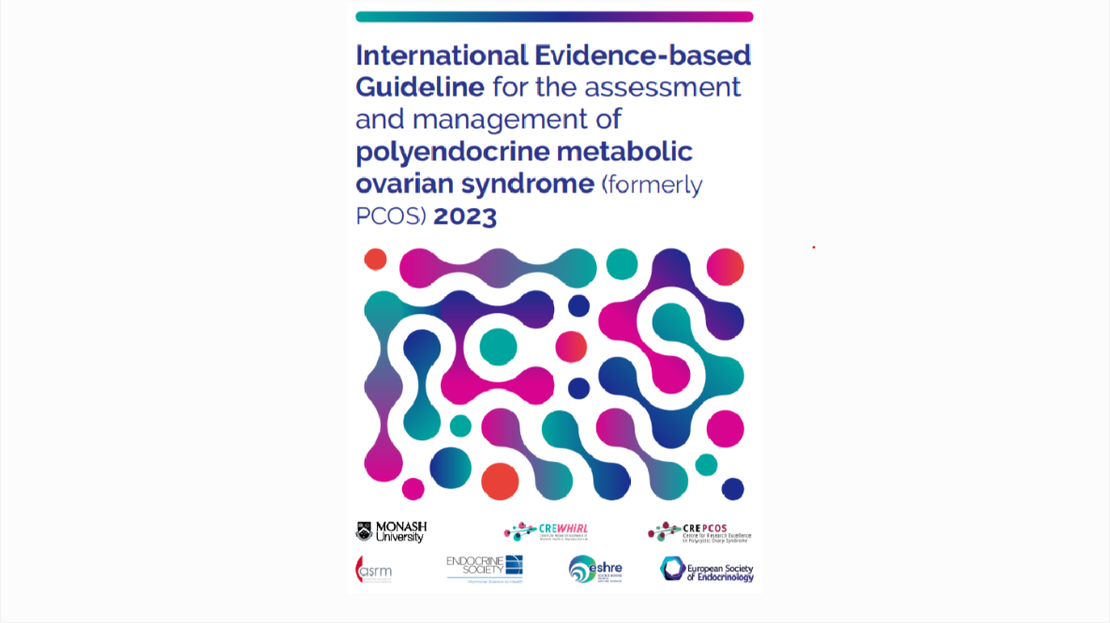

Slide 15
Thank you

