Slide 1
Diagnosis to Decision: Common Dermatology Presentations in General Practice
Dr Gregg Murray, Consultant Dermatologist

Slide 2
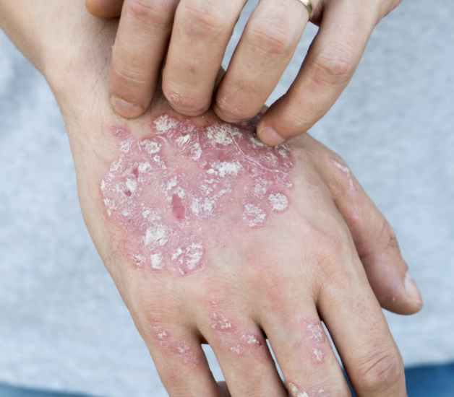
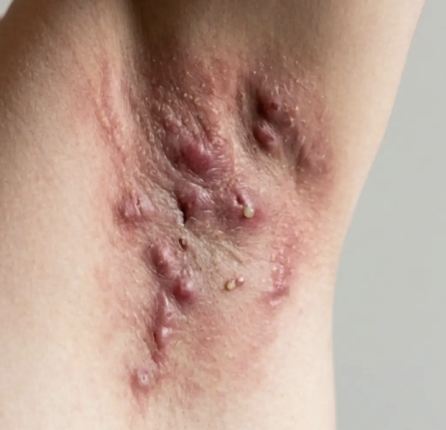
Two Common Inflammatory Conditions – Beyond the Skin
Psoriasis
Hidradenitis Suppurativa

Slide 3
PSORIASIS

Slide 4
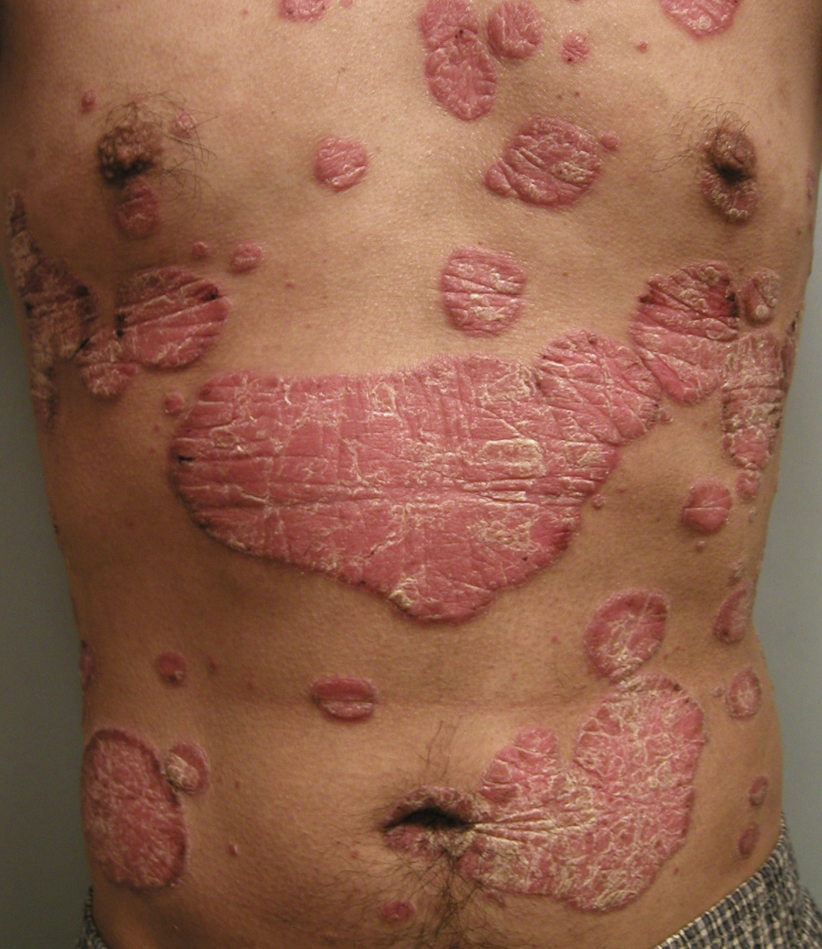
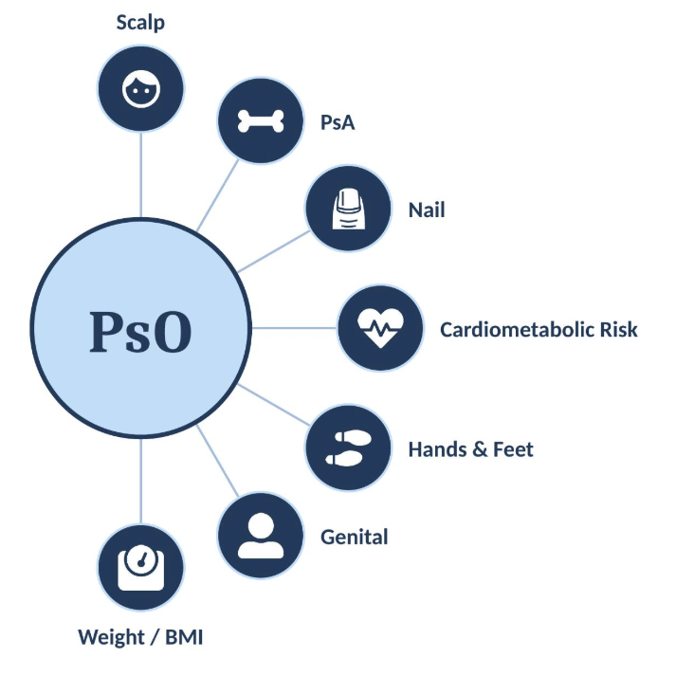
Psoriasis
Chronic inflammatory dermatoses
2-3% of global population
5.526 million – Population of Ireland¹
110,000-166,000 people living with psoriasis
Moderate - Severe Disease:
PASI > 10
BSA > 10
DLQI > 10
References
CSO

Slide 5
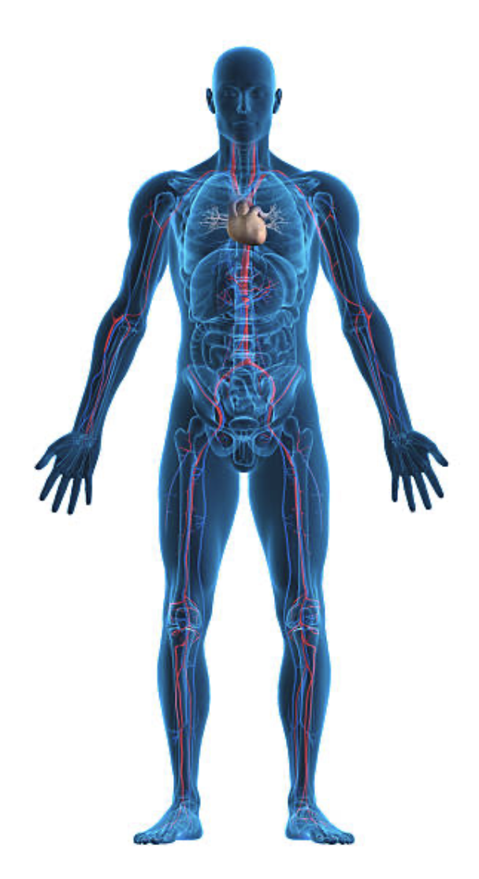
Psoriasis – High-impact site disease
- High-impact sites are common but challenging to treat
- Prevalence¹
Scalp: Application of topical treatments can be difficult and UV therapy may not penetrate the scalp
Face: Topical therapies and partial treatment may not be cosmetically acceptable to the patient. This delicate area is susceptible to steroid atrophy and steroid-induced acne
Scalp:
45–56%
Face: ~50%
Genitals: Often misdiagnosed as infection, delaying diagnosis and treatment. Discussion is limited by embarrassment and low awareness
Palms and soles of feet:
12–16%
Genitals: 30–40%
Palmoplantar disease: These areas require functional as well as cosmetic treatment goals
Nails: Difficult to achieve effective concentrations of topical therapies. Slow nail growth can complicate
effective monitoring
Nails:
23–27%
References:
1 Aldredge LM and Higham RC. J Dermatol Nurses Assoc 2018;10:189–197;
2. Merola JF, et al. Dermatol Ther 2018;31:e12589;
3. Warren RB, et al. Br J Dermatol 2011;164:S1–14;

Slide 6
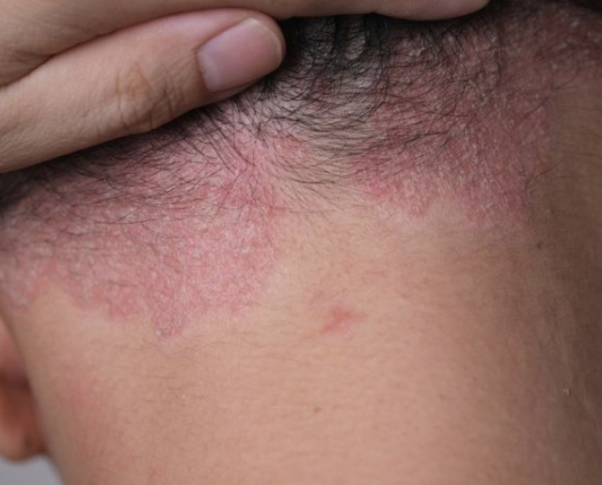
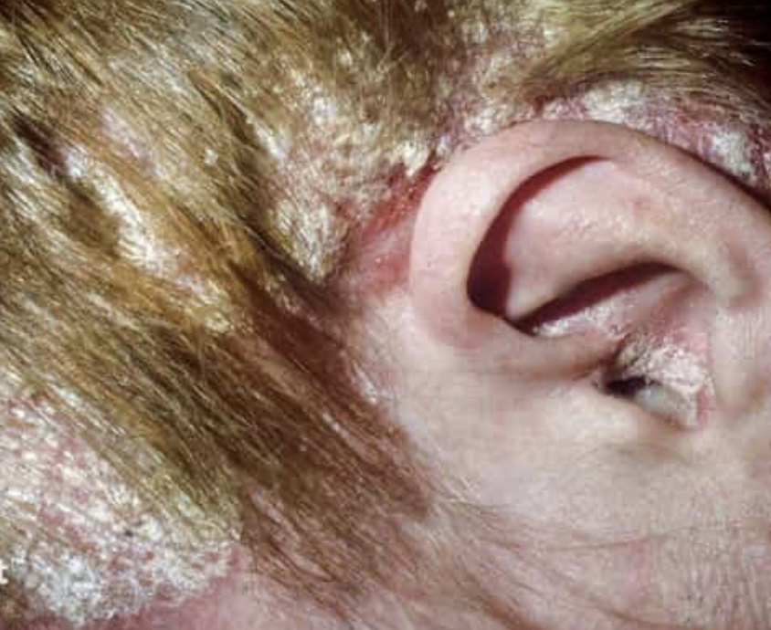
Psoriasis – Scalp
Scalp PsO
Diprosalic (betamethasone dipropionate + salicylic acid) vs. steroid alone:
Diprosalic was significantly better than betamethasone valerate alone.. (p=0.009).²
1. Topical corticosteroid monotherapy — Anti-inflammatory; penetration limited by thick scale.
2. Corticosteroid + keratolytic (e.g. Diprosalic) — combines anti-inflammatory and desquamating action
3. Corticosteroid + vitamin D analogue (e.g. Dovobet, Enstilar) — synergistic anti-inflammatory/antiproliferative effect; strongest evidence base
4. Keratolytic monotherapy (e.g. Cocois, Sebco) — coal tar, salicylic acid, sulphur; descales before definitive therapy
5. Medicated shampoos (e.g. Capasal, ketoconazole) — adjunctive and maintenance therapy
Dovobet (calcipotriol + betamethasone) vs. steroid alone Combination gel achieved clear/almost clear scalp in 68.4% of patients vs. 41.0% with betamethasone (n=1,417).¹
Best maintenance option — PSO-LONG trial: (Enstilar)
Proactive twice-weekly application of Ensitlar foam significantly outperformed reactive (as-needed) treatment for keeping patients in remission. (p<0.001), and fewer relapses per year (3.1 vs. 4.8).³
References:
1 Van de Kerkhof et al. A new scalp formulation of calcipotriol plus betamethasone dipropionate compared with each of its active ingredients in the same vehicle for the treatment of scalp psoriasis: a randomized, double-blind, controlled trial. Br J Dermatol. 2009;160(1):170–176.
2. Vickers CFH, Norris T, Glover DR. A comparative study of betamethasone dipropionate with salicylic acid and betamethasone valerate for the treatment of steroid-responsive dermatoses of the scalp. J Dermatol Treat. 1990;1(4):193–195.
3. Lebwohl M, Kircik L, Lacour JP, et al. Twice-weekly topical calcipotriene/betamethasone dipropionate foam as proactive management of plaque psoriasis increases time in remission and is well tolerated over 52 weeks (PSO-LONG trial). J Am Acad Dermatol. 2021;84(5):1269–1277.

Slide 7
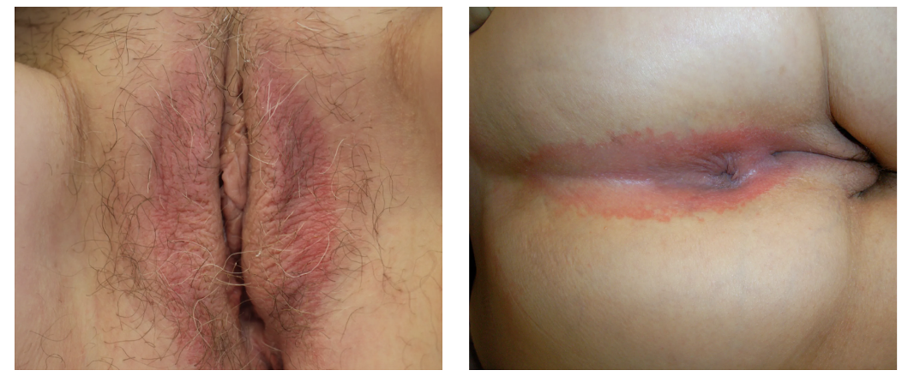
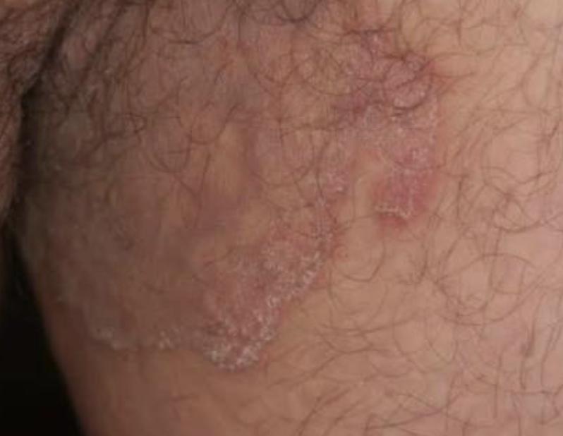
Psoriasis - Genitals
Genital PsO
Vs
Tinea Cruris
Well demarcated plaques
Shiny, no scale
Bilateral
Natal cleft
Fissuring
Trailing edge scale
Central clearing
Annular ring

Slide 8


Psoriasis - Biologic treatment eligibility
Definition of moderate-to-severe PsO:
BSA >10% or PASI >10, and DLQI >10
or
mild PsO* may be ‘upgraded’ to moderate-to-severe disease if one or more of the following criteria apply:¹
Major involvement of visible areas
Onycholysis of at least two fingernails
Major involvement of the scalp
Presence of itch leading to scratching
Involvement of the genitals
Presence of recalcitrant plaques
References:
1. Nast A, et al. J Eur Acad Dermatol Venereol 2020;34:2461–2498;

Slide 9
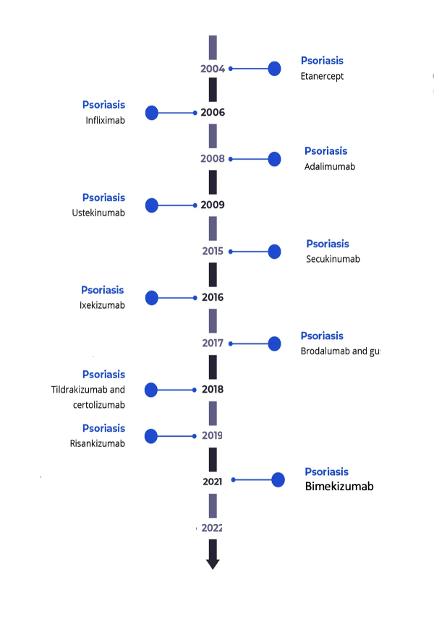
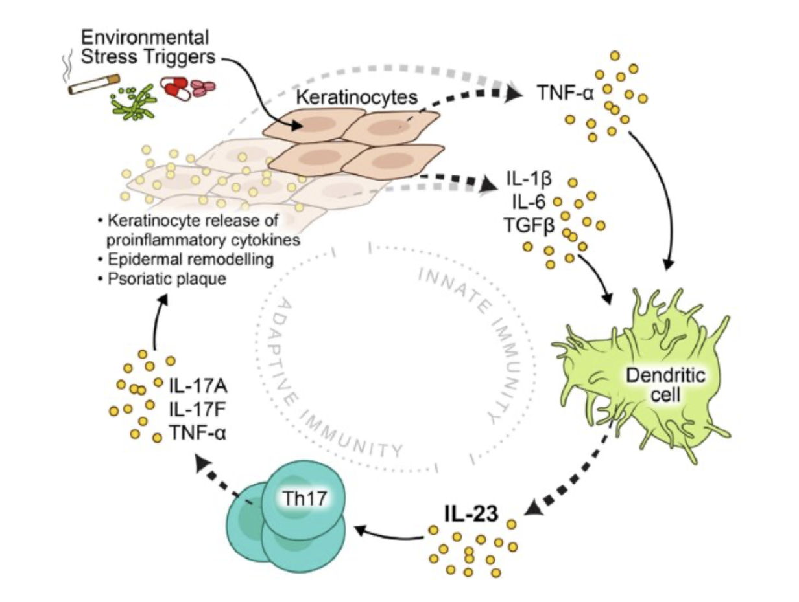
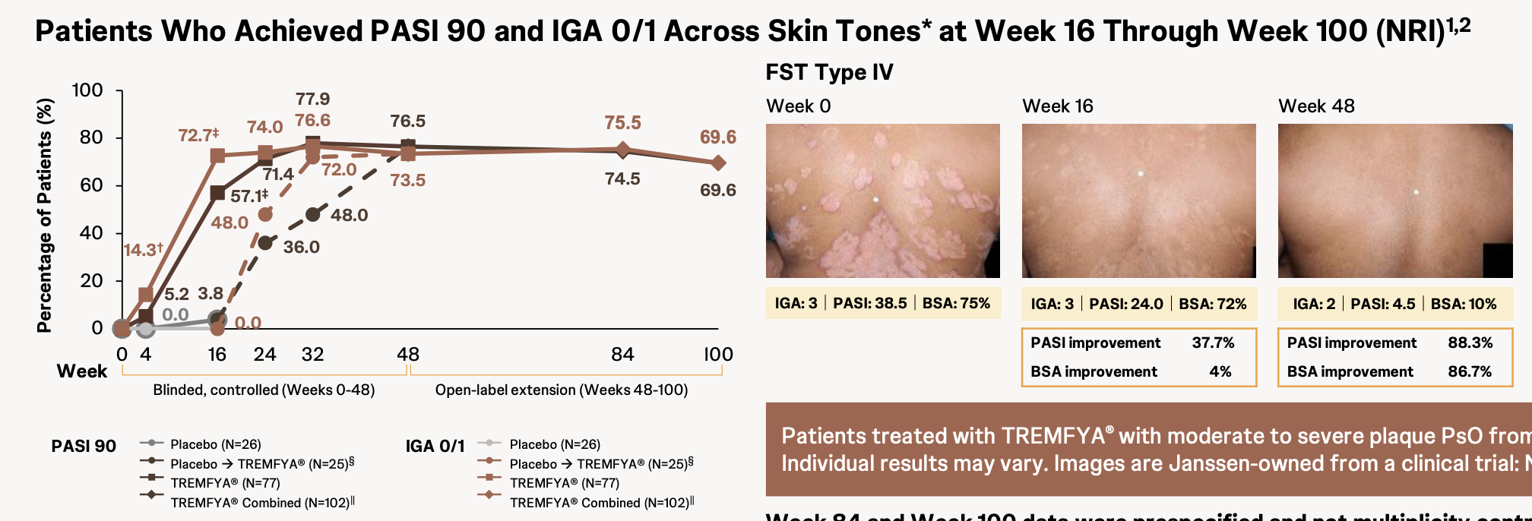
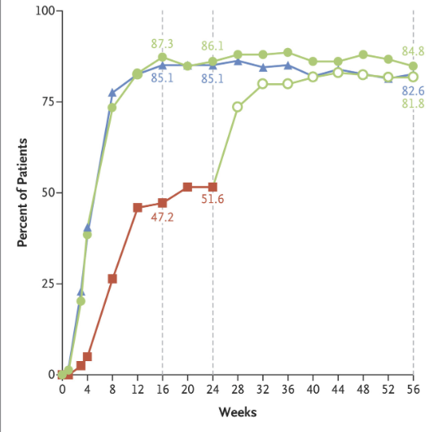
Psoriasis – A treatment revolution
75% achieving PASI 90
85% achieving PASI 90

Slide 10
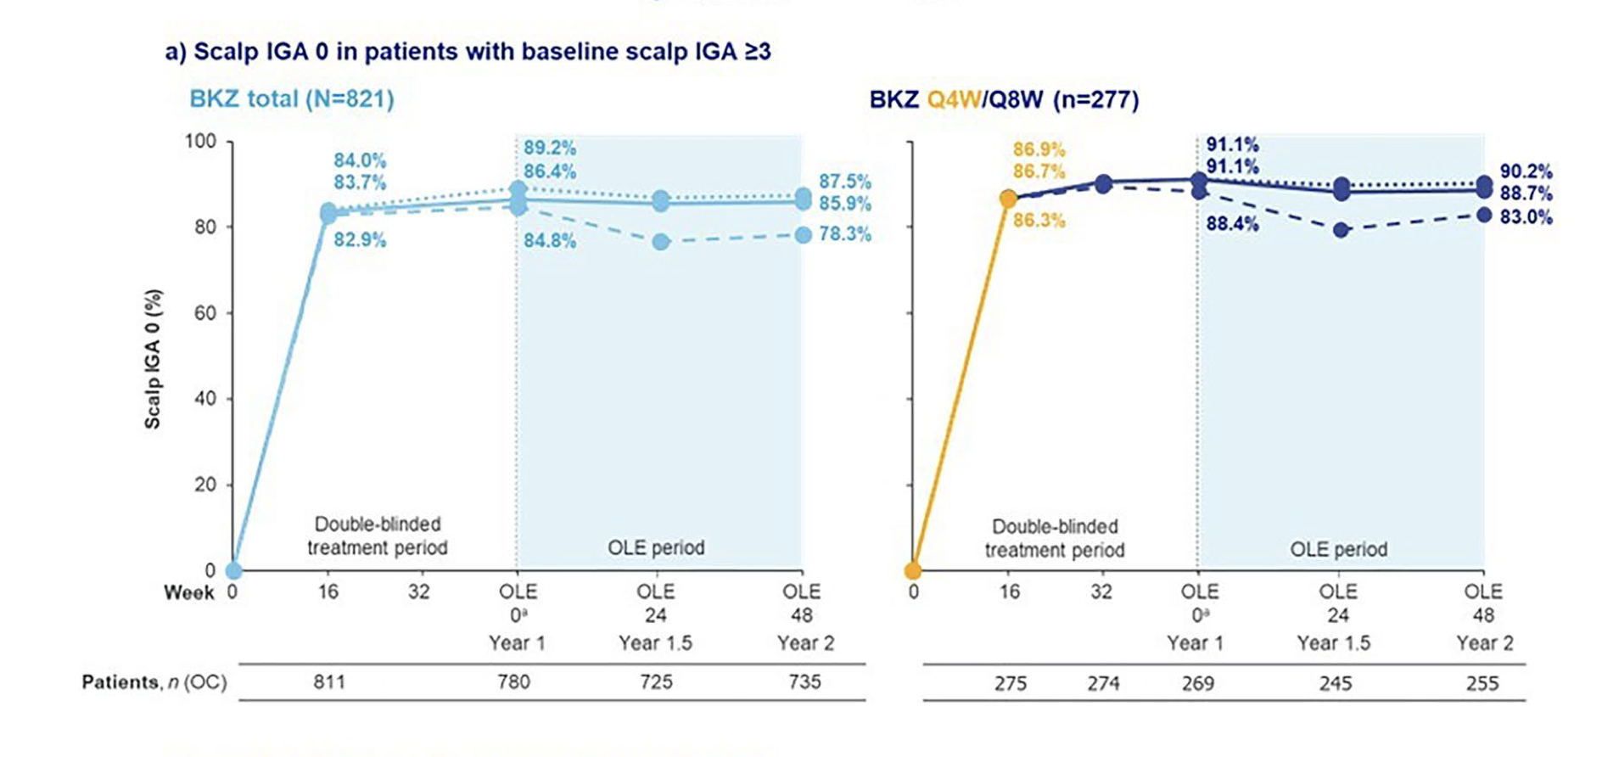
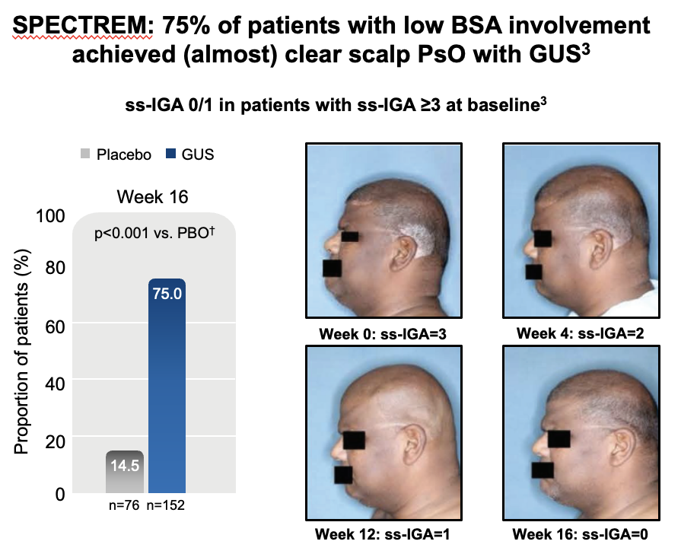
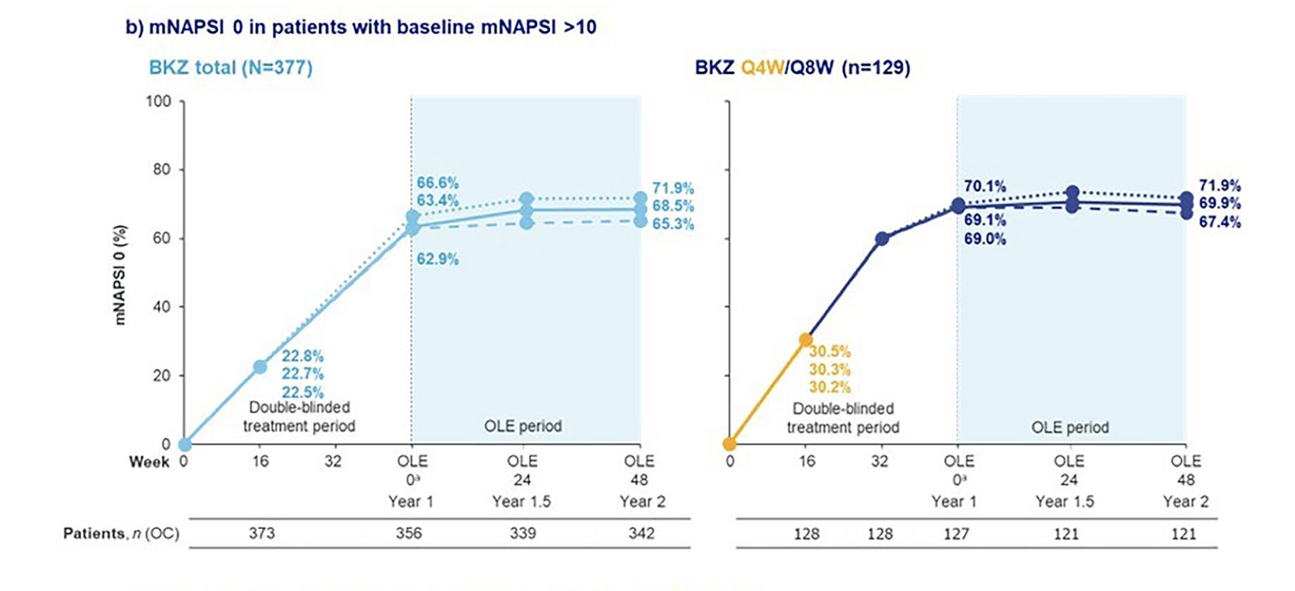
Psoriasis – High impact site disease
Anti IL-17
Anti IL-23
Scalp Disease
Bimekizumab achieved completely clear scalp skin in roughly 85-90% of patients with moderate-to-severe scalp psoriasis, and that response held for two years.
Nail Disease
Bimekizumab achieved completely clear nails in about two-thirds of patients with significant baseline nail psoriasis, rising steadily from roughly 23% at 16 weeks to 65-72% by two years.
Guselkumab; 75% of patients with significant scalp involvement achieved an almost-clear scalp by week 16.

Slide 11
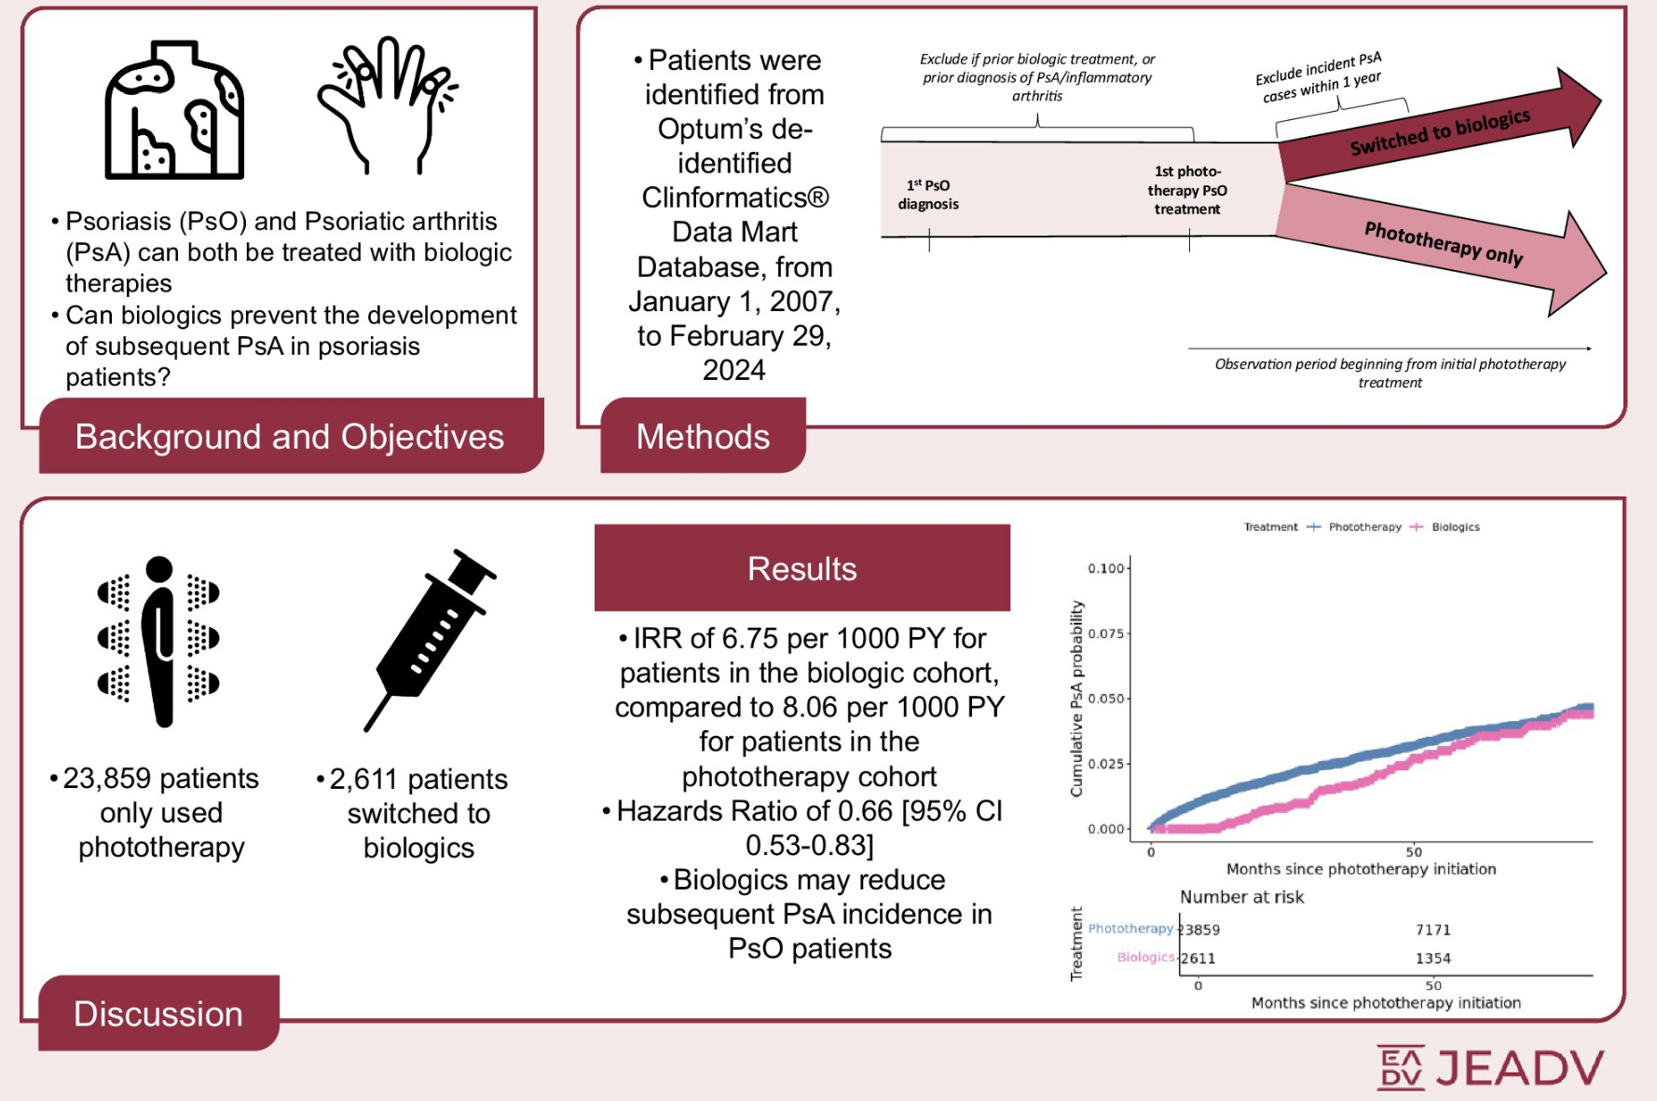
Psoriasis – Early biologic intervention
Early intervention with biologics shows a reduced disease severity and progression to PsA.
Early biologic therapy in moderate-to-severe psoriasis is associated with a ~34% lower incidence of psoriatic arthritis compared with continued phototherapy (adjusted HR 0.66, 95% CI 0.53–0.83) — a large US cohort that specifically excluded PsA cases in the first year post-biologic to guard against protopathic bias.
References
Miao KL, Huang MY, Guo L, Lung K, Armstrong AW. Effect of biologic use on the development of psoriatic arthritis: A population-based study. J Eur Acad Dermatol Venereol. 2026; 40: 900–907.

Slide 12



Psoriasis – Cardiovascular Risk
An independent, severity-graded cardiovascular risk factor
Psoriasis carries a significantly increased cardiovascular risk
Higher rates of myocardial infarction, stroke and cardiovascular death compared with the general population
Armstrong EJ, Harskamp CT, Armstrong AW. J Am Heart Assoc. 2013;2(2):e000062
Risk rises with disease severity
Moderate-to-severe psoriasis carries the greatest cardiovascular burden of all
Armstrong EJ, Harskamp CT, Armstrong AW. J Am Heart Assoc. 2013;2(2):e000062
Now formally recognised by cardiology guidelines
ACC/AHA (2019) lists psoriasis as a cardiovascular risk-enhancing factor
Arnett DK et al. J Am Coll Cardiol. 2019;74:1376–1414
References
1. Armstrong EJ, Harskamp CT, Armstrong AW. Psoriasis and Major Adverse Cardiovascular Events: A Systematic Review and Meta-Analysis of Observational Studies. J Am Heart Assoc. 2013;2(2):e000062.
2. Arnett DK, Blumenthal RS, Albert MA, et al. 2019 ACC/AHA Guideline on the Primary Prevention of Cardiovascular Disease: Executive Summary. J Am Coll Cardiol. 2019;74(10):1376–1414.

Slide 13
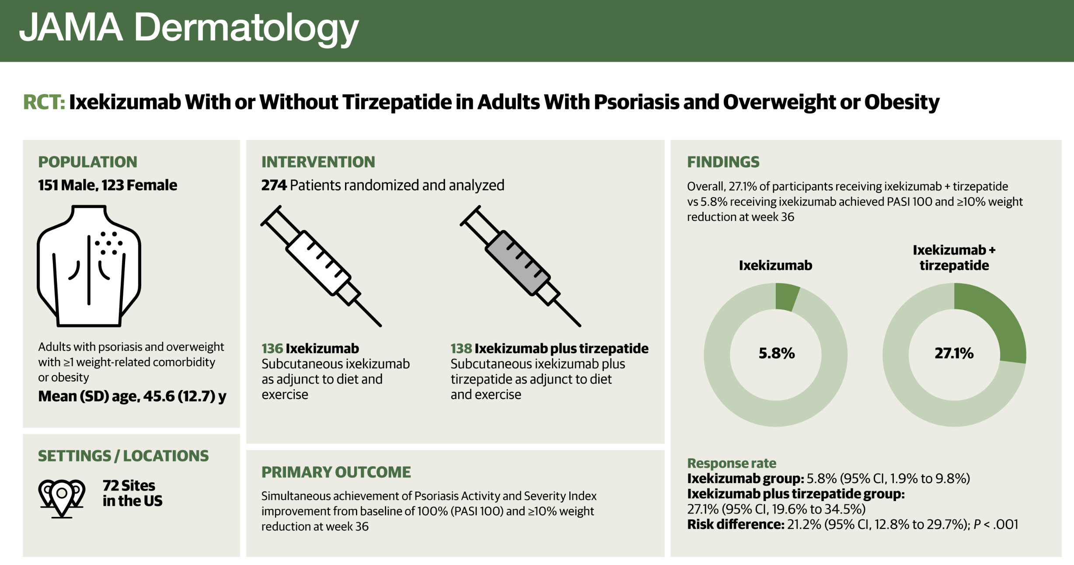
Psoriasis – Obesity
TOGETHER-PsO Trial
Overweight and obesity affect 60–78% of people with psoriasis.
Patients with psoriasis have over 50% increased odds of developing obesity.
Higher BMI is linked to poorer biologic response, higher treatment discontinuation, and greater risk of psoriatic arthritis.
GLP-1/GIP receptor agonists don't just reduce weight — they improve cardiometabolic parameters and attenuate the same inflammatory mediators implicated in psoriasis.
References
Lebwohl M, Blauvelt A, Kartman CE, et al. Ixekizumab With or Without Tirzepatide in Adults With Psoriasis and Overweight or Obesity: A Phase 3b Randomized Clinical Trial. JAMA Dermatol. 2026;162(7):709–719.
Notes:
In the TOGETHER-PsO trial, combining ixekizumab with tirzepatide produced significantly better outcomes than ixekizumab alone. More patients achieved complete skin clearance — PASI 100 in 40.6% versus 29.0% with ixekizumab alone.
The combination also produced significant reductions in cardometablic parameters such as reduction in, systolic and diastolic blood pressure, HbA1c, total cholesterol, and triglycerides. LDL and HDL cholesterol did not differ significantly between the two groups.

Slide 14
HIDRADENITIS
SUPPURATIVA

Slide 15
Hidradenitis Suppurativa
Chronic inflammatory skin disease affecting apocrine gland bearing skin.
  Axillae, sub-mammary region, groin, perianal region, buttocks
Characterized by inflammatory nodules, abscesses -> progress to sinus tract formation.
Global prevalence: varies from 0.4 -> 4%. In Ireland: 1.4%¹
References:
1. Delany E, Hughes R, Kirby B. A cross-sectional epidemiological study of hidradenitis suppurativa in an Irish population (SHIP). J Eur Acad Dermatol Venereol. 2018 Mar;32(3):467-473.

Slide 16
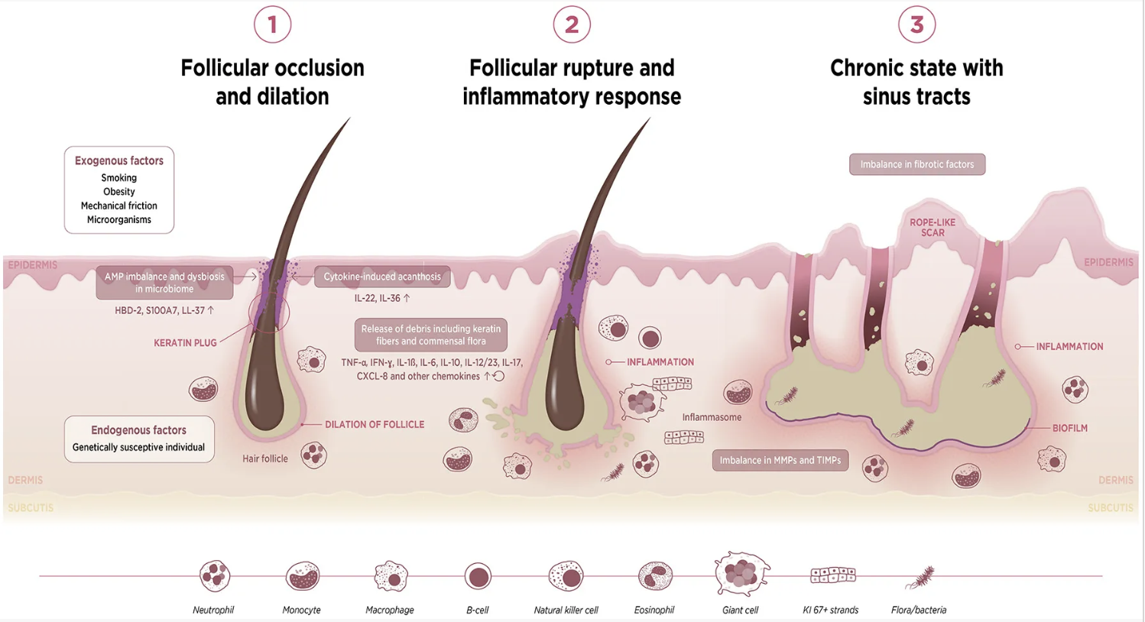
Hidradenitis Suppurativa
Not an infection: an autoinflammatory condition — not caused by poor hygiene, and not contagious
Multifactorial: genetic, immune, hormonal, microbial, mechanical and lifestyle factors (smoking, obesity, friction) all contribute
  1. Blocked follicle: hair follicles become occluded and dilated
2. Rupture & inflammation: the follicle ruptures, triggering an abnormal immune response, bacterial imbalance and abscess formation
3. Chronic disease: persistent inflammation drives fibrosis and deep, pus-draining tunnels (sinus tracts)
References:
Vossen ARJV, van der Zee HH and Prens EP (2018) Hidradenitis Suppurativa: A Systematic Review Integrating Inflammatory Pathways Into a Cohesive Pathogenic Model. Front. Immunol. 9:2965. doi: 10.3389/fimmu.2018.02965

Slide 17
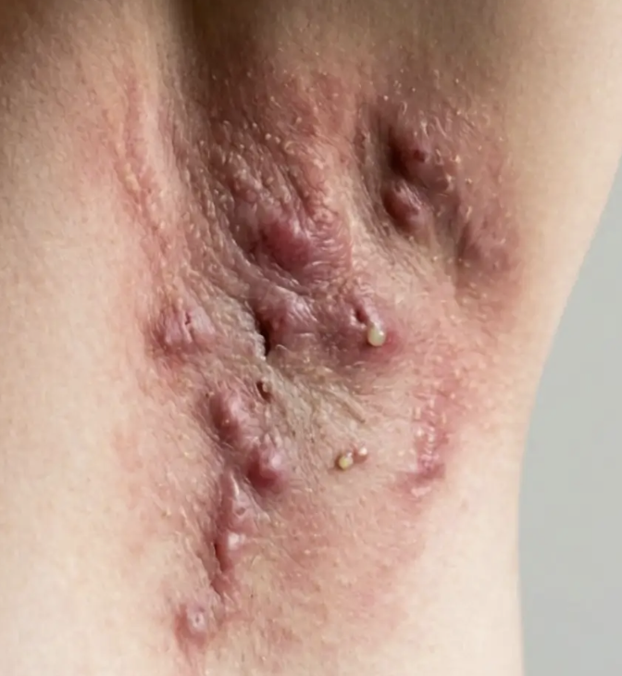
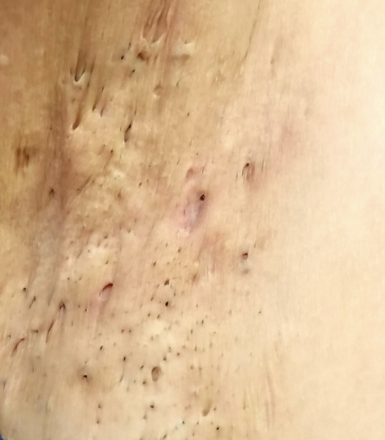
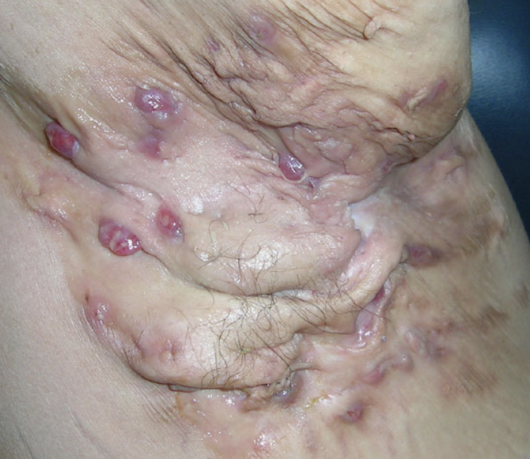
Hidradenitis Suppurativa
Inflammatory
Nodules
Diagnostic delay – major issue with patients with HS – on average 7-10 years.
2 or more inflammatory lesions at the typical sites (axillae, groin, inframammary, perianal/buttock) over 6 months has been shown to identify HS with around 97% accuracy¹.
Double Comedones
Abscesses, Sinus Tracts, Scarring
References:
Vinding GR, Miller IM, Zarchi K, Ibler KS, Ellervik C, Jemec GBE. The prevalence of inverse recurrent suppuration: A population-based study of possible hidradenitis suppurativa. Br J Dermatol. 2014; 170(4): 884–889.

Slide 18
Hidradenitis Suppurativa – Treatment Algorithm
Counsell all patients:
Smoking cessation, weight loss/
Screen associated comorbidities: Metabolic syndrome, anxiety/depression
Screen for treatable CVS disease:
BP, Lipids, HbA1c
Mild Disease
Mild/Localised Disease:
Tetracycline PO x 12 weeks
Topical Clindamycin 1%
Adjuvant treatments:
Metformin
Spironolactone
Semaglutide
Tirzepatide
Acitretin
Dapsone
Moderate Disease
Moderate Disease/
Lack of response :
Rifampicin 300mg BD + Clindamycin 300mg BD 10-12 weeks
Severe Disease
Severe Disease::
Adalimumab 40mg weekly SC
Bimekizumab 320mg 4-weekly SC

Slide 19
Summary
Psoriasis affecting the scalp, nails, genitals, or palms/soles can count as severe disease even at low BSA - site, not just extent, can meet the threshold to escalate care
Moderate-to-severe psoriasis is now a recognised cardiovascular risk-enhancing factor (ACC/AHA)
HS is a chronic follicular occlusion disease, not an infection - recurrent "boils" at typical sites for 6+ months should raise suspicion
Both conditions carry real, under-recognised cardiometabolic burden - the shared thread is chronic systemic inflammation
In HS, diagnostic delay - not treatment choice - is what's costing patients the most

Slide 20
Thank you

