Slide 1

TIAs
Dr. Dan Ryan PhD FRCPI
Consultant Stroke Physician, Geriatrician
Department Lead Geriatric and Stroke Medicine - Tallaght University Hospital
Beacon Brain Institute – Beacon Hospital

Slide 2
Acute transient focal neurology in your practice
Diagnosis
Risk categorization
Early management

Slide 3
DIAGNOSE

Slide 4
Diagnosis is tricky
3 Stanford stroke consultants
Reviewed 50 clinical cases
Three outcomes:
  Probable TIA
  Possible TIA
  Unlikely TIA
Consensus agreement in 50% of cases
Notes:
Don't wait for diagnostic certainty before initiating the urgent pathway.

Slide 5
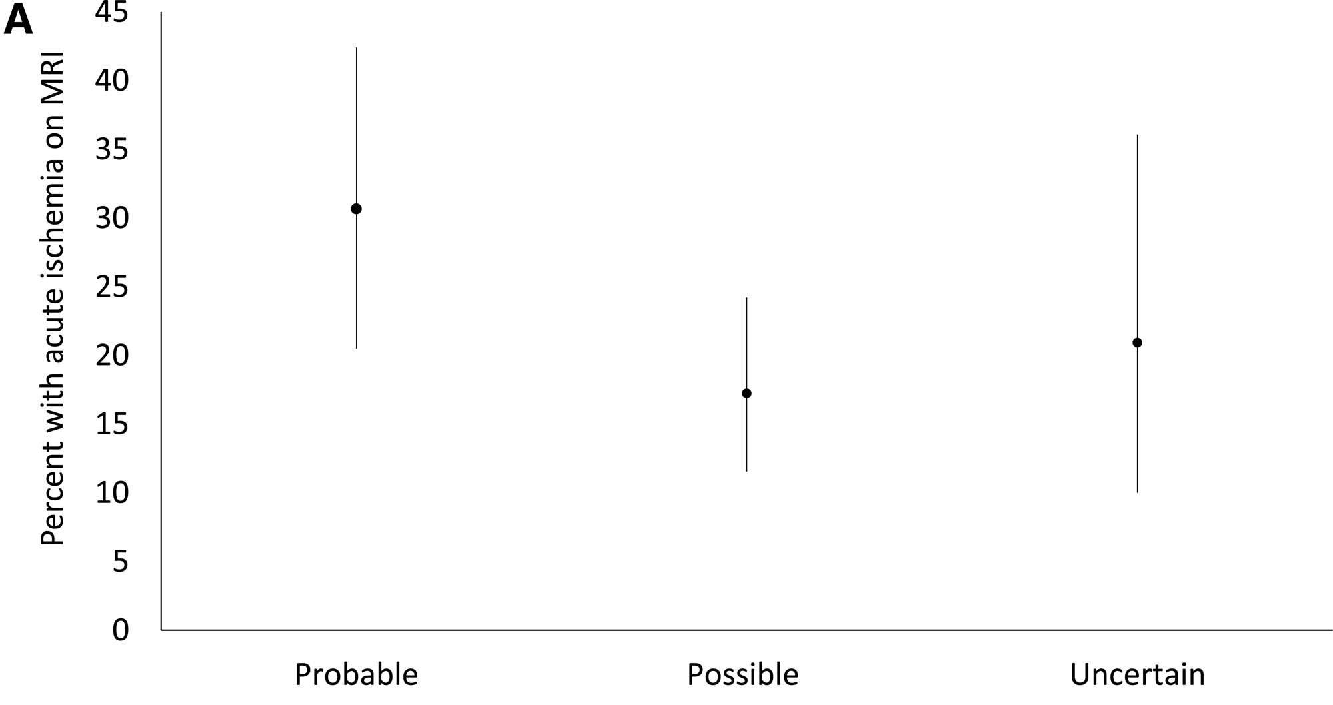
Diagnosis correlates poorly with acute ischaemia on MRI
30% acute infarct
17% acute infarct

Slide 6
Categorise Risk
You don't need to be certain it's a TIA to make the right first decision

Slide 7
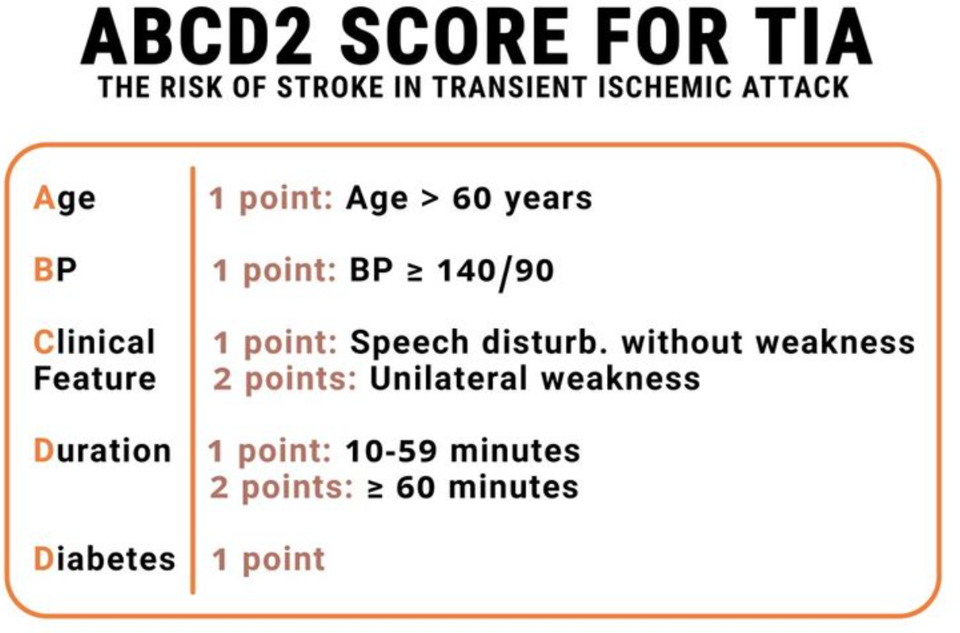

ESO guidelines: Do not use ABCD2 “alone” to categorise risk
Four or more
UK and Ireland Guidelines recommend against the use of the ABCD2 score in categorising risk

Slide 8

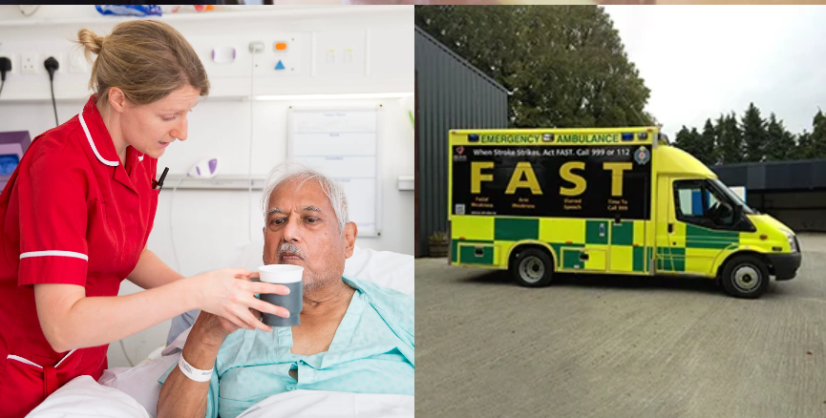
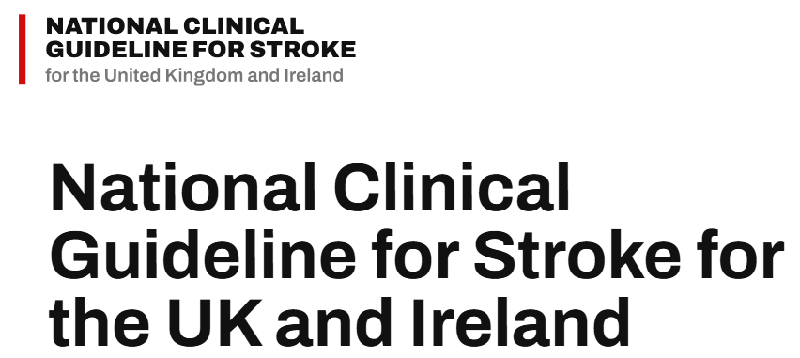
Risk Categorisation
ABCD2 – useful info, but not the whole risk assessment
Many TIA services still request an ABCD2 score (0-3 low risk)
Do not use ABCD2 alone to determine urgency
Clinical high-risk features may mandate ED assessment regardless of score:
  recurrent TIA
  Atrial Fibrillation
  symptomatic carotid stenosis
  residual neurological deficit
Symptoms >7 days- assess ASAP within 7 days

Slide 9
Early Management
Aspirin 300mg is the immediate GP intervention
    If neurology resolved
Definitive antithrombotic and vascular prevention is then completed through the stroke pathway

Slide 10
Summary
Accurately diagnosing TIA is challenging
Focus on Urgency
  ABCD2 is still requested on many TIA referral proformas, but it should not be used in isolation to determine urgency
Act immediately
  Aspirin 300 mg unless contraindicated + urgent TIA assessment

Slide 11
Risk Categorisation
High Risk Pathway:
  Cant just use the ABCD2 score to risk categorise (4 or more)
  Dual TIA
  Atrial fibrillation
  Known Carotid Stenosis
Low risk pathway: ABCD2 score 0-3 and none above- TIA clinic or ED
Lower risk: Symptoms >7 days old-
ASAP within 7 days
GO TO
LOCAL ED

Slide 12
Summary
TIA diagnosis is ambiguous, among stroke consultants
In this grey zone risk categorisation and early management become key
  High risk- ABCD2 4 OR TIA X2, or TIA with afib or TIA with carotid stenosis
  Low risk- ABCD2 score less than 4- clinic
  More than 7 days- clinic and review ASAP within 7 days
Give aspirin if symptoms have resolved

Slide 13
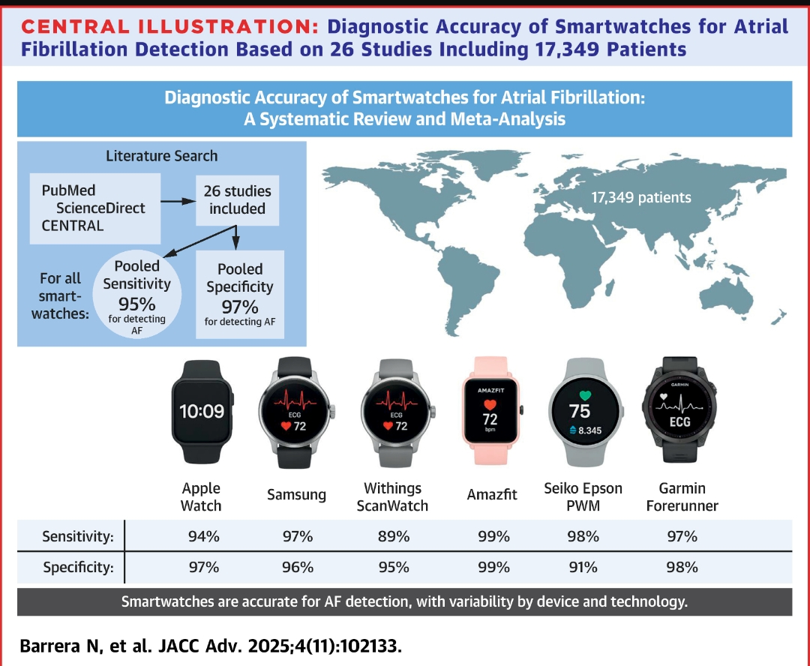

Slide 15
THANK YOU

