Slide 1
Asthma- sMART Treatment
Dr Conor Hensey, Consultant Paediatrician

Slide 2
Outline
Clinical case
Practical implementation of GINA 2026 Report
Treatment and inhaler choice
Specific issues for younger children

Slide 3

Sinéad- 6 yr old attends practice
Current Treatment-
Prior diagnosis of viral induced wheeze aged 4 years
Salbutamol 100mcg 2 puffs prn
Issue-
Frequent salbutamol use 3-5 days a week
Nocturnal cough
Recent exacerbation of asthma requiring oral steroids secondary to viral RTI
Unable to participate in dancing

Slide 4
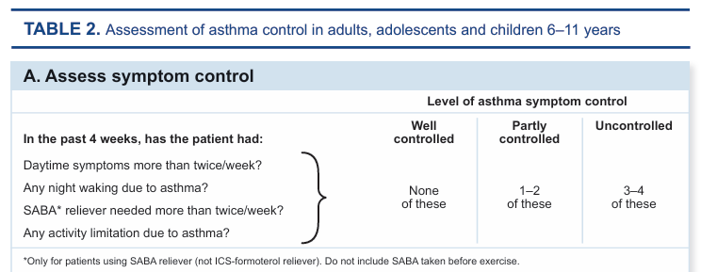

Slide 5
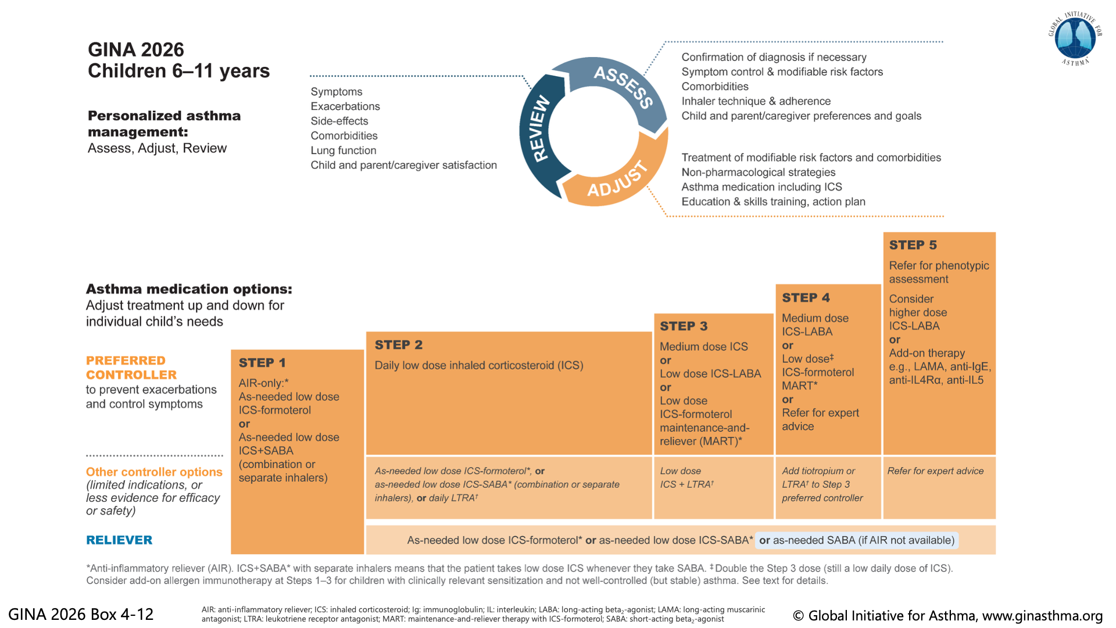

Slide 6
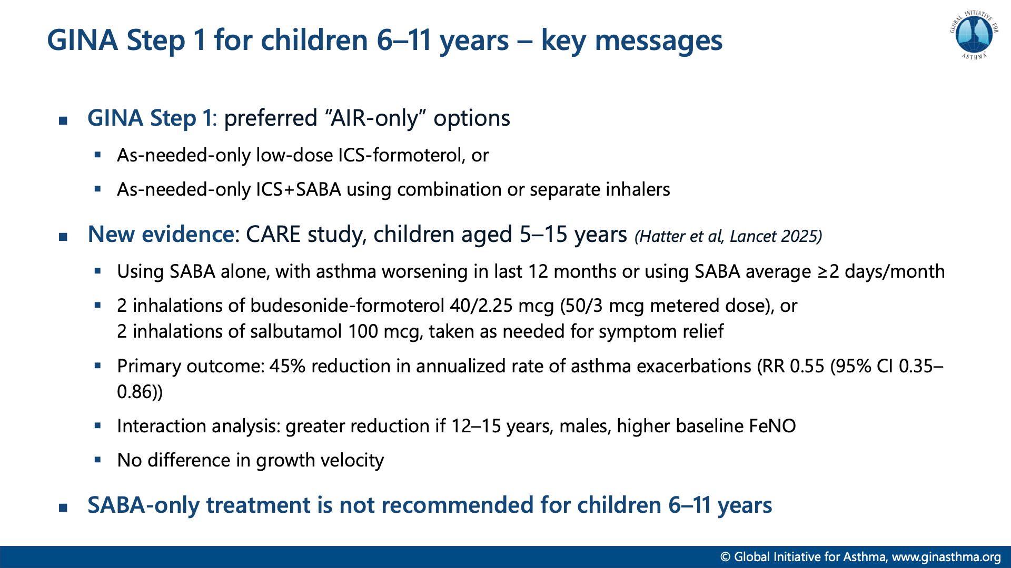

Slide 7
AIR and MART
Anti-inflammatory Reliever
Maintenance and Reliever Therapy
Most evidence is with Budesonide-Formoterol (Symbicort)
Best alternative available in Ireland for younger children is Flucitasone/Formoterol (Flutiform)
Formoterol is preferred to salmeterol:
  Shorter onset of action <3 mins compared with 30mins, both last up to 12 hours
  Full agonist with higher intrinsic activity in comparison to salmeterol which is a partial agonist of β2 receptor.

Slide 8
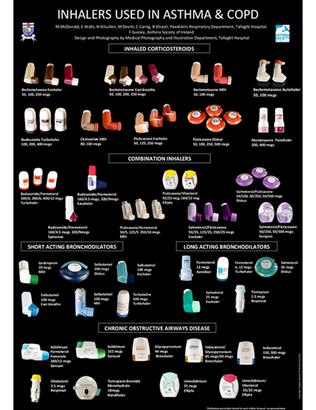
Inhaler Choice

Slide 9
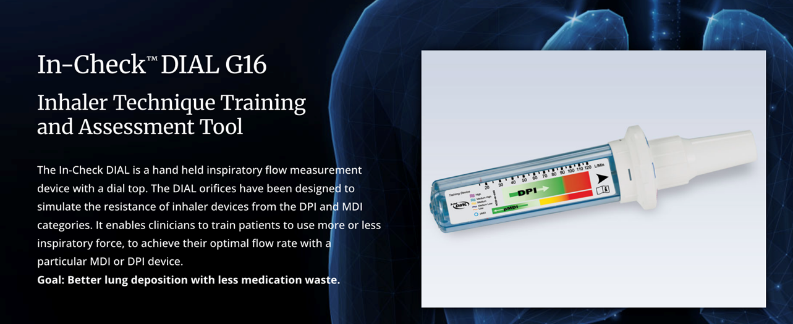
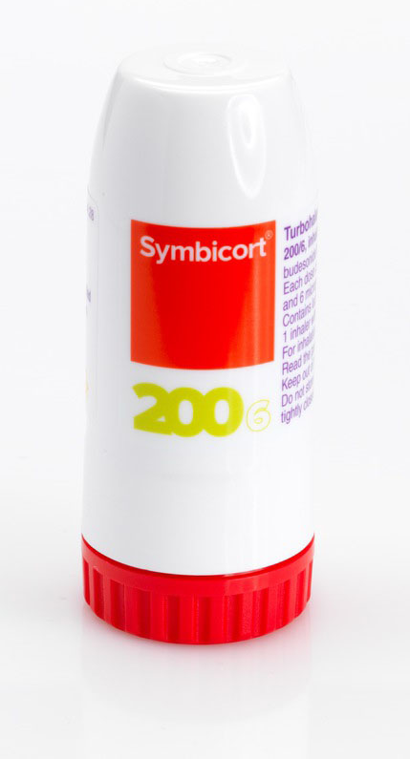
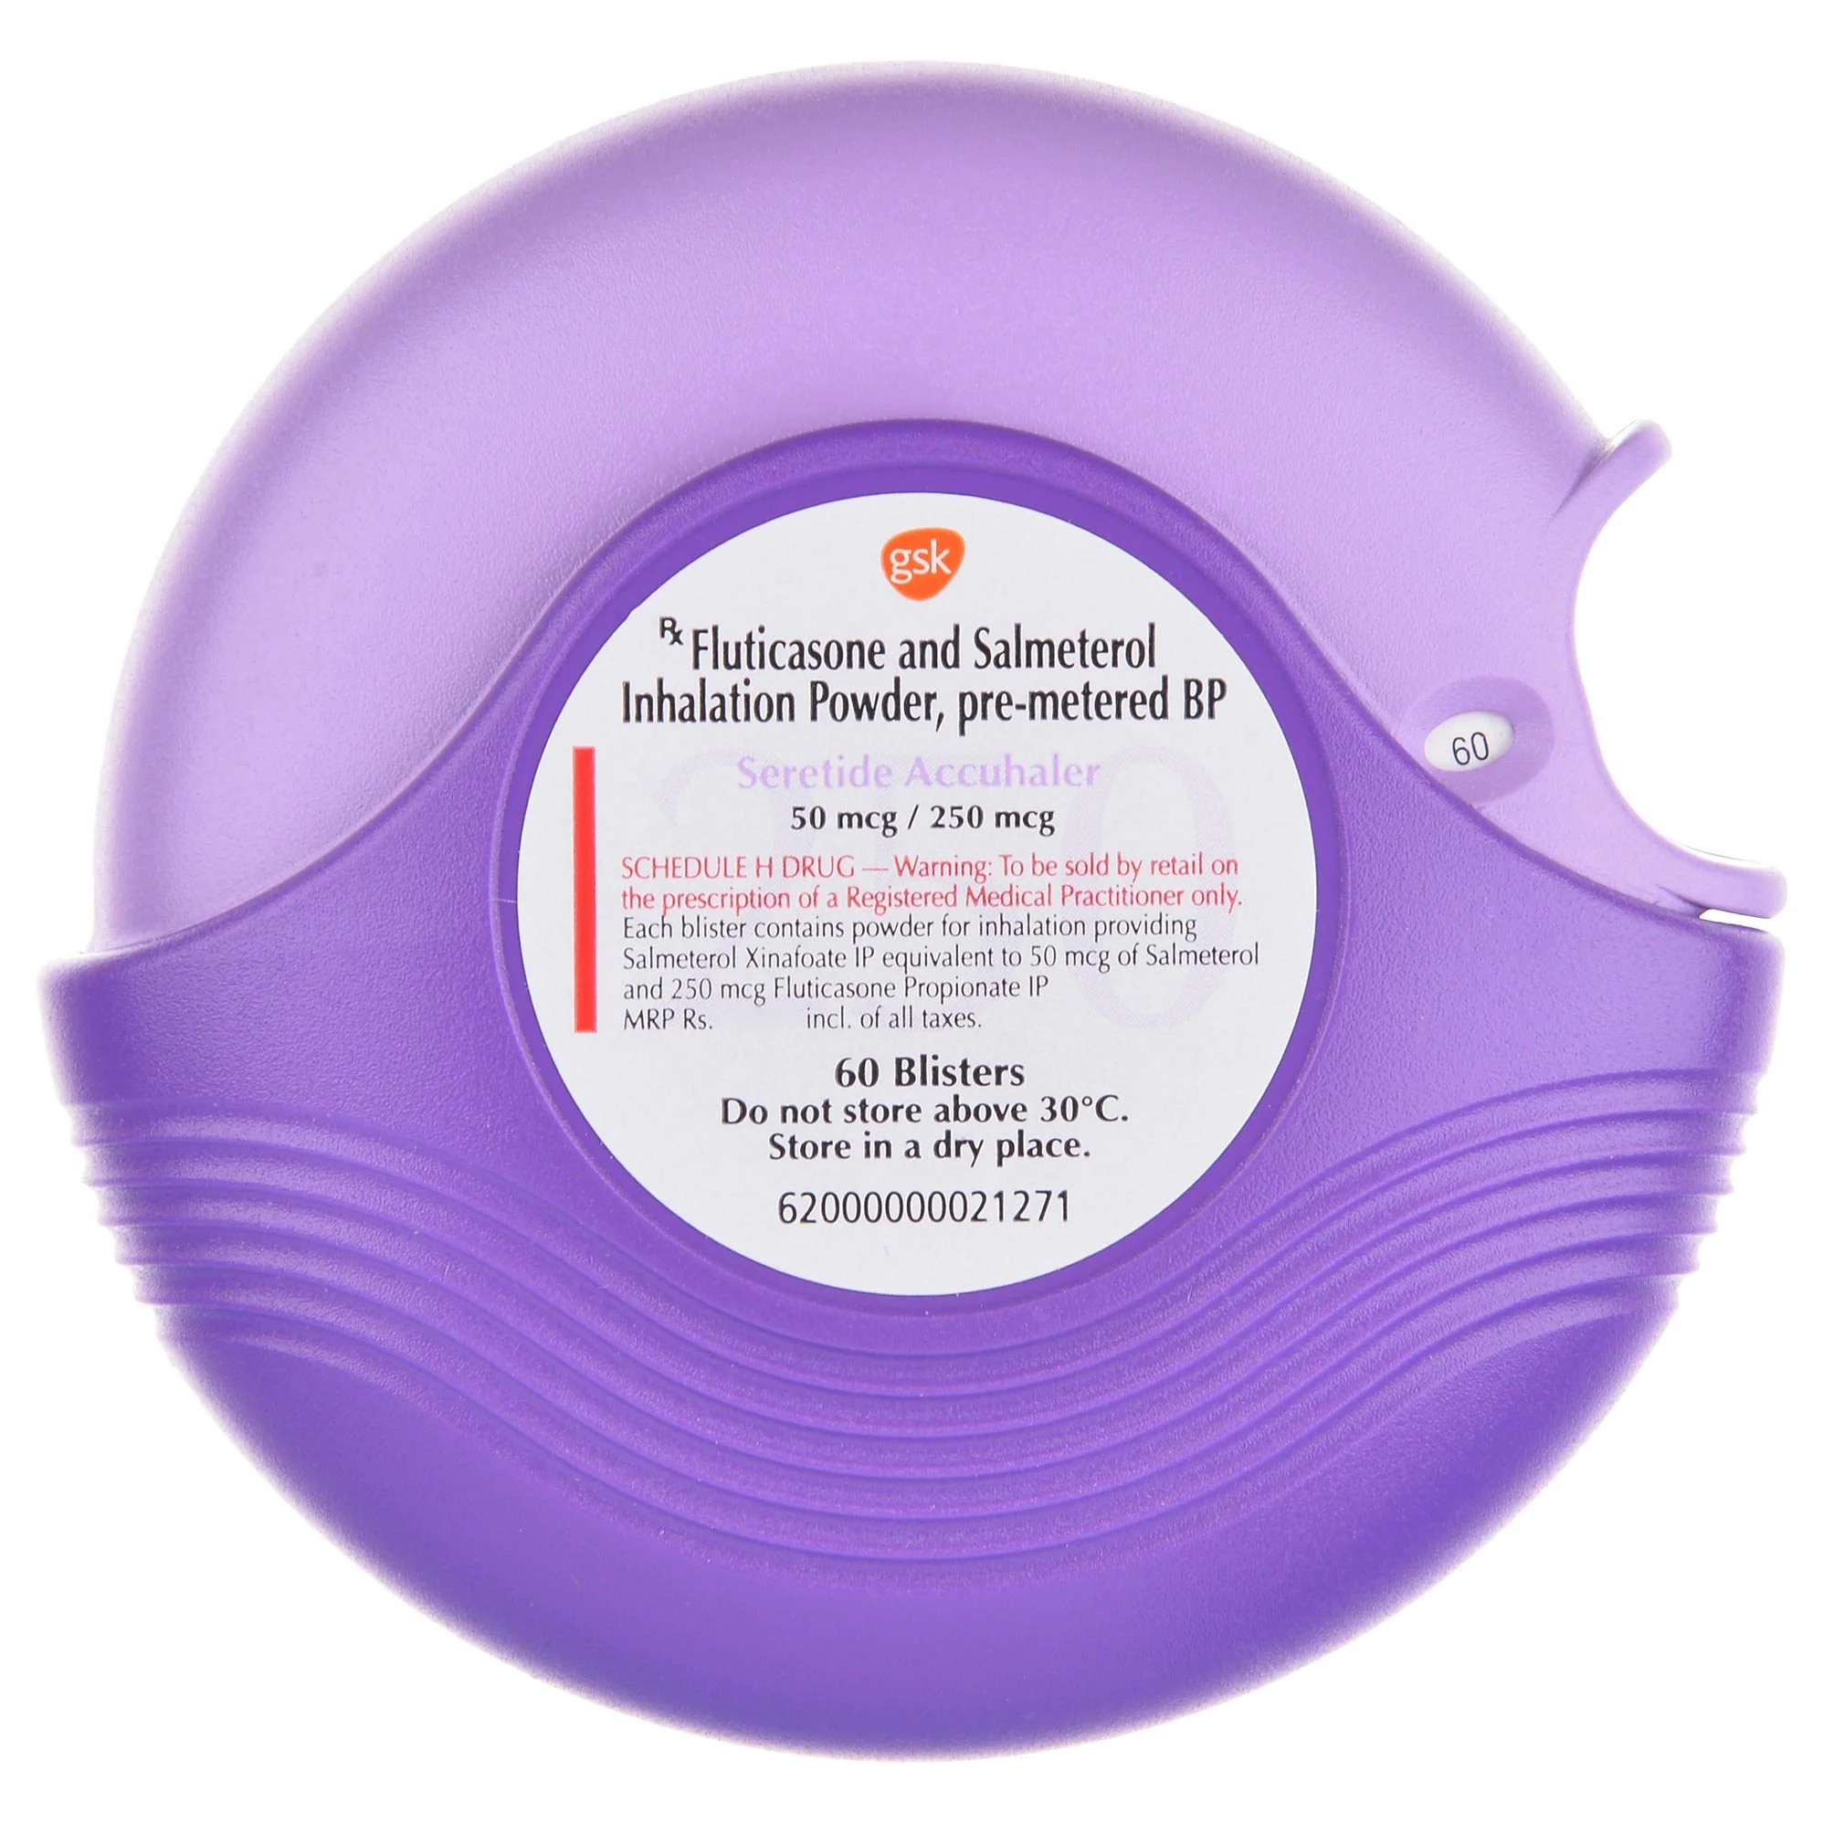
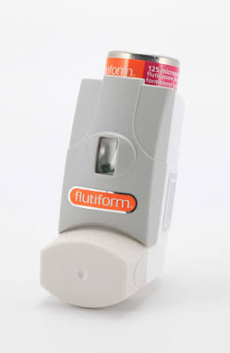
Inspiratory flow required for DPI

Slide 10
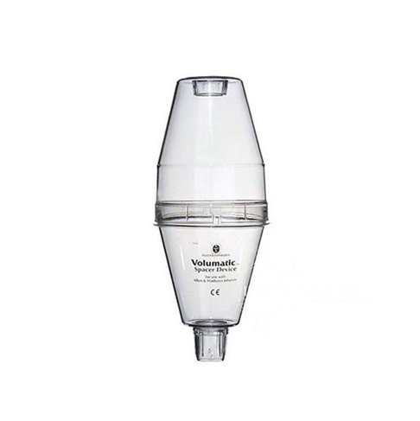
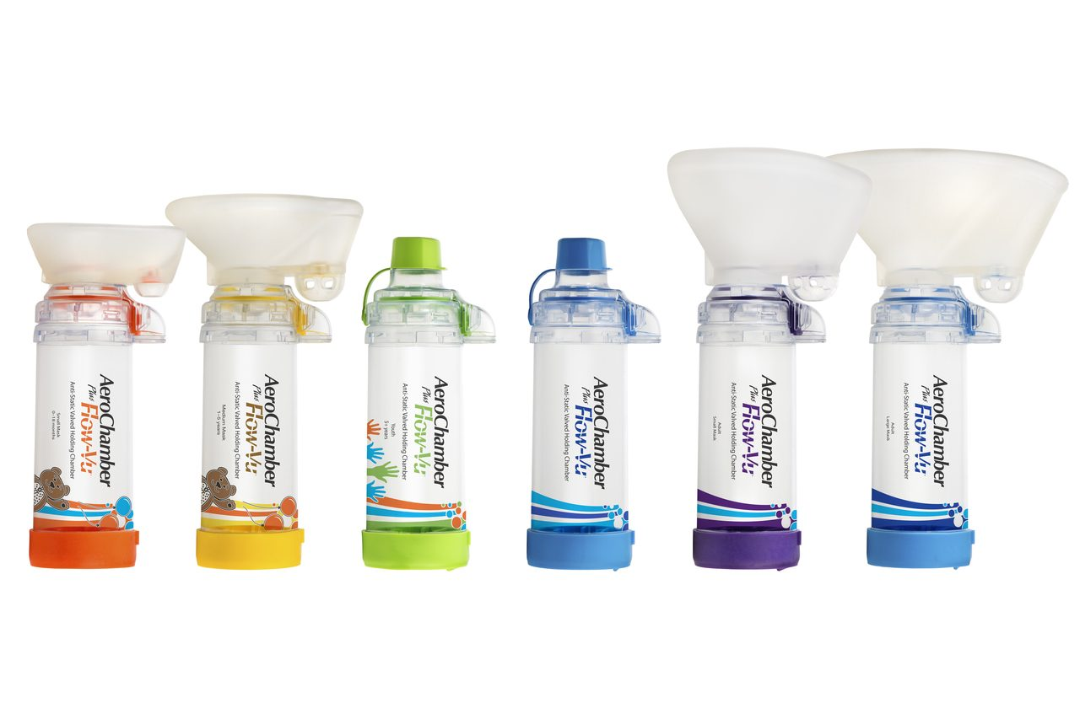
Spacer Choice

Slide 11
Inhalers for Children and Adolescents
SABA- Salbutamol 100mcg
ICS- Becotide 50mcg/100mcg Flixotide 50mcg/125mcg
Combination inhalers (ICS/LABA)
  MDI Seretide (Flucitasone/Salmeterol) 50/25
  MDI Flutiform (Flucitasone/Formoterol) 50/5
  DPI Symbicort Turbohaler (Budesonide/ Formoterol) 200/6
  DPI Seretide Diskus (Salmeterol/Fluticasone) 50/100, 50/250

Slide 12
Issues we have encountered
Side effects of LABA
  Tremor, agitation, muscle cramps, tachycardia
Reported lack of response in acute asthma
  Consider prescription of salbutamol for emergency treatment (with expectation they will seek urgent medical care)
Poor inhaler technique when unwell
  Spacer device and tidal breathing technique
Cost differential
  Covered by GMS and DPS

Slide 13
Thank you

