Slide 1
Pearls in Paediatric Dermatology
Dr Ciara Maguire
Consultant Dermatologist and Paediatric Dermatologist
19/09/2026

Slide 2
Atopic dermatitis (Eczema)
Pearl 1: Bathing
Bathing- up to daily is ok*
  lukewarm water and <10 minutes duration
  +/- soap substitute
*Bradshaw et al, Br J Dermatol 2025, RCT
Notes:
RCT with 438 patients, 108 children aged 1-15 included, bathing at least 6 times/week vs once/twice/week- no significant difference in eczema symptoms over the course of four weeks

Slide 3
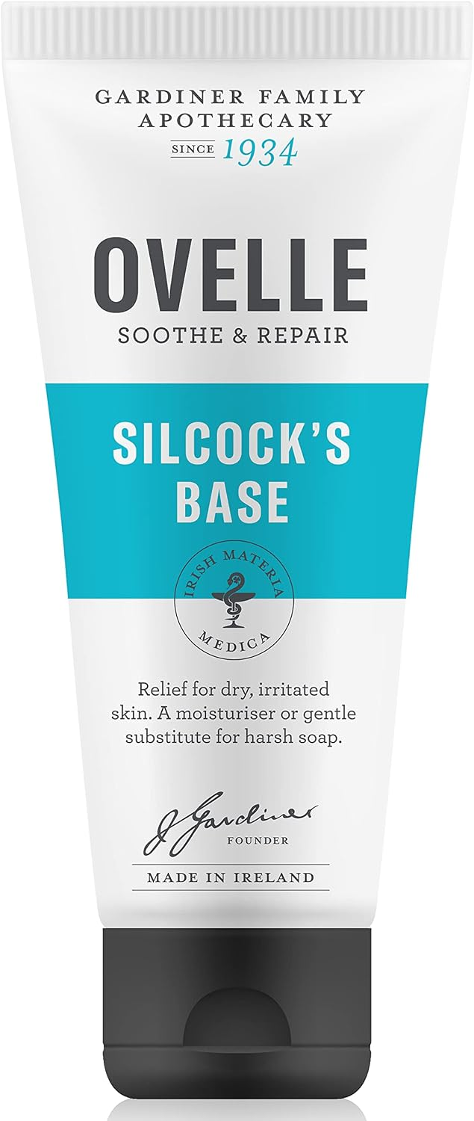
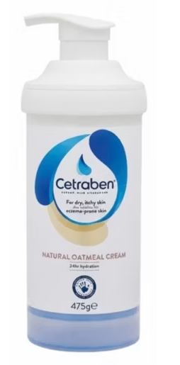
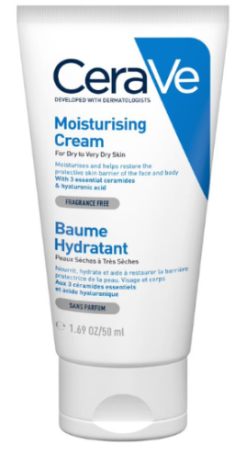
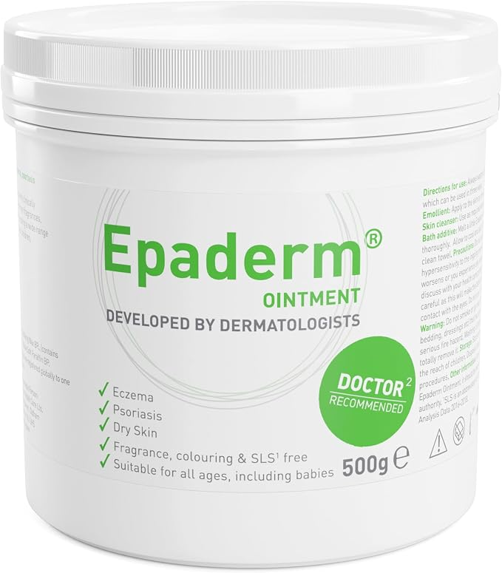
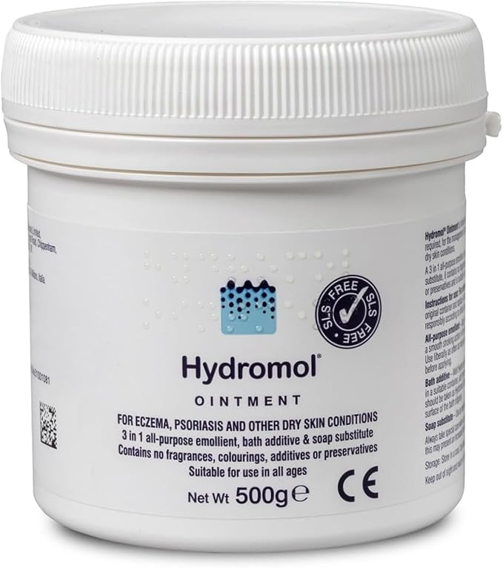
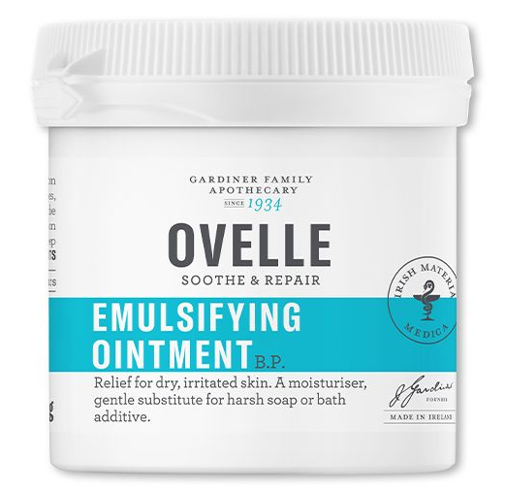
Atopic dermatitis (Eczema)
Pearl 2: Emollient
Emollients- regular use reduces itch, eczema severity and eczema flares*
  Best time to apply is to damp skin immediately after bathing
  Ovelle products (Silcock’s base, emulsifying ointment) are redeemable against the Drug Payment Scheme if prescribed
  Non-redeemable emollient options: Cetraben cream, CeraVe moisturising cream, Epaderm ointment, Hydromol ointment
  Adults ~500g/week of emollient, younger children ~300g/week
*van Zuuren et al, Cochrane Systematic Review 2017: Most studies use twice daily application of emollient

Slide 4
Atopic dermatitis (Eczema)
Pearl 3: Topical steroids
Ointments generally favoured over creams
Eumovate ointment | Eumovate cream
Clobetasone butyrate Liquid paraffin White soft paraffin | Clobetasone butyrate Glycerol Glycerol monostearate Cetostearyl alcohol Beeswax substitute 6621 (mixture of hydrocarbon and natural waxes) (contains paraffin) Arlacel 165 (mixture of glyceryl stearate and PEG 100 stearate) Dimeticone 20 Chlorocresol Sodium citrate Citric acid monohydrate Purified water
Source: hpra

Slide 5
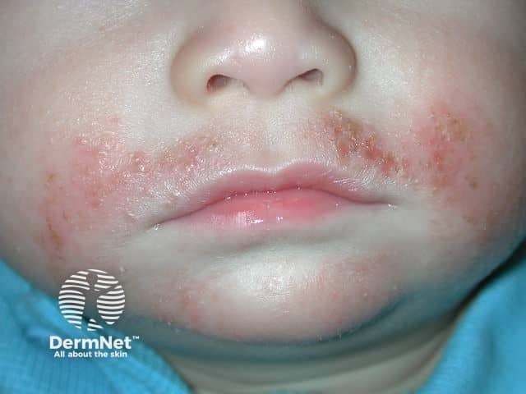
Atopic dermatitis (Eczema)
Pearl 4: Superficially infected eczema (bacterial)
Treat with aggressive management of the underlying eczema with appropriate strength topical steroids, not antibiotics
Insufficient evidence on the effects of anti-Staphylococcal treatments (including topical steroid/antibiotic combinations, oral antibiotics and bleach baths) in infected or uninfected eczema*
*George et al, Cochrane Systematic Review 2019
Image source: Dermnet NZ
https://dermnetnz.org/topics/atopic-dermatitis
Notes:
George et al: (but low quality evidence with difficulty pooling data)
What’s the role of bleach baths?
Currently recommended for use as an adjunct treatment in moderate-severe eczema
Probably result in a modest improvement (relative decrease in severity of 22% ) when used 2-3 times/week
Effects on S.Aureus burden are inconsistent, transient and do not clearly correlate with patient-important outcomes
Bakaa et al, systematic review and meta-analysis, Ann Allergy Asthma Immunol 2022

Slide 6
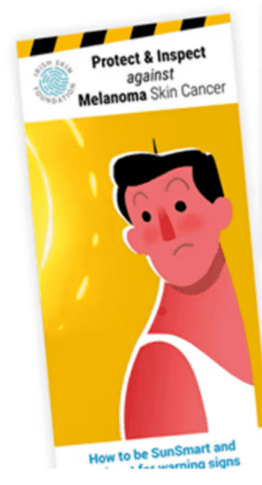
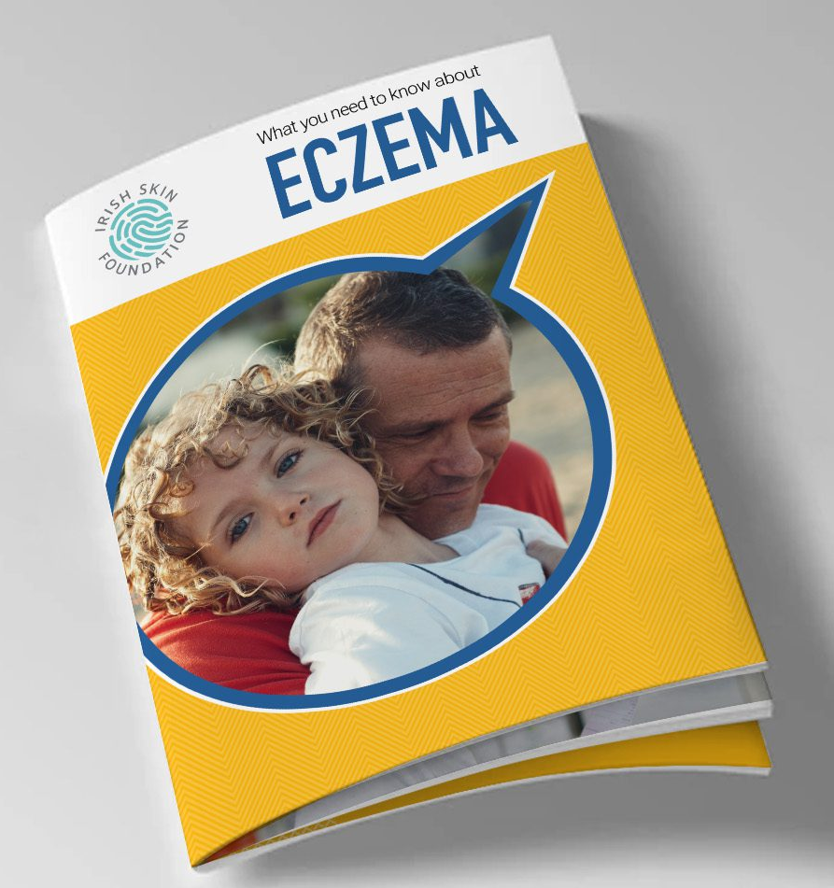
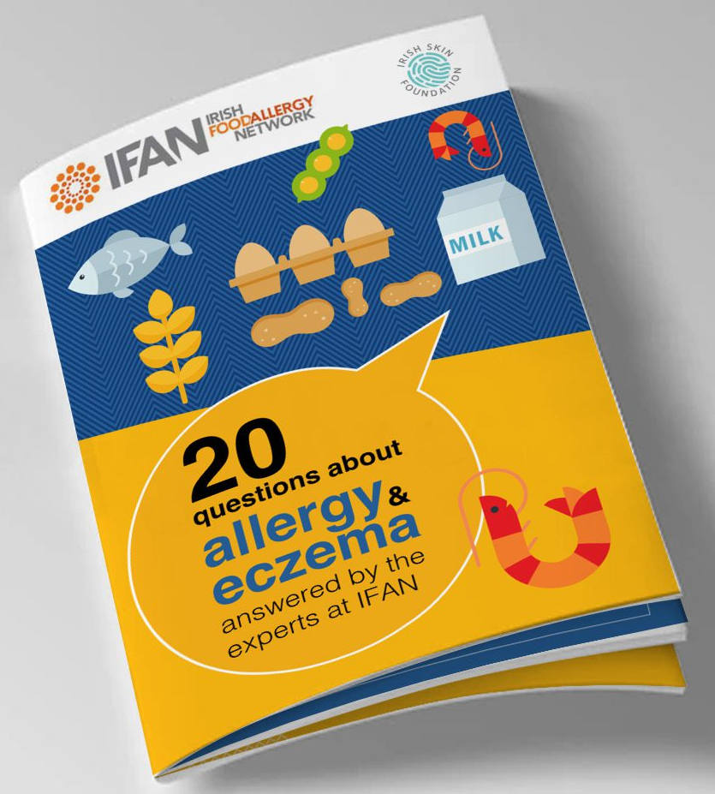
Resources
Irish Skin Foundation (www.irishskin.ie)
  Helpful eczema booklet and Irish Food Allergy Network booklets
  Melanoma booklet: Photoprotection and ABCDE
British Society for Paediatric and Adolescent Dermatology (www.bspad.co.uk)
British Association of Dermatologists (www.bad.org.uk)

Slide 7
Thank you

